Slide 1
Building
GRIT & RESILIENCE
First-Year Experience
Tips for Success

Slide 2
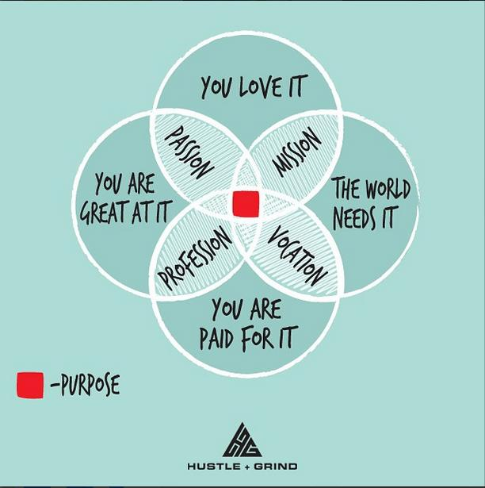

Slide 3
Steps to Success
This study looked at successful college students to see what strategies they used to help them succeed.
Four themes emerged:
A GROWTH MINDSET and RESILIENT ATTITUDE
2. ACADEMIC SUPPORT STRATEGIES; mentors, tutors, advisors
3. SUPPORTIVE RELATIONSHIPS
4. MEANINGFUL INVOLVEMENT
Thriving in Transitions, 2012
Notes:
Do it for self, family, something to prove. Positive attitude; potential; worth; internal locus of control
establish graduation goal; use academic resources; adapt learning techniques; ability to work hard; self awareness
parents, peers, staff, spirituality
cocurriculuar; leadership skills, social capital

Slide 4


COLLEGE
This isn’t meant to be easy.
Setbacks are Normal & are part of a rigorous education.
Goals Help You Get There: Plan, reflect, take action & make adjustments to overcome obstacles
Failure is an essential, important part of the learning process.
Take Risks. Be Brave.
Trying to avoid failure just limits your growth and success.
You Belong Here!

Slide 5

Personal Resiliency Builders
Relationships
Service/Volunteerism
Humor
Gratitude
Involvement
Accepts Help
Optimism for the future
Love of Learning
Self Awareness
Checking Tasks off your To-Do list
Healthy Habits
Spirituality
Perseverance
Creativity
Strong Physial and Mental Health
Patience

Slide 6
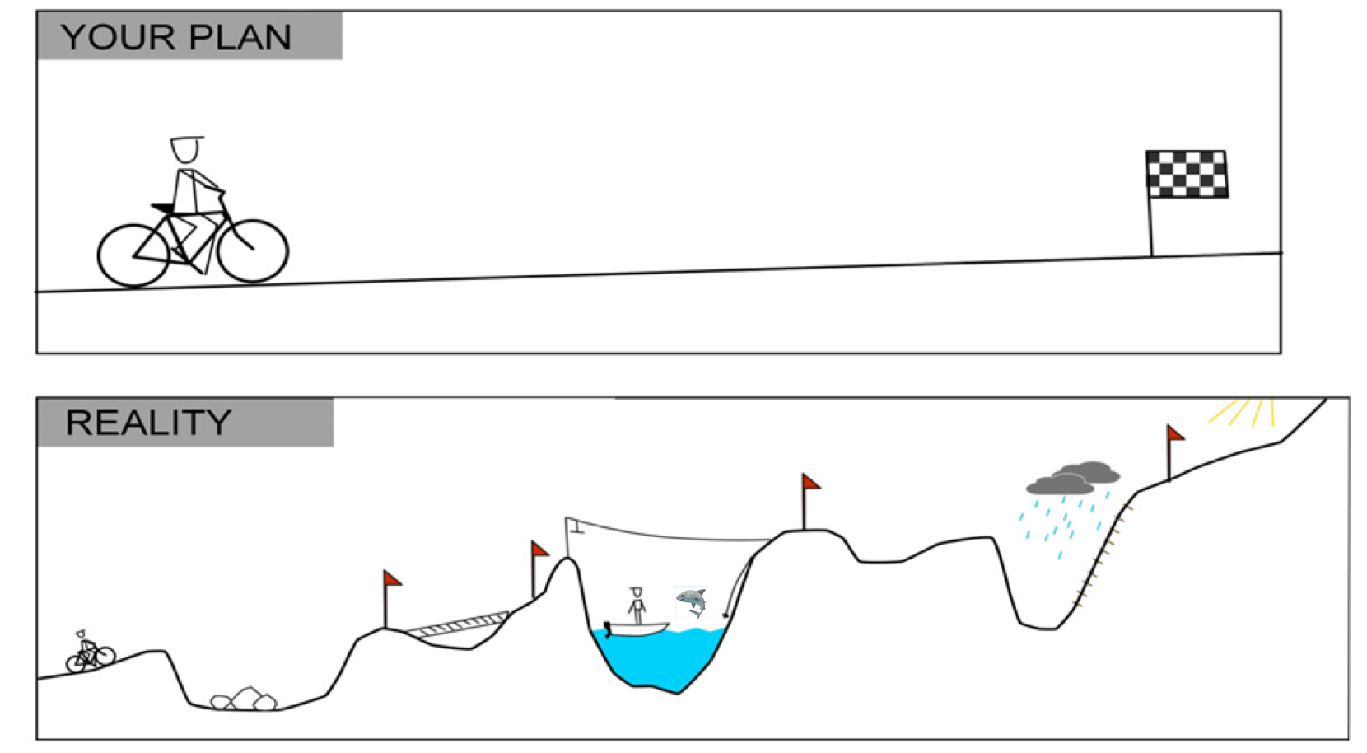

Slide 7
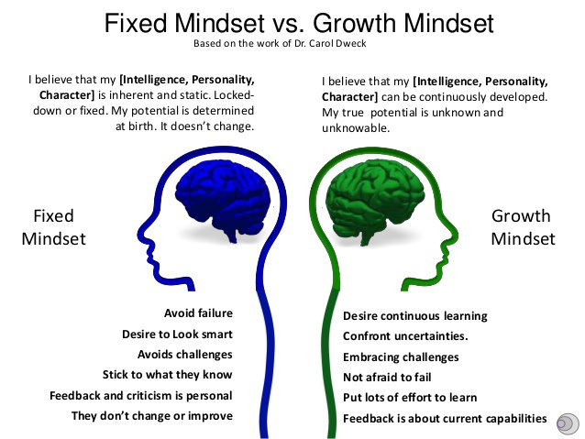

Slide 8
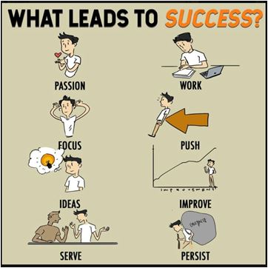

Slide 9

Serena Williams is arguably the greatest tennis player of all time. Her 23 Grand Slam titles, her 319 weeks spent as the world's number one, and her 27 years at the top as a professional are testament to her grit and personal resilience. She retired this week from professional tennis.

Slide 10
Scheduling Your Time
Use technology notifications to your advantage
Reserve adequate study time *Follow the 2-for-1 rule*
Estimate time needed for assignments
Schedule exercise & time for self care
Accountability is your responsibility
Get help early on

Slide 11
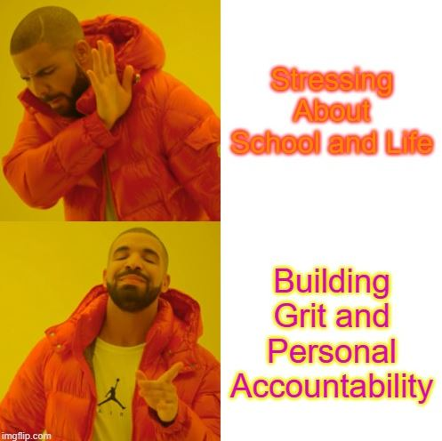
TRY THIS:
REMEMBER: You’re in control of two things - your attitude and your efforts.
HIT PAUSE: Control how much external stimuli you allow, such as Netflix, gaming, socializing, and social media scrolling. Invite space and time in your day to decompress and declutter your mind through reflection, stillness, or exercise.
STRESS LESS: Pinpoint sources of stress and pay attention to how they react to these stressors. Where does stress originate for you and what negative reactions or behaviors does it provoke? How can you redirect and handle stress better?

Slide 12
Additional Resources
2013 US Dept. of Ed Report Promoting GRIT, Tenacity, and Perseverance: http://pgbovine.net/OET-Draft-Grit-Report-2-17-13.pdf
The Duckworth Lab at Univ. of Pennsylvania: https://sites.sas.upenn.edu/?q=duckworth/pages/character-lab-0
The Resilience Project @ Stanford: https://undergrad.stanford.edu/resilience
Jia Jiang’s 100 Days of Rejection: http://fearbuster.com/
The Science of Resiliency: https://www.youtube.com/watch?v=403i7IWrv78
Resiliency quiz: http://www.resiliency.com/free-articles-resources/the-resiliency-quiz/
TedTalks: Scott Gellar, Carrie Green, and Eduardo Briceno

