Slide 1
FYEX 101
TIME MANAGEMENT & STUDY SKILLS
Notes:
Hi class. I hope everyone is well. Are there any questions about anything we have discussed so far?

Slide 2

TIME MANAGEMENT
Accountability
is
your
Responsibility.
Control how you use your time, rather than letting it control you.
Falling behind and stressing to
catch up is a recipe for failure.
Find a system that works for you and stick with it.
Time is your Most Valuable Resource
Maximize study and review time
Organize your environment
Notes:
Today we will discuss time management, a key factor in achieving academic success. You have control over how you use your time, so it is important to find a system that works for you. This will help you stay organized and avoid falling behind throughout the semester.

Slide 3

Managing Your Energy
Recognize your daily energy pattern.
  When are you most energized? Early morning? At night?
Strategies to re-energize:
  Carry healthy snacks
  Drink water
  Take breaks
  Walk, Stretch, & Breathe
  Short Nap (10-15 min)
  Don’t overextend yourself!
Notes:
Your best plans will not work if you don’t have the energy to make them happen. Energy is an essential resource. Although it is renewable, we each have a limited amount per day.
Each person has a daily pattern of physical, emotional, and mental activity. Some people are early risers and have a lot of energy in the morning, others accomplish tasks most effectively at the end of the day. You can better manage your energy by recognizing your daily pattern and establishing a routine around it.
Your energy also depends on how you take care of yourself. Give yourself a boost by:
Carrying healthy snacks with you, such as fruit, nuts, or yogurt. This will save your time and money as you avoid trips to vending machines and convenience stores. Eating well will also keep your energy up.
Drink plenty of water.
Take brief naps when possible. Research shows that naps are more effective than caffeine.
Being overextended, or having to much to do given your available resources, is a primary source of stress for college students. Avoid overextension by determining what a realistic workload is for you. Take on only what you can handle, and learn to say “no” to requests that prevent you from meeting your academic goals. You may have to let go of one or more commitments.

Slide 4
Overcoming Procrastination:
Use a planner and create to-do lists
Break big jobs into manageable tasks
Circuit train your to-do list
  Rotate through 4-5 items on your to-do list in fixed intervals of time
  When you find a groove and feel focused on a task, stick with it for longer while you’re on a roll
Find the right place to study
Limit distractions
Reward yourself
Notes:
If procrastination is a problem for you, work to overcome it by:
Reminding yourself of the possible consequences if you do not get down to work, and that not enjoying an assignment is not a good reason to put it off – it’s an excuse, not a reason.
Creating a to-do list. Check off items as you finish – this can be gratifying and motivating in and of itself, as you can visually track what you accomplish. Move things that aren’t getting done to the top of the list.
Breaking big jobs into smaller steps. Tackle short, easy-to-accomplish tasks first.
Promising yourself a reward for finishing a task. Use bigger and better rewards for finishing larger tasks.
Finding a place to study that’s comfortable and doesn’t allow for interactions.
Saying “no” to people who want your attention. Schedule time with them later.
Shutting off electronic devices and social media.
Being aware that it may be more difficult to stay on track in online courses, as there are few or no weekly meetings. Connecting with another student in the course can help you both stay focused.
Considering asking those you live with the help keep you on track. Have them remind you to study.
If none of these strategies work, consider re-examining your purpose and priorities in terms of college. If you unwilling or unable to stop procrastinating, may you are not ready to commit to academic priorities.

Slide 5
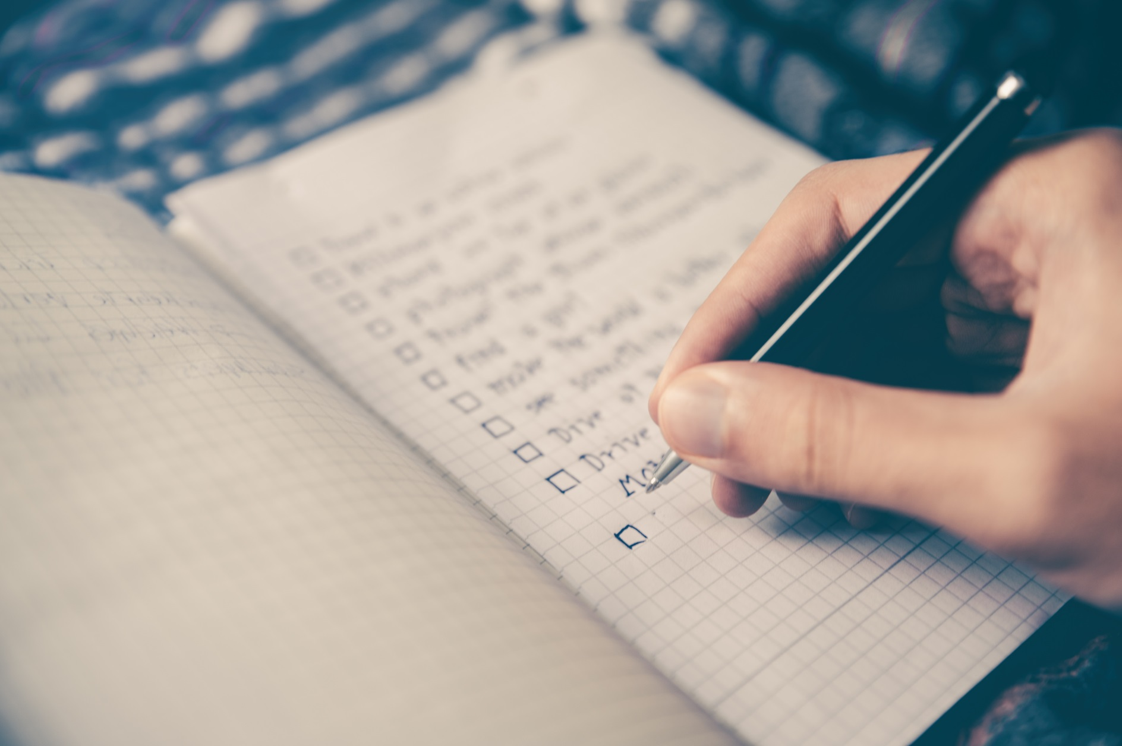
Using a Daily or Weekly Planner
Carry your planner at all times.
Use a planner that is convenient for your lifestyle.
Add contact information.
Back up your planner.
Review syllabi and revise as needed.
Notes:
Be sure to enter details such as locations, phone numbers, etc. to ensure that your planner is complete.
Many people find a backup planner valuable. You might have heard of people who lost their planner and had no idea of their schedule as a result. Part of time management is developing a backup system. However, there are some challenges to using two planning devices. You can put information on one and forget to do so on another. One trick is to use two electronic planners linked to one another. I suggest you make it a habit to back up one planner daily to the other. That way, any changes you make in your primary planner will be reflected in your backup at least daily.
No matter how thorough you are in your planning, there are many reasons to revise a schedule. You may need to change your plan because some tasks were not completed, and of course, emergencies can happen. Flexibility is important in college, as in life. As you practice skills, you will find that you will need less time for many tasks as you become more proficient in them. You will also get better at estimating the time you need for specific types of tasks.

Slide 6
Scheduling Your Time
Use technology notifications to your advantage
Reserve adequate study time
*Follow the 2-for-1 rule*
Estimate time needed for assignments
Schedule exercise & time for self care
College requires more self discipline
Get help early on
Notes:
After you consider the big picture, you need to focus on daily tasks.
Remember, college often requires more self discipline to ensure due dates are met.
Long-term goals and priorities CAN drive your schedule if you take charge, but remember to be realistic and flexible.
While you are a whole person and have to balance multiple needs and responsibilities, you cannot do everything at the same time. Planning is the key to success.
Practice and flexibility will help you learn to manage your time effectively. And ask for help when needed.
Create one of your own. As you do, keep in mind the suggestions we’ve discussed. Do you want your back-to-back or with breaks in between? How early in the morning are you willing to start classes? Do you prefer—or do work or family commitments require you—to take evening classes? Are there times of day when you are more alert? Less alert?

Slide 7

Get the Most out of Class
Pay attention to the syllabus
Do assigned reading ahead of class
Bring materials with you to class
Listen for main concepts & new ideas
Participate in class discussion
Ask questions
Know your learning style
Study with friends or tutors
Notes:
It is important to keep the syllabus for your classes in a safe place. Once the professor distributes a syllabus, it becomes your responsibility to follow the course requirements with few or no reminders. Each week, do your assigned reading and review notes and summaries.

Slide 8

Prepare For The Lecture
Read all textbook material relevant to the topic being covered prior to class.
Attend Class
Take Notes
You are familiar with the subject & you know what to ask.
You don’t waste time by writing down stuff that is already in your study materials.
You know what to write, concepts are clearer, you’re one step ahead of the game.
By the time the lecture is over, you are in a much clearer state of mind.
This way, taking notes becomes more meaningful and helpful.
Ask professors who lecture too fast if you can tape their lecture.
Notes:
Taking notes in math and science differs in many important ways from non-quantitative courses. Summarizing information will not be helpful in math and science. Math and science terminology is unique to the context and can be confusing because terms have a generic meaning as well as a specialized meaning for a course. For example, vector has many meanings in different contexts. In math, vector is quantity that has both direction and magnitude, such as force or velocity, and is usually represented by an arrow. In computer language a vector has any length but only one dimension. Finally, in biology a vector could be a disease-transmitting organism like a mosquito. It is important to listen carefully to the meaning of terms in specific classes and consider the context.
Also be sure to write down and explain symbols and abbreviations. Check your notes after class to ensure you correctly recorded the information.

Slide 9
Reviewing Your Notes
Forgetting curve: most forgetting happens in 1st twenty-four hours
Write down the main ideas a second or third time
Recite ideas out loud
Preview your notes again before the next class
Compare notes
Hide your notes from yourself and see if you can reconstruct them from memory
Notes:
Review and revise your notes as quickly as possible after each class and do not wait until later to review and highlight notes. You will remember information better if you review the material immediately, and waiting until later will likely result in your forgetting information.
Reflect on how the class meshes with the information you already know.
Revise your notes as needed.
If you are an aural learner, reciting your ideas out loud might be helpful.
Remember that reflection is important for learning. Reflection and identification helps you better understand and remember information.
Consider how classes mesh with each other when setting up your schedule. Perhaps it will help to have an hour or so between classes so you have time to revise your notes from the previous class and review your preparation for the upcoming class.
One challenge of college is that in a single day you may have classes with distinctly different content. What strategies could you use for example between an English literature class and a biology lecture?
Exercising between classes could help you clear your head.
Finally, being organized is incredibly important when you need to review notes before the next class or for a test so using binders can be really helpful.

