Slide 1

Engineering/Robotics Student Access and Safety Training
College of Science, Technology, Engineering and Mathematics

Slide 2
Room Access Responsibilities
Lock lab room doors whenever the room is vacated.
DO NOT unlock doors for unauthorized persons.
Student use is restricted to normal university hours (7am-10pm).
A faculty or staff member must be within the building to assume responsibility for the student.
A safe and clean room condition must be maintained at all times.
Student activity within the lab rooms must be within the scope of work as defined by the supervising faculty member.

Slide 3
Loss of Privilege
Misuse of school rooms and equipment will result in a loss of privileges.
Misuse can include such actions as
  damaged equipment
  damage to the physical room
  unsupervised after-hours room use
  any other action as deemed a misuse by faculty and staff
The time period for loss of access will be determined by the Dean of the College of STEM.

Slide 4
General Robotics Lab Safety
Always wear the appropriate PPE as determined by your supervisor.
Keep work area neat and orderly. Clean work area before (if necessary) and after work has been performed.
Return tools and other items to their appropriate storage areas after use.
Know where the nearest fire extinguisher and first aid kit are located.

Slide 5
General Tool Safety
Maintain tools regularly.
Always inspect tools before each use – do not use if broken.
Signs of damage should be reported to supervisor.
Use/operate tools according to manufacturer’s instructions.
Wear the appropriate PPE for the work being performed.
Use correct tool for the work being performed.
Do not wear loose or baggy clothing or jewelry.
Secure long hair.
Use tool guards!
Practice good housekeeping.
Perform work in well lit area.

Slide 6
Hand Tool Safety
Do not use tools with cracked, splintered or loose handles or tools that are bent or dull – report damage to supervisor and others working in the area.
Use the correct tool for the job (size, type, etc.) – e.g. don’t use a screw driver as a chisel.
Return tools to their designated storage area.
Wear safety glasses and gloves when appropriate.

Slide 7
Power Tool Safety
Do not use damaged power tools. Report problems to your supervisor and others in the area.
Ensure guards are in place and in good condition prior to use. Failure to use machine guards is not acceptable and can result in injury or loss of life as well as fines/citations from regulatory agencies.
Unplug tools when not in use, when cleaning, when changing accessories and when servicing.
People not involved in the work should keep distance.
Do not carry tools by cords.
Do not hold “on-switch” while carrying tools.
Eye protection should always be worn by those operating power tools AND those in the area during operation.

Slide 8
Power Tool Safety (cont’d)
Do not operate power tools or other machinery without the permission of your supervisor.
Follow all safety guidelines for each piece of equipment. If you are unsure – ASK!
Never use tools or operate machinery under the influence of alcohol or drugs.
Never operate power tools or machinery alone.
BE SMART – DON’T PUT YOURSELF AND OTHERS AT RISK!

Slide 9
Soldering Safety
Always wear safety glasses when soldering.
Secure loose and baggy clothing and loose or long hair.
Never solder a live circuit.
Always place soldering iron back into a secured stand when not in use – do not place hot soldering iron on work surface!
Unplug soldering iron after each use and when unattended.
Let recently soldered components cool before touching.
Working surface should be free of clutter and combustible materials (paper, notebooks, etc.).
Use a vice, clamps, or tweezers for holding components.
Legs and arms should be covered to avoid burns.

Slide 10
Electrical Safety
Damaged or loose electrical cords should be replaced or repaired – report these items to your supervisor.
Extension cords are for temporary use. Return to storage after each use.
Avoid running electrical cords across doorways and aisles.
Follow manufacturer’s instructions for plugging in power tools, machinery, appliances, etc. into a receptacle outlet.
Avoid overloading outlets.
Do not “daisy chain” power strips.

Slide 11
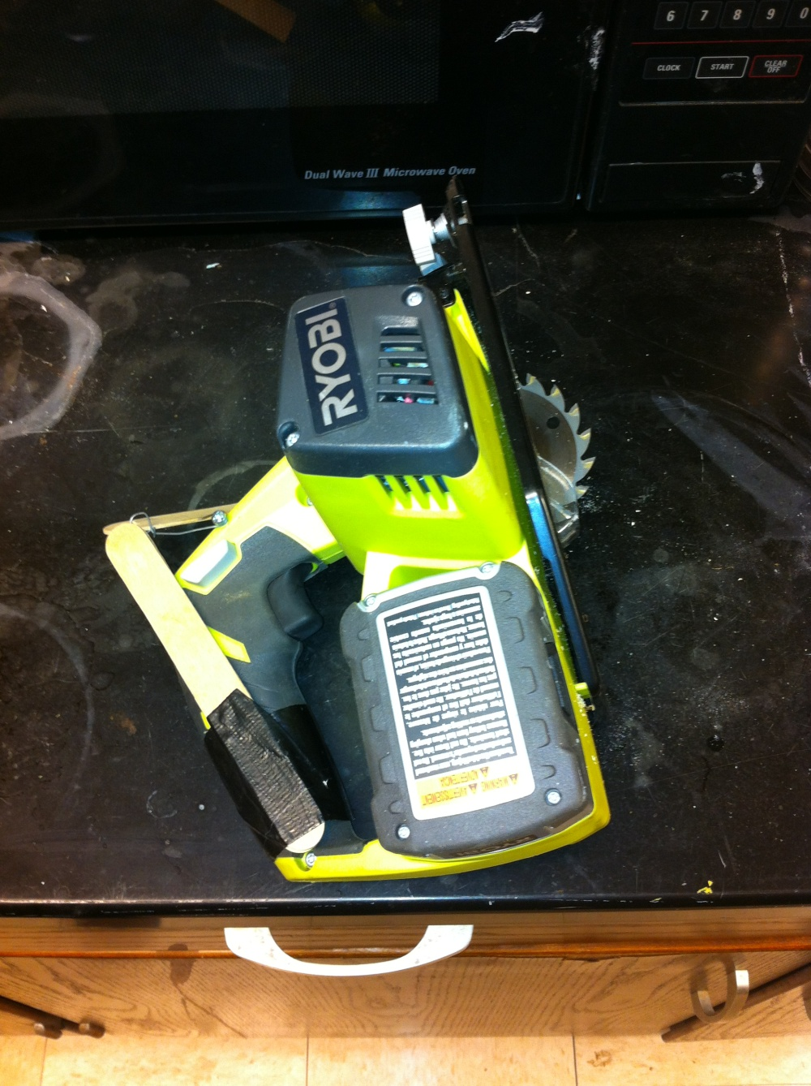
Don’t Bypass/Remove Guards!

Slide 12
Used Battery Management
Universal Waste Batteries are required to be collected and managed per Environmental Protection Agency and West Virginia Department of Environmental Protection Regulations
Universal Waste Batteries include:
  Lead-acid and other lead-containing batteries
  Silver-containing
  Mercury-containing
  Rechargeable Batteries (Lithium-ion; Nickel-Cadmium (Ni-Cd); Nickel Metal Hydride (NiMH) and other rechargeable batteries)
Do not discard in regular trash!

Slide 13
Management (Non-Leaking)
Large batteries (e.g. Lead-acid)
  Tape terminals and label individual battery (no containment necessary)
Small batteries
  Tape battery terminals or place individual batteries in a sealed plastic bag.
  Place in sturdy leak-proof container (White screw-top pail with blue lid)
  Label the outer container
May not be accumulated longer than one year
Full containers should be reported to supervisor.

Slide 14
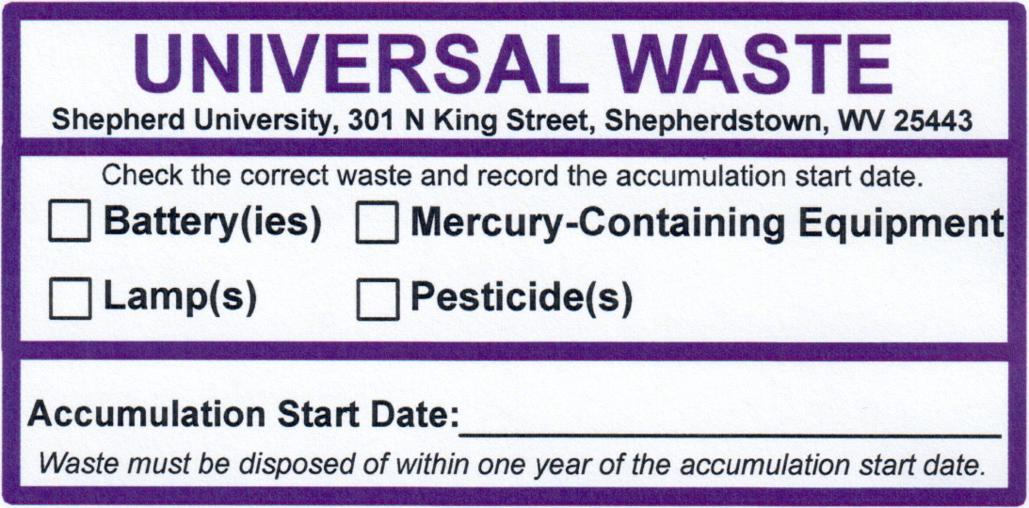
Labeling
Label using a pre-printed Shepherd University Universal Waste Label
  Check the box to indicate “Battery(ies)”
  Record the date on which the battery(ies) were first accumulated
Label the container or battery with the following information
  The words “Used Battery” or “Used Batteries”
  The date on which the battery was first accumulated
Additional labels may be requested in room BY208 or from your supervisor.

Slide 15
Emergency Procedures
In the event of an emergency, know how to respond appropriately and whom to contact.
In a true emergency (fire, serious bodily injury, etc.) call 911.
Landline phones must dial 9 then number
The contact chain is:
  Supervising faculty member
  Any available CSTEM faculty/staff member
  Campus security 304-876-5374 (8am-4:30pm) 304-876-5202 (after 4:30pm)

Slide 16
QUESTIONS?

