Slide 1
Student Laboratory Safety Training
College of Science, Technology, Engineering and Mathematics

Slide 2
Hazard Communication
The Occupational Health & Safety Administration (OSHA) regulates workplace safety
Hazard Communication Standard (HazCom) is for workplaces with hazardous chemicals
HazCom training must include information on:
Hazardous Chemical Exposure
Hazard detection
Measures of protection
Chemical labels & Safety Data Sheets (SDSs)
Notes:
OSHA regulates workplace safety in the private sector. The HazCom Standard was developed to provide protection and information to employees in workplaces with hazardous chemicals and requires training for employees.
Training on HazCom elements is provided to student employees, researchers, and volunteers working in the labs outside of their general course work. Training involves information on hazardous chemical exposure, detection and protection. It also includes information on chemical labeling and SDSs.

Slide 3
Responsibility
Lock doors whenever room is vacated
Do not unlock door for others
Access is restricted to normal University hours (7am – 10pm)
Supervisor must be within building to assume responsibility
Student activity within lab/room must be within scope of work as defined by supervisor
Do not use equipment, instruments, tools, etc. without permission.
Follow all safety guidelines for each piece of equipment, instrument, tool, etc.
If unsure how to run equipment, instruments, tools, etc. – Ask!
Return equipment, chemicals, supplies, etc. to correct storage location.
Maintain a safe and clean work space

Slide 4
Loss of Privilege/Access
Dean provides all access privileges and has right to revoke privileges
Actions resulting in loss of privilege:
Damaged equipment, room or furniture
Unsafe acts – putting others at risk
Unsupervised before/after-hour use
Can result in faculty sponsor’s ability to provide access to other students

Slide 5
Onity Lock Operation
Most Onity locks require Onity key cards to be dipped once to unlock and dipped again w/ door in the closed position to lock.
Green = Unlocked, Red = Locked
If you exit through a door that was locked, you have unlocked that door. Do not leave without ensuring all doors are locked.
Report problems to supervisor/faculty member.
Notes:
Onity locks keep room access logs, so if something were to happen, the log may be referenced to determine who may have been involved or have knowledge. It is important to ensure that you lock labs upon leaving. Understand how the locks to the rooms that you will be accessing work so that you know that you are securing labs when leaving (some lock automatically, some do not). It is recommended that if you unlocked a lab, you lock that lab upon leaving even when others entered the unlocked lab after you. This will ensure that you have a “time stamp” of when you entered and left the lab and you won’t lock others in the room.

Slide 6
General Lab Safety
No eating or drinking in any lab
Always wear appropriate PPE as directed
Never wear shorts or open-toed shoes
Avoid loose fitting clothing & long jewelry
No unauthorized “experiments” in the lab
Clean-up small spills immediately, report large spills to supervisor/faculty member
All near-misses and injuries should be reported

Slide 7
Emergency Procedures
Call 911 (9-911 from Red Phones & SU land lines)
Fire, serious bodily injury
Non-Emergency Call Boxes
Push to talk, release to listen
Connect directly to Facilities
Located in:
Byrd Science Center NE corridors
Snyder Hall corridors
Stutzman-Slonaker Hall corridors
Non-emergency events – inform faculty member or use chain of contacts (next to doors leading to each lab)

Slide 8
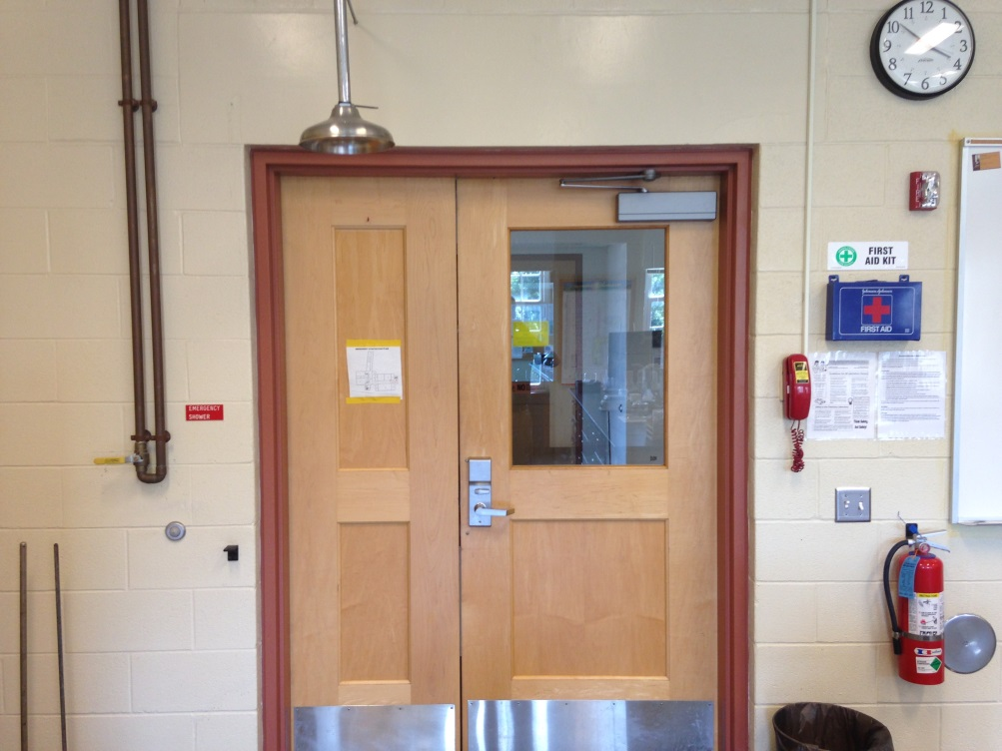
Emergency Equipment
Most laboratories have the following emergency equipment
Eye Wash Stations
First Aid Kits
Spill Kits
Showers
Emergency Gas Shutoffs
Fire Extinguisher
Fire Blanket
Notes:
Take note of the location of emergency equipment in the labs in which you will be working. Most labs are laid out in a similar fashion, but there are minor differences.
Fire extinguisher use: Use the PASS method (Pull the pin, AIM the nozzle at base of fire, SQUEEZE the handle, SWEEP side to side)
Fire blankets can be used to put out small fires.

Slide 9
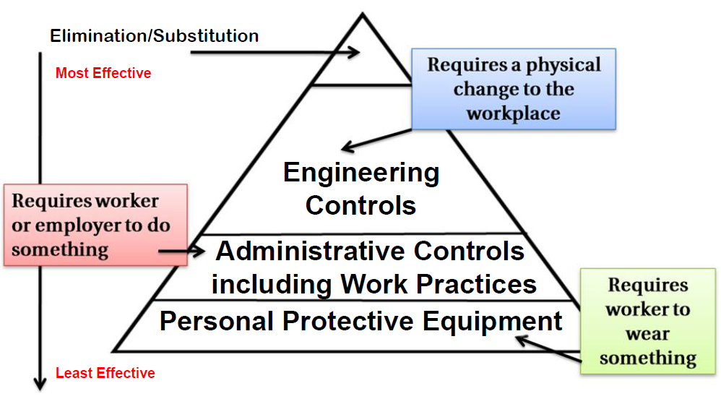
Hierarchy of Hazard Controls
Notes:
There are different methods of controlling hazards in order to protect yourself. Understanding how hazards are and can be controlled is important in ensuring your own safety. OSHA, CDC and other health and safety organizations and regulatory agencies use a Hierarchy of Controls that can be used to provide protection from hazards.
The first step is to always see if a hazard can be eliminated (e.g. removing a highly toxic chemical from a lab experiment). If a hazard cannot be eliminated, can it be substituted for something less hazardous? (e.g. replacing a highly toxic chemical with a chemical with a low toxicity to achieve the same results).
The second step is to use engineering controls provided. For instance, use of chemical fume hood helps provide protection from harmful vapors. Engineering controls require a change to the workplace and can expensive.
The third step is to utilize administrative controls. These include things such as policies, training, and housekeeping. This requires your participation!
Lastly, PPE, such as gloves, goggles an lab coats, is considered. As the last line of defense, PPE is an important component of lab safety!

Slide 10
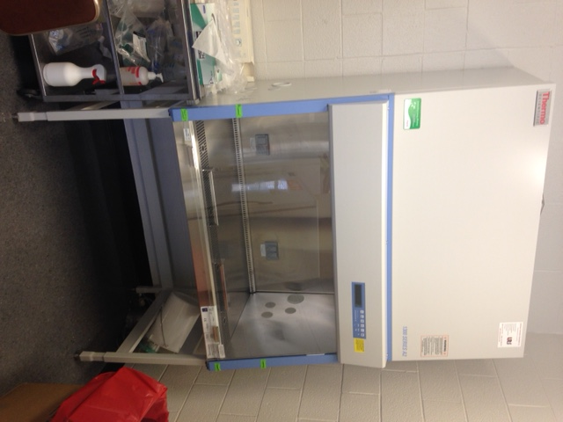
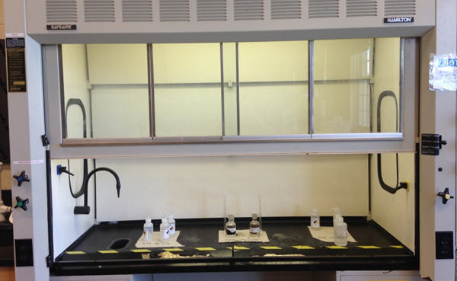
Engineering Controls
Remove or provide a barrier from hazard such as:
Chemical fume hood
Biosafety cabinet (BSC)
Machine guard
General HVAC
Notes:
General HVAC and Chemical fume hoods are the most common engineering controls in labs. General HVAC ensures fresh air is continuously introduced into the lab and is not recirculated. Chemical fume hoods provide additional protection when working with hazardous chemicals. Machine guards and biosafety cabinets are other engineering controls that may be seen in SNS&M labs.

Slide 11

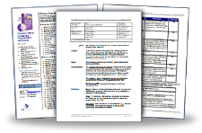
Administrative Controls
Require action – rely on users
Training
Policy/Procedures
Housekeeping & Hand washing
Preventative Maintenance
Notes:
The training that students go through for access approval and the policy that requires the training are both examples of administrative controls. Employer/supervisor and employee/student are both required to take part. Labeling chemical and waste containers and ensuring containers are closed, housekeeping and hand washing and preventative maintenance and testing/calibrating equipment are all examples of administrative controls.

Slide 12

Personal Protective Equipment
Least effective control
Gloves
Goggles
Lab Coats
Closed-toed Shoes
Face Shields
(Wear appropriate size)
Notes:
The least effective control (and last control to consider) is PPE. PPE requires the employee/student to do something (don/doff goggles, gloves, etc.). Other controls can be in place to minimize exposure to a hazard, but a potential exposure still exists. PPE provides protection from expected or incidental hazard exposures. Just because other controls are in place, it does not mean that PPE is optional! For example, just because you are working in a hood with a solvent does not mean that goggles and gloves should not be worn.

Slide 13
Electrical Safety
Damaged or loose electrical cords should be replaced or repaired – do not use them!
Report these to your supervisor/faculty member.
Extension cords are for temporary use. Avoid running them across aisles and doorways
Avoid overloading outlets.
Do not daisy-chain/piggyback power strips or extension cords.
Check all cords prior to use!

Slide 14
Piped Gas Safety
Ensure all gas valves are in the closed position prior to use
Connect device (inspect device and tubing)
Make appropriate adjustments to device
Open emergency gas valve (if in the off position)
Follow applicable procedures for use of device
When finished, close benchtop valve
Ensure emergency gas valve is off (Push to stop)
Notes:
Check emergency gas valve to ensure it is in the “off” position (pushed down). Prior to use, ensure that all valves are in off position. Connect device and inspect device and tubing for defects – do not use faulty tubing or devices! If applicable, make appropriate adjustments to device. Open the emergency gas valve. Turn on gas valve connected to device at benchtop. Follow applicable procedures for proper use of connected device. When finished, close the benchtop valve (handle perpendicular to gas line). Check to ensure all other valves are closed. Turn off gas at emergency gas shutoff (push down).

Slide 15
Chemical Fume Hood Safety
Provide protection from hazardous and toxic chemicals
Does not exempt user from wearing required PPE
Ensure sash is at proper operating level
Work should be performed six inches from plane
Do not cross plane of hood opening w/ head
Close sash when not in use

Slide 16
Chemical Routes of Entry
Ingestion
through the digestive tract
Absorption
through the eyes, skin or mucous membranes
Inhalation
through the respiratory tract
Injection
piercing the skin
Protect yourself from exposure!
Notes:
You will be working in a lab, so it is important to understand how you can be exposed and how to protect yourself from exposure. There are four routes of entry – Ingestion, Absorption, Inhalation and Injection. Knowing the potential routes of entry is important in identifying the controls that can be used to protect yourself from exposure.

Slide 17
Methods of Detection
Protect yourself by using your senses!
Recognize when hazards may be present
Examples:
Smell odorant in propane, burning material or chemical
See a spill, bulging container, uncapped needle
Hear the hissing of a container or gas cylinder
Hear an alarm beeping or buzzing
Feel dizzy or light-headed
Feel burning sensation of skin
Notes:
Protect yourself by using your senses to recognize when hazards may be present. Smelling, seeing, hearing, feeling or even tasting something can indicate that you have been or are being exposed to a hazard. Report all hazards observed or perceived immediately to your supervisor.

Slide 18
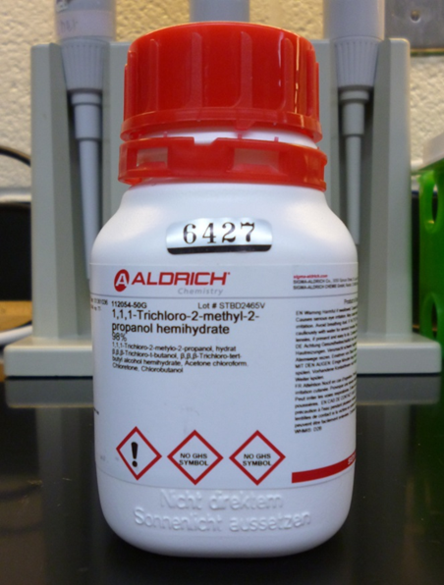
Labeling: Primary Containers
Name, Address and Telephone Number
Signal Word (“Danger” or “Warning”)
Hazard Statements
Precautionary Statements (4)
Prevention, Response, Storage, Disposal
Pictograms (9)
Supplementary Info (not required)
Notes:
Chemical labeling is a requirement. It is an important administrative control. Without labeling, human and environmental health can be put at risk. HazCom requires

Slide 19
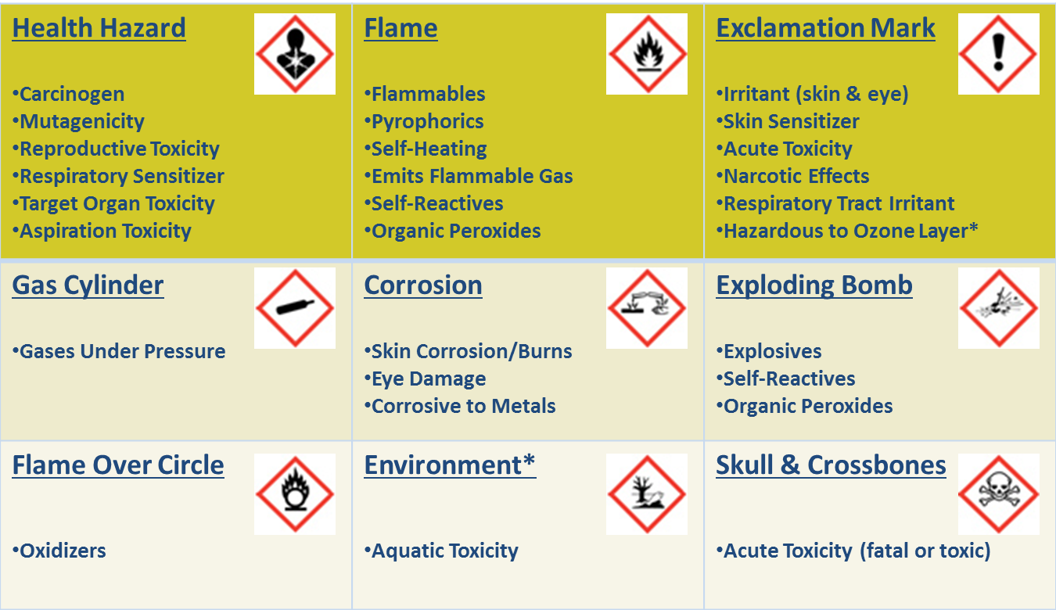
Pictogram Hazards
Notes:
There are four health hazard pictograms: 1. Health Hazard; 2. Exclamation Mark; 3. Corrosion; 4. Skull & Crossbones
There are five physical hazard pictograms: 1. Flame; 2. Gas Cylinder; 3. Corrosion; 4. Exploding bomb; 5. Flame Over Circle
There is one environmental hazard pictogram: 1. Environment

Slide 20
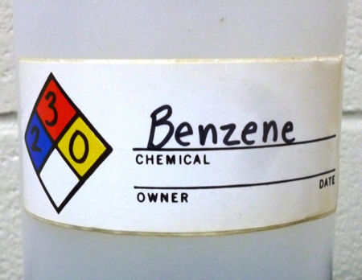
Labeling: Secondary Containers
All containers, except those for immediate use, must be labeled
At minimum, must include:
Product Identifier/Chemical Name (no abbreviations, no chemical formulas, etc.) AND
Product/Chemical Hazards (Words, symbols or combination of words and symbols)

Slide 21

NFPA Label
National Fire Protection Association (NFPA) 704 Hazard Rating System
Ratings are 0 (no hazard) to 4 (severe hazard)
Health (Blue); Flammability (Red); Instability (Yellow); Special Hazard (White) 6 o’clock
Position always the same
Health 9 o’clock
Flammability, 12 o’clock
Instability, 3 o’clock
Special hazard, 6 o’clock
May be in black and white

Slide 22

Safety Data Sheets
Provide information on hazardous chemicals
Must be accessible to employees (including student employees) for each hazardous chemical in the workplace
Students and employees may access SDSs in:
Most labs and/or prep rooms (binder)
Online at www.shepherd.edu/safety
Online by searching a vendor’s website
3E Company 1-800-451-8346

Slide 23
SDS Sections
Identification
Hazard(s) Identification
Composition/Information on Ingredients
First-aid Measures
Fire-fighting Measures
Accidental Release Measures
Handling and Storage
Exposure Controls/Personal Protection
Physical and Chemical Properties
Stability and Reactivity
Toxicological Information
Ecological Information
Disposal Considerations
Transport Information
Regulatory Information
Other Information
Jones Reagent SDS

Slide 24
Bio-hazardous Waste
Waste placed in containers includes:
Cultures and stocks of toxic agents;
Human & non-human blood, body fluids & tissue;
Products contaminated with blood/tissue or other potentially infectious materials;
Contaminated glass and plastic (pipettes, Petri dishes, etc.)
DO NOT place contaminated items in the general waste.
DO NOT place general waste in Bio-Waste Boxes
DO NOT overfill Bio-hazardous containers or sharps containers – request new containers from your supervisor or visit BY208.
When in doubt, ask!

Slide 25
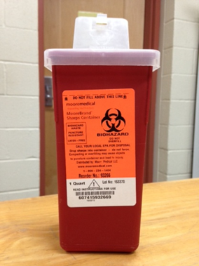
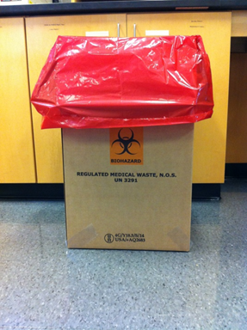
Bio-hazardous Waste
Dispose of biological waste in the bio-hazardous waste containers, sharps in sharps containers.
Extra supplies (boxes, liners, sharps containers) may be requested in BY208.
Bio-hazardous containers and sharps containers are located in:
BY203
BY204
BY210
BY211
SS306
SS303

Slide 26
Hazardous and Chemical Waste
Cradle-to-Grave requirement to manage all hazardous waste
All hazardous waste must be identified and labeled
Common laboratory hazardous wastes:
Corrosive/Caustic liquid wastes
Flammable wastes (Flash point < 140°F)
Reactive wastes
Toxic wastes
Heavy metal wastes (Arsenic, Barium, Cadmium, Chromium, Lead, Mercury, Selenium, Silver)
Certain organic chemicals (Benzene, Carbon tetrachloride, Chloroform, Cresols, Methyl ethyl ketone, Nitrobenzene, Pyridine)
Certain pesticides
Notes:
Shepherd University has a cradle-to-grave management requirement for all hazardous waste it generates under EPA and WV DEP regulations.
Typical wastes generated in the SNS&M labs are those that are corrosive, ignitable/flammable (including oxidizers), reactive and toxic.
Toxic

Slide 27
Hazardous and Chemical Waste
Consult your supervisor/sponsoring faculty member before disposing of any waste.
Read the labels!
Do not mix incompatible wastes
Do not fill containers completely – leave room in neck of containers or leave 1in. From top of wide mouth containers
All containers of hazardous waste must be closed, except when adding or removing waste
If unsure – ask!
Notes:
ALWAYS READ THE LABELS BEFORE ADDING WASTE TO A CONTAINER. WHEN IN DOUBT, ASK! Filling containers completely, especially with incompatible wastes can be dangerous. Always keep containers closed, except when adding or removing a waste (EPA and WV DEP requirement).

Slide 28
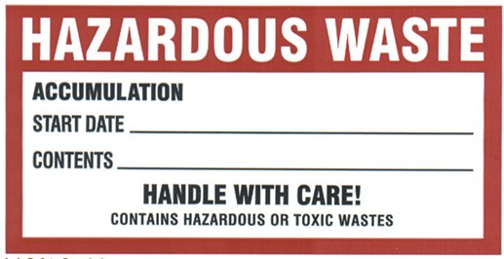
Hazardous Waste Labeling
All hazardous waste must be properly labeled with:
The words “Hazardous Waste”
All Contents*
Abbreviations, chemical formulas and other forms of short hand are not allowed
The Accumulation Start Date
Notes:
A pre-printed hazardous waste label is not required, but can make labeling easier. Ensure that the three required elements are on container even if no pre-printed label is available. Ensures safety when handling and disposing or recycling. Think of those down stream! Must know when something is generated for compliance purposes.

Slide 29
Generator Responsibility
Step 1
Waste Determination
Step 2
Container Selection
Step 3
Containerize Waste
Step 4
Label Container
Step 5
Container Management
Notes:
Determine if it is a hazardous waste - consult supervisor or instructor.

Slide 30
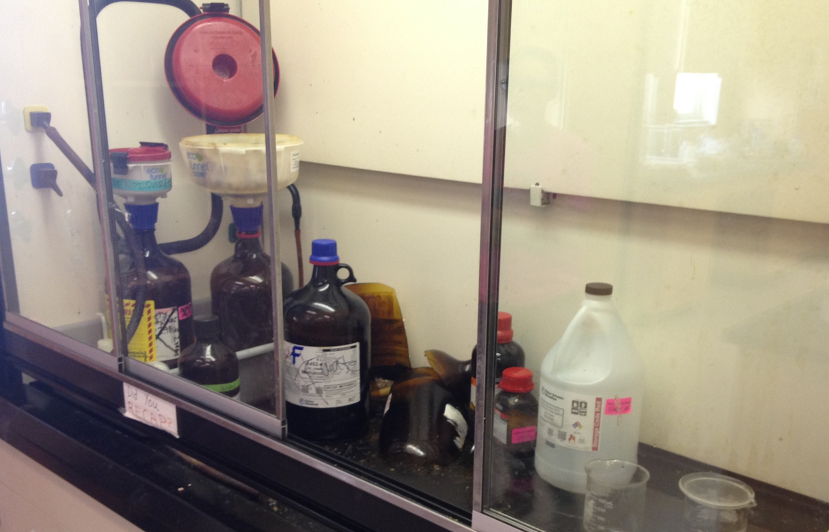
Do not mix incompatible wastes!
Notes:
Dangerous situations when filling containers completely (no room in neck of container) and mixing incompatibles (conc. Acid and conc. Base). Better to start a new container of waste than chance an unwanted reaction.

Slide 31
Questions?

