Slide 1
Field Lab Safety Training
College of Science, Technology, Engineering and Mathematics

Slide 2
Responsibility
Access is restricted to normal University hours (7am – 10pm)
Supervisor must be within building to assume responsibility
Student activity within lab/room must be within scope of work as defined by supervisor
Do not use equipment, instruments, tools, etc. without permission.
Follow all safety guidelines for each piece of equipment, instrument, tool, etc.
If unsure how to run equipment, instruments, tools, etc. – Ask!
Return equipment, chemicals, supplies, etc. to correct storage location.
Maintain a safe and clean work space

Slide 3
Loss of Privilege/Access
Dean provides all access privileges and has right to revoke privileges
Actions resulting in loss of privilege:
Damaged equipment, room or furniture
Unsafe acts – putting others at risk
Unsupervised before/after-hour use
Can result in faculty sponsor’s ability to provide access to other students

Slide 4
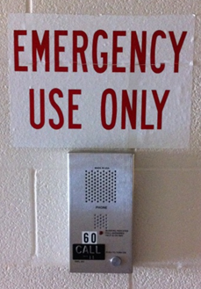
Emergency Procedures
Call 911 (9-911 from Red Phones & SU land lines)
Fire, serious bodily injury
Non-Emergency Call Boxes
Push to talk, release to listen
Connect directly to Facilities
Located in:
Byrd Science Center NE corridors
Snyder Hall corridors
Stutzman-Slonaker Hall corridors
Non-emergency events – inform faculty member or use chain of contacts (next to doors leading to each lab)

Slide 5
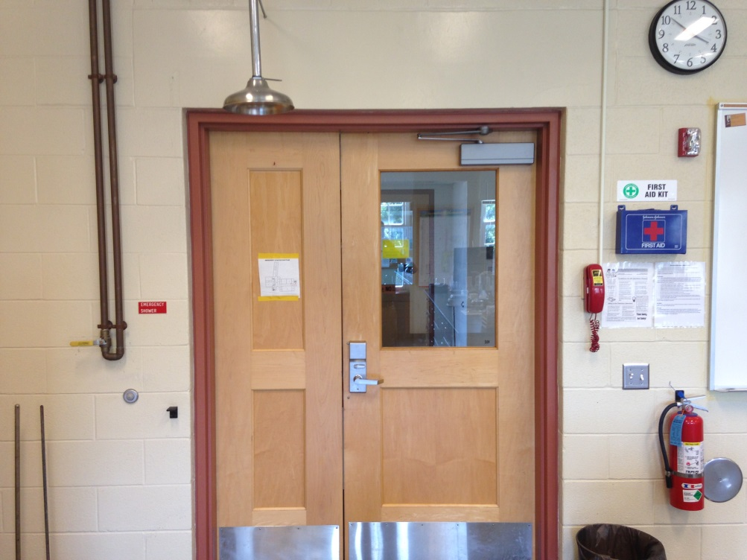
Emergency Equipment
Most laboratories have the following emergency equipment
Fire Extinguishers
Fire Blankets
Eye Wash Stations
First Aid Kits
Spill Kits
Showers
Emergency Gas Shutoffs
Familiarize yourself with the location of the equipment
Notes:
Take note of the location of emergency equipment in the labs in which you will be working. Most labs are laid out in a similar fashion, but there are minor differences.
Fire extinguisher use: Use the PASS method (Pull the pin, AIM the nozzle at base of fire, SQUEEZE the handle, SWEEP side to side)
Fire blankets can be used to put out small fires.

Slide 6

Personal Protective Equipment
Least effective control
Gloves
Safety glasses
Closed toed shoes
Wear appropriate size
Notes:
The least effective control (and last control to consider) is PPE. PPE requires the employee/student to do something (don/doff goggles, gloves, etc.). Other controls can be in place to minimize exposure to a hazard, but a potential exposure still exists. PPE provides protection from expected or incidental hazard exposures. Just because other controls are in place, it does not mean that PPE is optional! For example, just because you are working in a hood with a solvent does not mean that goggles and gloves should not be worn.

Slide 7

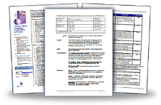
Administrative Controls
Training
Policy/Procedures
Labeling & Closing containers
Housekeeping & Hand washing
Preventative Maintenance
Notes:
The training that students go through for access approval and the policy that requires the training are both examples of administrative controls. Employer/supervisor and employee/student are both required to take part. Labeling chemical and waste containers and ensuring containers are closed, housekeeping and hand washing and preventative maintenance and testing/calibrating equipment are all examples of administrative controls.

Slide 8
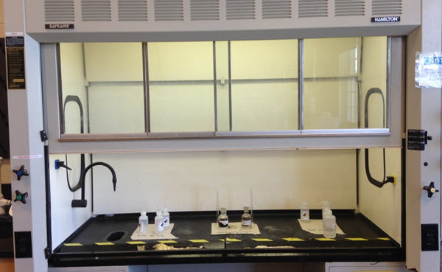
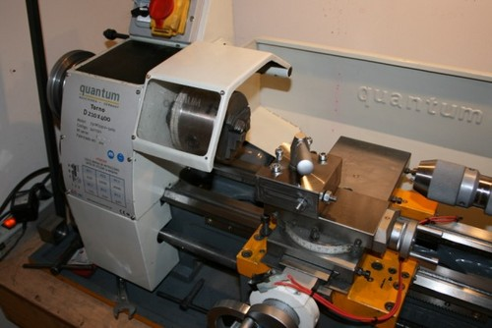
Engineering Controls
Remove or provide a barrier from hazard
Chemical fume hood
Biosafety cabinet (BSC)
Machine guard
General HVAC
Notes:
General HVAC and Chemical fume hoods are the most common engineering controls in labs. General HVAC ensures fresh air is continuously introduced into the lab and is not recirculated. Chemical fume hoods provide additional protection when working with hazardous chemicals. Machine guards and biosafety cabinets are other engineering controls that may be seen in SNS&M labs.

Slide 9
Hand & Power Tool Safety
Inspect all tools prior to using
Damaged cords
Guards damaged/removed
Loose handle or other parts
Report all damaged tools immediately to your supervisor
Ensure others in area are informed
Wear appropriate PPE for the work being performed

Slide 10
Hand & Power Tool Safety
Use the correct tool for the work being performed (e.g. using screw driver as a chisel)
Do not wear loose or baggy clothing or jewelry and secure long hair.
Perform work in a well lit area
Follow all safety guidelines and manufacture’s instructions when using tools

Slide 11
Power Tool Safety
Never bypass safety guards
Unplug tools when not in use, when cleaning, changing accessories, etc.
Do not carry power tools by cords
Do not hold “On” switch/trigger while carrying
Eye protection should always be worn when using tools

Slide 12
Electrical Safety
Damaged or loose electrical cords should be replaced or repaired – do not use them!
Extension cords are for temporary use. Avoid running them across aisles and doorways
Avoid overloading outlets.
Do not daisy-chain/piggyback power strips or extension cords.

Slide 13
Ladder Safety
Do not use in front of doors, unless locked or someone is on watch
Wear appropriate footwear
Maintain three points of contact at all times
Do not overreach while on ladder
Do not use aluminum ladders with power tools

Slide 14
Ladder Safety
Only use ladder rungs when climbing
Ascend/descend facing the ladder (Do not jump or slide down ladder)
To be used only by one person, unless designed for two
Use appropriate size ladder (not too tall or short)
Notes:
NIOSH = National institute of occupational safety and health

Slide 15
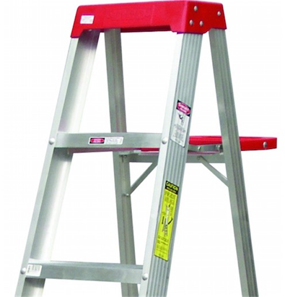
Step Ladder Safety
Requires level surface for all four legs
Fully spread and lock spreader before use
Never “lean” a step ladder against objects to use
Do not place ladder on other objects/bases to gain height
Never stand on top (cap) of ladder
Notes:
A level surface is required when use a step ladder. If this cannot be achieved, then another ladder type may be required.
Ensure ladder spreader is locked before using.
Never use a step ladder as a “straight” ladder (i.e. Do not lean ladder against objects when using such as a wall)
Do not place ladder on other objects to gain height, use a taller ladder!
Follow the manufacturer’s instructions for use, otherwise never stand on top two steps or the cap of a step ladder.

Slide 16
Working Outdoors
Plan ahead when working outdoors
Follow weather forecast
Choose clothing to match work & weather conditions
Maintain a safe work environment
Plan and organize work
Store/place materials in safe places
Take time for “housekeeping”
Don’t dig without approval!
Notes:
Make sure you are aware of weather forecast each day. This ensures safety AND efficiency.
Choose clothing that will match the work you will be performing and in the weather conditions expected. You may need multiple outfits (i.e. cold in morning, hot during afternoon)

Slide 17

Weather Alerts
Watch = Possible (Conditions are favorable)
e.g. Tornado Watch, Severe Thunderstorm Watch
Monitor weather forecast
Be ready to act
Warning = Immediate (Occurring/about to occur)
e.g. Tornado Warning, Severe Thunderstorm Warning
Immediate danger to life and property
Take action!

Slide 18

Thunderstorm/Tornado Safety
Postpone activities during a Warning and be prepared to act during a Watch
If you can hear thunder, you are close enough to be in danger from lightning
Move indoors for at least 30 minutes
Tornado Warning
Lower level, away from windows

Slide 19
Working in the Heat
Drink lots of fluids! Before, during and after!
Water and sports drinks
Avoid caffeinated and alcoholic beverages
Can take 5-7 days to acclimate to the heat
Take breaks in cool areas to cool body down
Do most strenuous work early in the day
Wear light colored, light clothing and a hat

Slide 20
Heat-Related Illnesses
Heat Cramps
Muscle pains and spasms
Heat Exhaustion
flushed skin; Headache; Nausea; Dizziness; and Weakness
Heat Stroke
High body temp; red skin; Changes in consciousness; Rapid, weak pulse; Rapid, Shallow breathing; Confusion; Vomiting; and Seizures

Slide 21
Heat Cramps
Get the person to cool dry place
Light stretch and massage the affected muscle(s)
Give electrolyte-containing fluid (PowerAde, Gatorade, fruit juice, etc.) or water.

Slide 22
Heat Exhaustion
Move person to cooler environment
Remove or loosen as much clothing as possible
Apply cool, wet cloths to skin
Fan/spray person with water
Give small amounts of a cool fluids (sports drinks, fruit juice, water)
4 ounces every 15 minutes
Call 911 if condition does not improve, person refuses fluids, goes unconscious or vomits

Slide 23
Heat Stroke
Call 911 – Life-threatening!
Rapidly cool the body by spraying person with cold water
Sponge person with ice water-doused towels
Cover the person in bags of ice
Notes:
Person likely has ignored signs of heat exhaustion.

Slide 24
Questions?

