Slide 1

Campus Services
Bookstore/Dining Services/Rambler Card/Residence Life/
Student Center/Wellness Center
Annual Report for Fiscal Year 2020

Slide 2
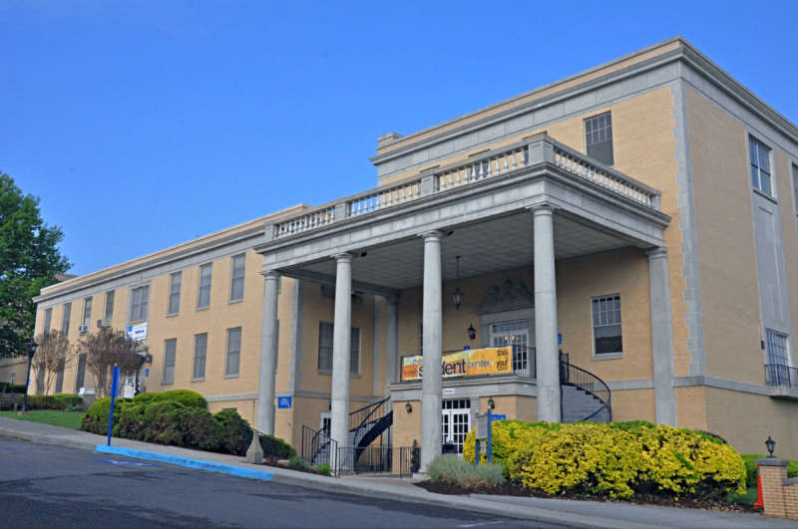
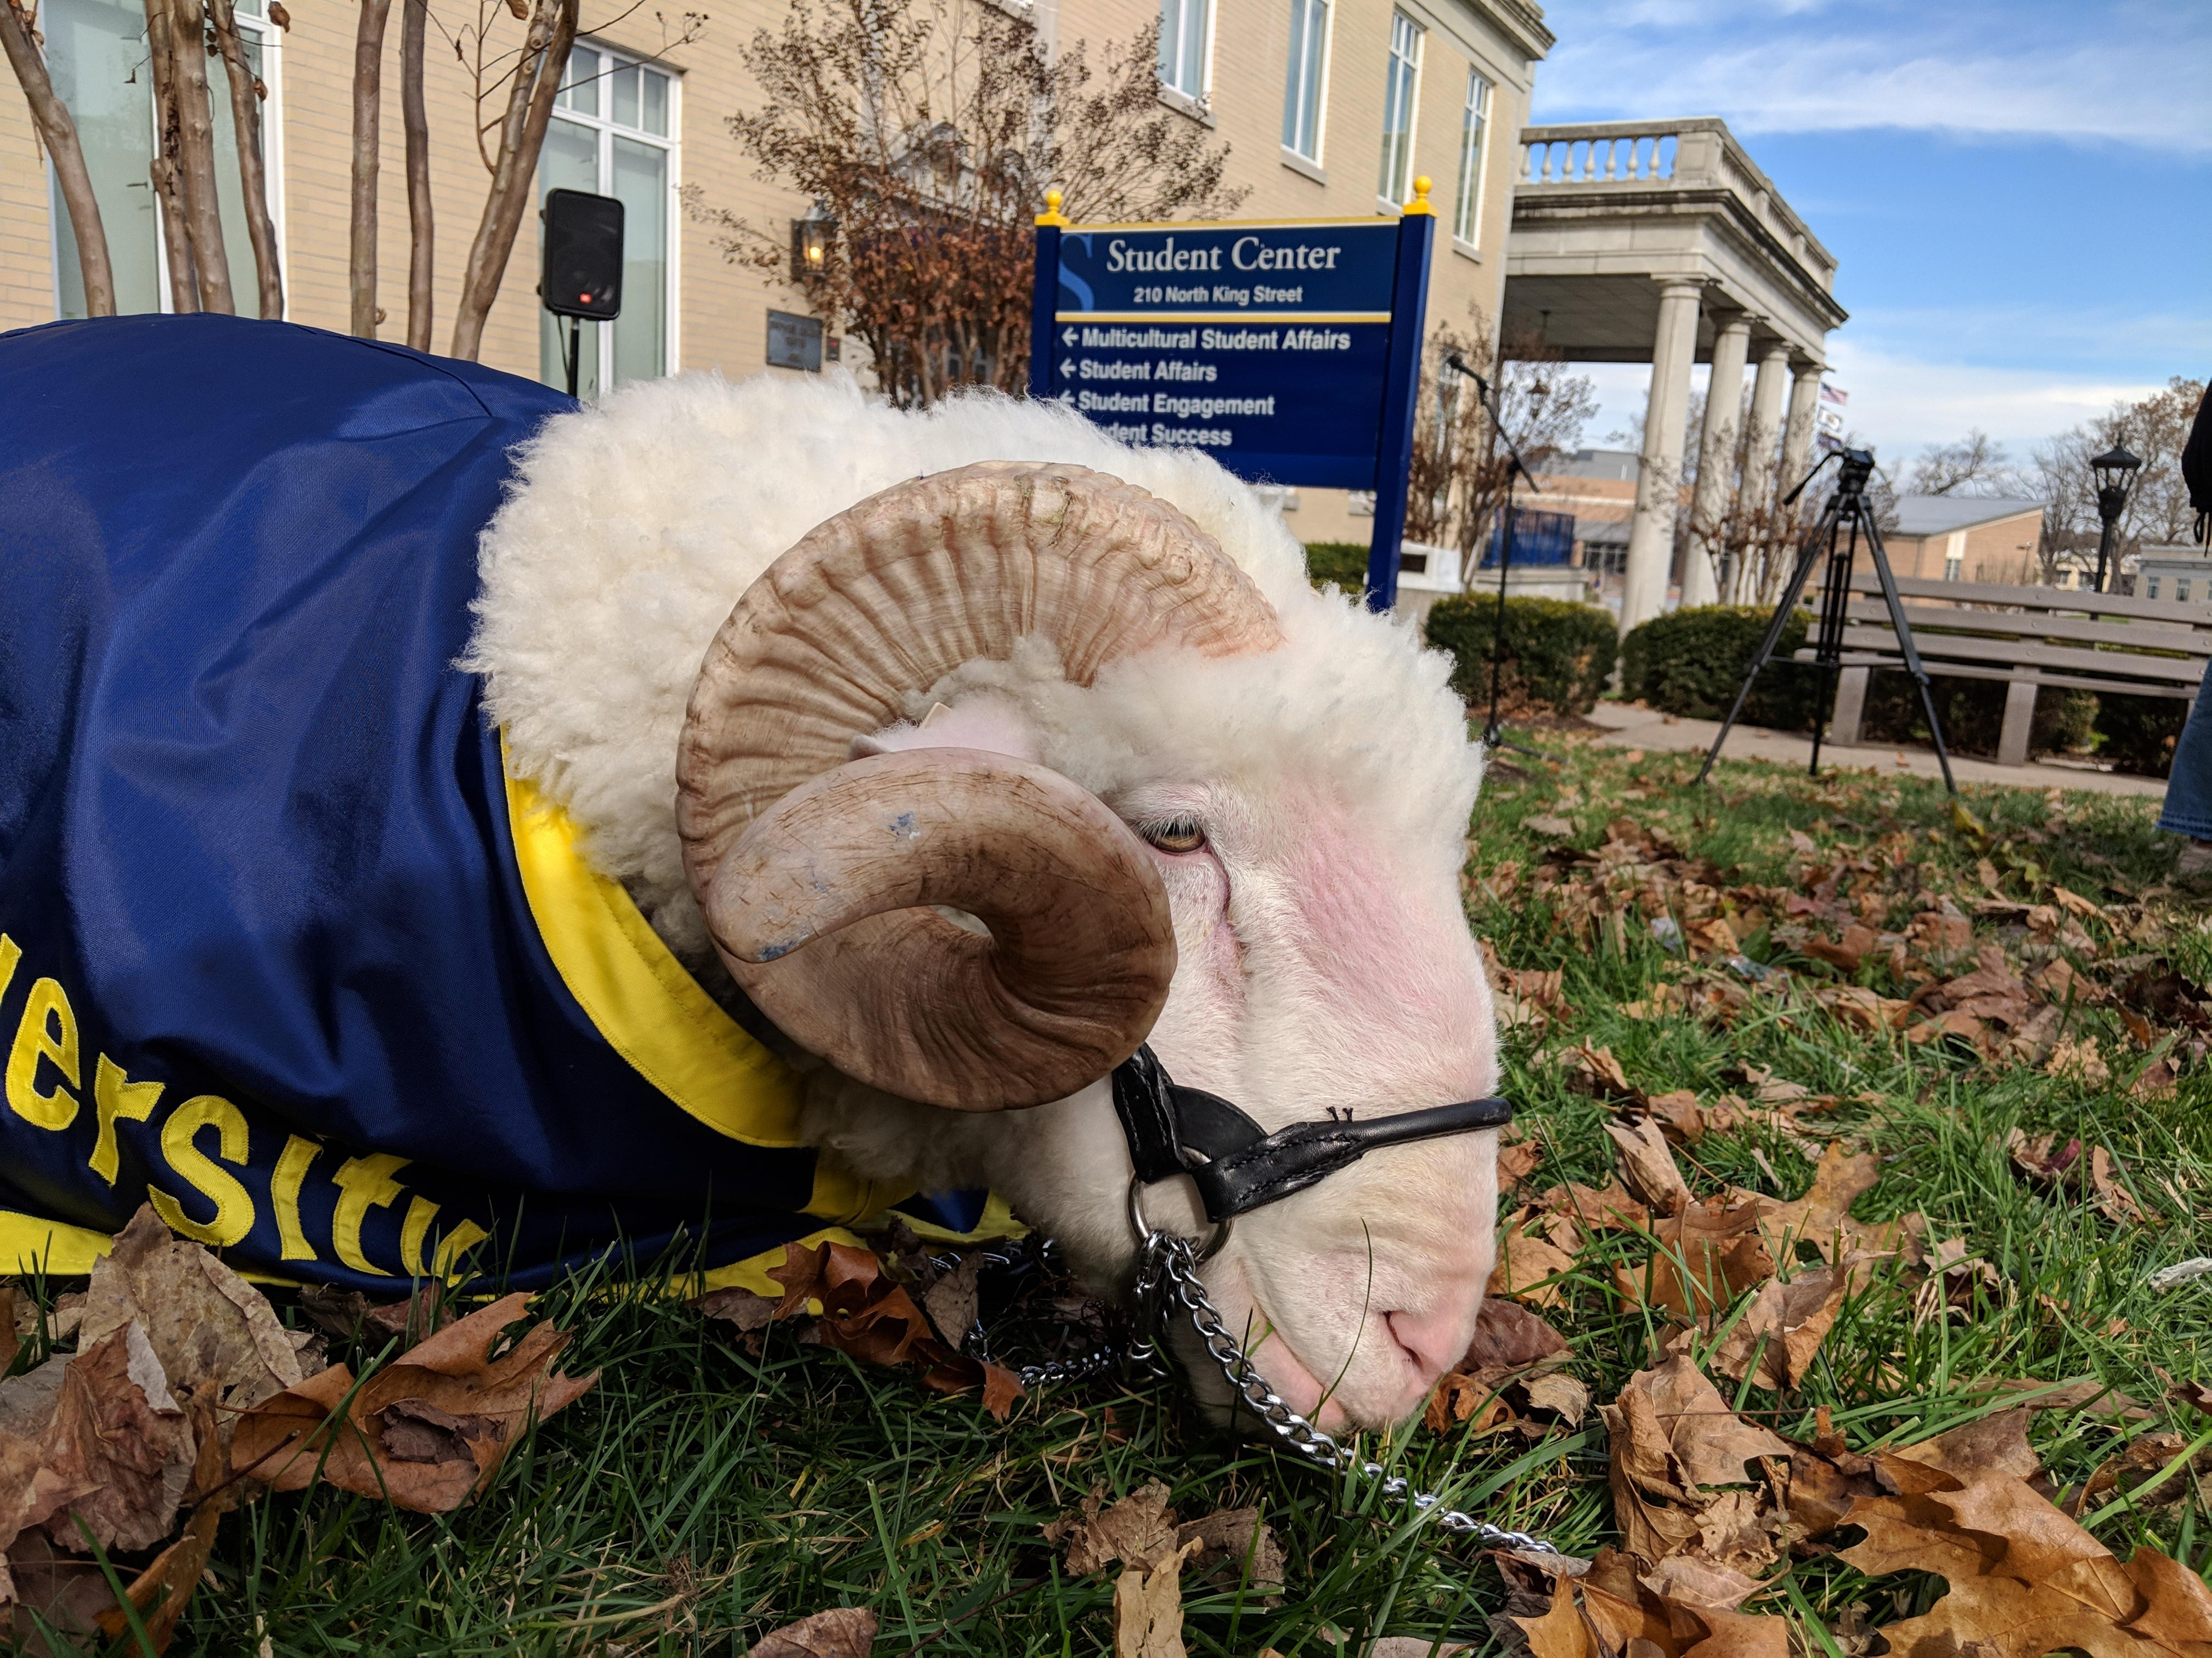
2020 Financial Overview
$ 9,466,488 Total Revenue
2020 Highlights
Terminated foodservice contract with Chartwells in May. Conducted RFP over spring and selected Aramark as new vendor. Aramark started service in July.
Installed new hard surface flooring in Martin and Miller Halls. Purchased new mattresses for Shaw, Thacher, and Martin Halls.
$ 2,335 Cost of Goods Sold
$ 2,279,732 Personnel Expenses
$ 7,312,165 Operating Expenses
$ 9,594,232 Total Expenses
$ (1,133,801) Net Income
$ (780,011) Capital Purchases
$ 83,274 Potomac Place Reserves
$ (1,913,812) Cash Flow
Revenue down $1.16M from year prior. Returned just over $1M in housing and dining revenue to students as a result in COVID related pivot to distance learning. Wellness Center revenue down $300K, mostly due to COVID related closure in April and May.
Housed approximately 60 students on campus during the April distance learning period of the spring semester.
Delivered Follett Inclusive Access across 63 courses and 125 section to 2,049 students yielding savings of $483,024.
Installed new roof to Student Center over spring, 2020.
Reduced operational expenditures by $582K, mostly in part time labor and dining contract fees.
($ 1,006,057 Covid-19 Credits)

Slide 3
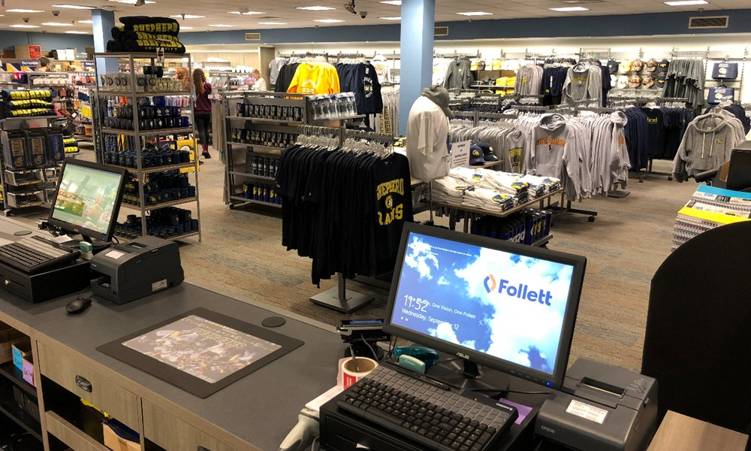
Bookstore
Revenue
2019
2020
$ 61,183
Personnel Expense
Cost of Goods Sold
Operating Expenses
Total Expenses
Net Income
$ 87,045
2018
$ 1,165,500
$ 34,852
$ 0
$ 250
$ 35,102
$ 51,943
$ 1,030
$ 1,030
$ 60,153
$ 0
$ 253,682
$ 933,610
$ 122,843
$ 3,10,135
$ (144,635)
$ 0
FY20 revenue decline related to fall, 2019 Inclusive Access revenue realized in FY19.
Provided Inclusive Access across fall, spring, and summer semesters for 63 courses with 125 sections to 2,040 students. Collective student course materials savings totaled $483,024. Savings were as much as 60% for some courses including Math, Biology, Business Administration, Economics, and Accounting.
Follett rolled out CorePOS, a point of sale system that allows for more streamlined rental transactions, refined POS screen layout that improved cashier efficiency, and better back office cash management.
The Shepherd Bookstore set up at the Evolve Popup Shop in downtown Shepherdstown during Christmas in Shepherdstown.
The bookstore closed due to COVID from 3/25/20 thru 7/31/20.
Follett continues to provide On Demand apparel sales service through the SU Athletics website portal.

Slide 4
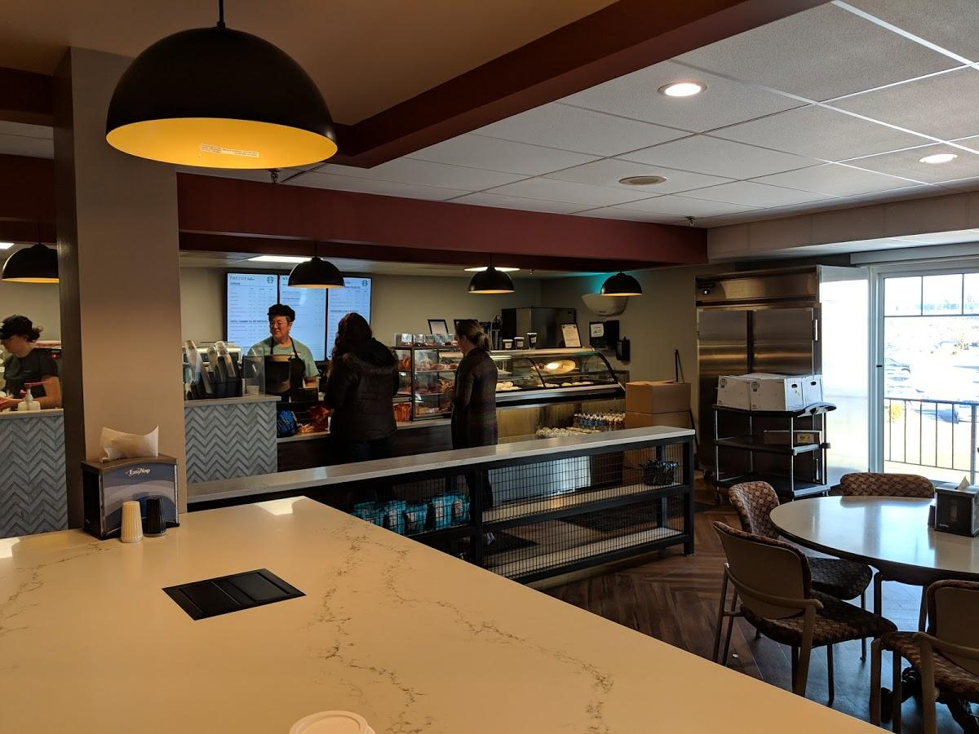
Dining Services
Revenue
2019
2020
$ 2,894,628
Personnel Expense
Cost of Goods Sold
Operating Expenses
Total Expenses
Net Income
$ 3,166,831
2018
$ 3,627,982
$ 1,482,310
$ 1,256,538
$ 924,953
$ (35,819)
$ 117,081
$ 1,094
$ 2,990,289
$ 58,367
$ 152,186
$ 0
$ 2,287,265
$ (14,890)
$ 2,439,451
$ 3,108,464
$ 3,663,801
COVID-19 Credits
($ 470,067)
Terminated contract with Chartwells in February, 2020. Conducted RFP over spring and received three responses. Selected Aramark in May, 2020 and transitioned the new vendor onto campus in July. Paid Chartwells $500K of unamortized investment in FY21. Will receive that back in support from Aramark.
Decline in revenue and expenses due to reduced April services and meal plan fee returns to students who moved off campus in April.
Personnel expense related to distribution of support staff payroll.
Did not have on campus dining services over summer, 2020.
Achieved 64.7% participation over fall, 2019 semester; up 3.4% points from year prior.
Served students in Riverside Market during distance learning portion of spring, semester in April.

Slide 5
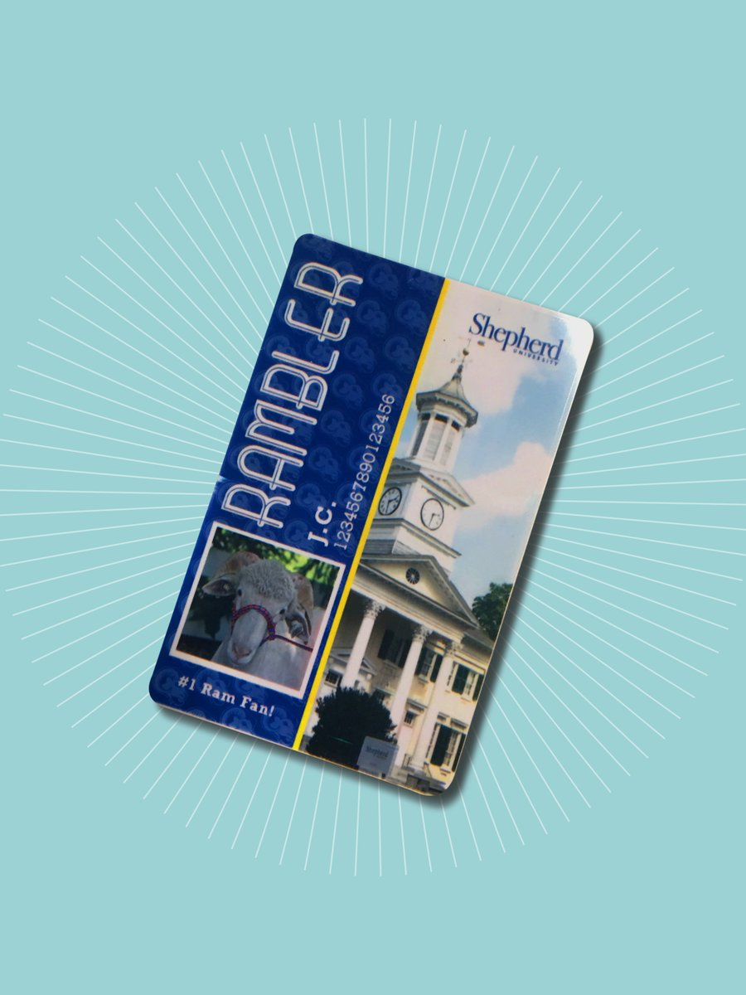
Rambler Card
Revenue
2019
2020
Personnel Expense
Cost of Goods Sold
Operating Expenses
Total Expenses
Net Income
$ 19,199
$ 58,347
$ 101,518
2018
$ 155,692
$ 44,410
$ -
$ 91,963
$ 136,373
$ 19,319
$ 11,594
$ -
$ (143,769)
$ 155,363
$ 85,649
$ -
$ 159,865
$ 69,714
$ (140,666)
Implemented online photo upload process for summer Orientation in response to COVID challenges. Assisted in mailing Rambler cards to new students over the summer in conjunction with a Bookstore gift-card promotion. This process has continued into the fall to assist with social distancing protocols and has helped to streamline the acquisition of cards for staff and students.
Provided web and video-based content support to new and continuing student organizations.
Designed Rambler solutions for swipe access to Ram Pantry food market.
Supported campus safety with increased card-based building access procedures.
No longer charging internal University customers for Rambler support.

Slide 6
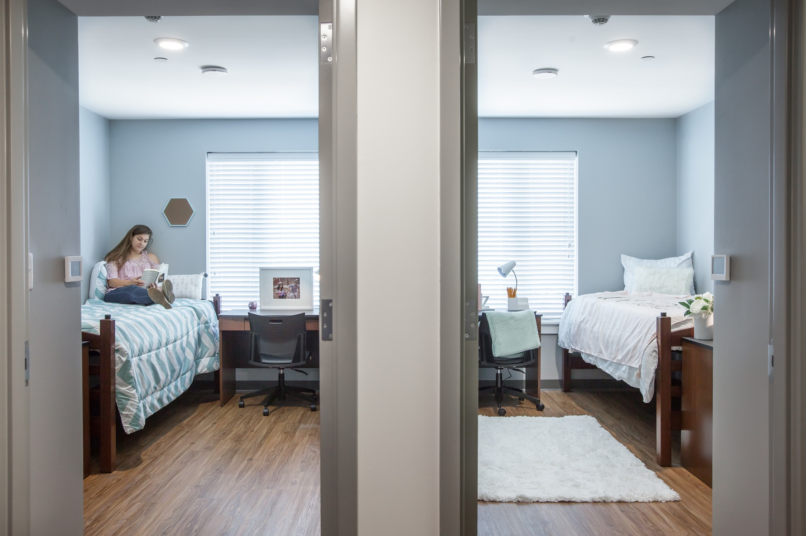
Residence Life
Revenue
2019
2020
2018
Personnel Expense
Cost of Goods Sold
Operating Expenses
Total Expenses
Net Income
Potomac Place Ground Rent and Reserves
Transfer of Funds to cover payment of student refunds
$ 3,616,935
$ 1,281,420
$ -
$ 2,955,279
$ 4,236,699
$ (1,155,754)
$ 83,274 Reserves
$ -
Does not include conferences
$. 4,068,958
$ 1,457,518
$ -
$ 3,411,930
$ 4,869,448
$ ( 800,490)
$ 532,590
$ (54,239)
Does not include conferences
$ 3,955,011
$ 1,362,709
$ -
$ 3,847,243
$ 5,209,952
$ (1,254,941)
$ 1,028,207
$ -
Does not include conferences
Covid-19 Credits
($ 535,990)
Housed all residents during distance learning portion of spring, 2020 semester in Potomac Place in an all-singles format. Moved students over Spring Break extended period in March from original assignment to Potomac Place to streamline coverage and insure all students had single restroom facilities. Allowed students to come back in campus over May in phased process to pick up belongings from the spring, 2020 semester.
Provided summer housing in Printz Hall to approximately 35 students.
Installed hard surface flooring in Miller and Martin Halls. Purchased new mattresses for Martin, Miller, Shaw, and Thacher Halls.

Slide 7
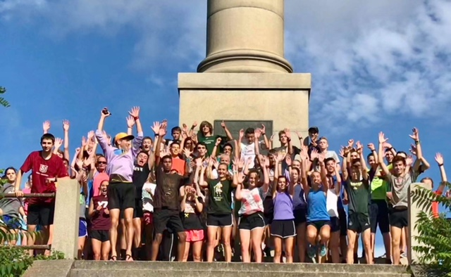
Conference Services
Revenue
2019
2020
$ 96,758
Personnel Expense
Cost of Goods Sold
Operating Expenses
Total Expenses
Net Income
2018
$ 106,309
$ -
$ 191,525
$ 16,033
$ 55,343
$ 29,555
$ 100,931
$ 90,594
$ -
$ -
$ 3,305
$ 3,305
$ 93,453
$ 1,516
$ 12,972
$ 14,488
$ 91,821
Did not have conferences in summer, 2020 due to COVID.
Established guidelines for use of University spaces for events hosted by outside organizations affiliated with the University.
Created graphical representation of campus space usage in support of COVID-appropriate classroom and study space availability.
Assisted in property rental to Morgan Academy (within Thacher Hall), CMI2 (in Gardiner Hall), and the Potomac Agency (within the One Room Schoolhouse).

Slide 8
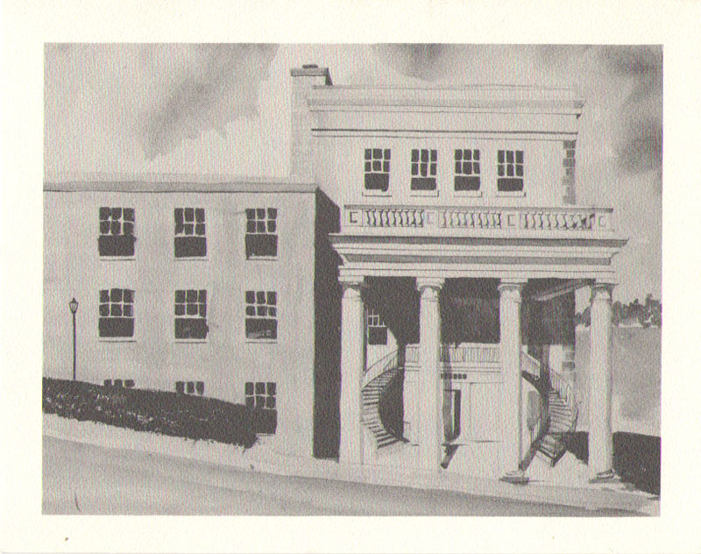
Student Center
Revenue
2019
2020
$ 782,034
Personnel Expense
Cost of Goods Sold
Operating Expenses
Total Expenses
Net Income
$ 132
$ 846,621
$ 225,647
$ 257,598
$ 483,377
$ 363,244
2018
$ 885,824
$ 237,807
$ 204
$ 242,922
$ 480,933
$ 404,891
$ 135
$ 213,728
$ 425,306
$ 356,728
$ 211,443
Stopped external rentals in March due to COVID-19 with lost rentals totaling approximately $45K.
Roof replacement project completed in April, 2020.
Converted most interior doors to Onity card access.
Transitioned staff restroom in Student Affairs suite to a gender-neutral public restroom in fall, 2020.
Stayed on budget through streamlined staffing, vacancy savings, inventory efficiency, and in-house completion of deferred maintenance.

Slide 9
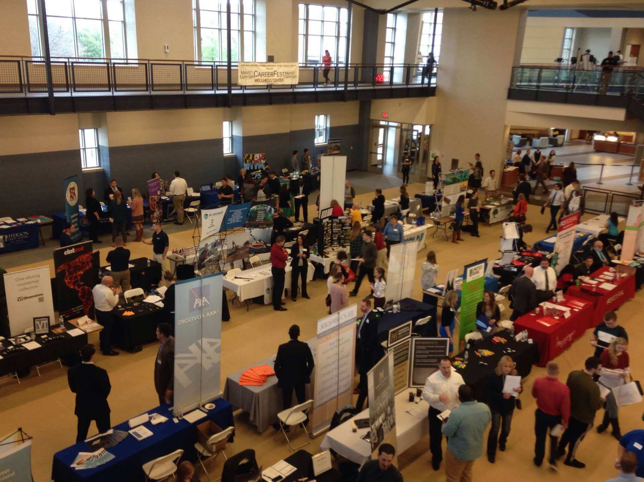
Wellness Center
Revenue
2019
2020
$ 2,003,356
Personnel Expense
Cost of Goods Sold
Operating Expenses
Total Expenses
Net Income
$ 4,372
$ 2,328,905
$ 634,583
$ 1,872,931
$ 2,511,886
$ (182,981)
2018
$ 2,474,839
$ 658,101
$ 5,577
$ 1,834,428
$ 2,498,106
$ (23,267)
$ 564,969
$ 2,200
$ 1,765,909
$ 2,333,078
$ (329,722)
Instituted cost-saving measures by cutting facility hours; having full-time admin staff work in student labor positions (lifeguarding, working the weight fitness floor, and the front desk) 12 hours a week.
Performed audit on memberships to assess correct fee discounting (identified $1,500/month in incorrect fee application, mostly due to staff/faculty discount). As a follow-up, we defined our protocol for determining membership type eligibility.
Partnered with a group exercise streaming service, Fitness On Demand. We launched the app portion while we were closed from March to June. Long-term use of this platform will be $18,000 savings annually.
We are officially a Silver Sneakers facility, which began in June. Silver Sneakers can bring in up to $10,000/month in revenue.
Completed boiler replacement, pump and chemical distribution repairs, and grate replacement for the pool. Assessed need HVAC repairs across the building.

Slide 10
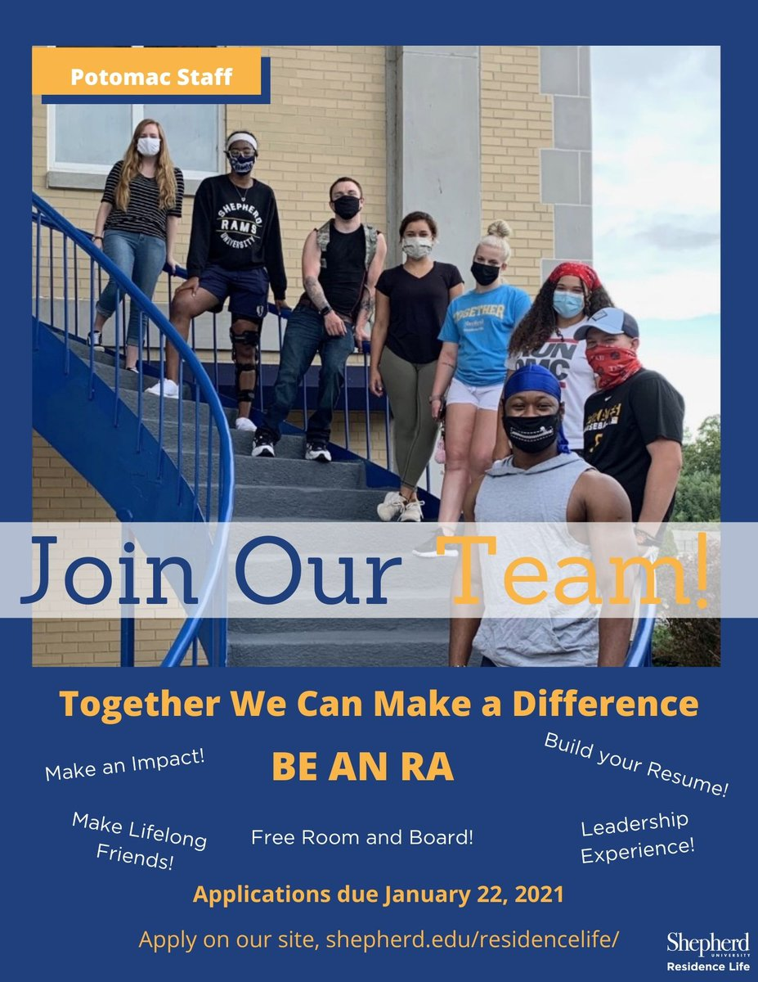
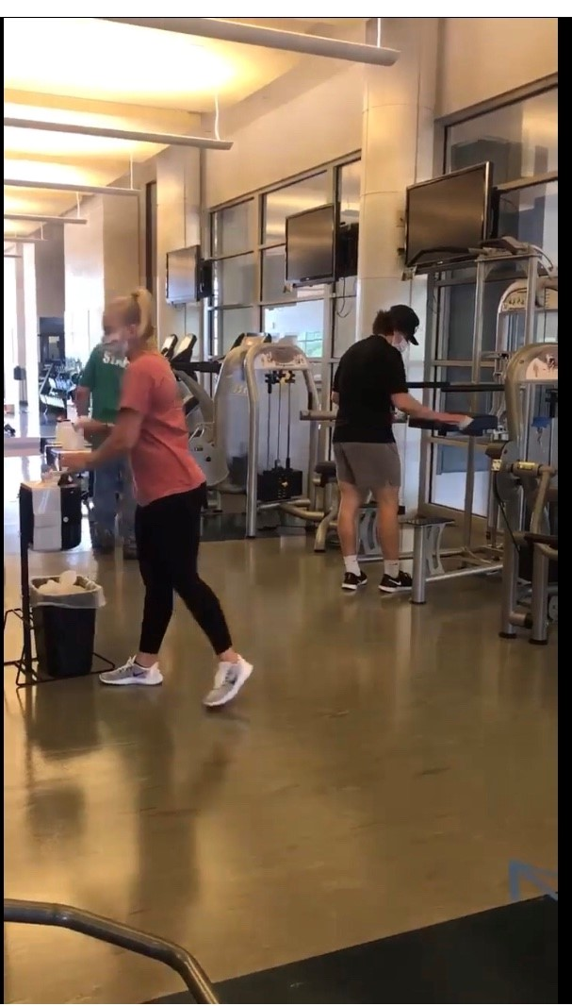
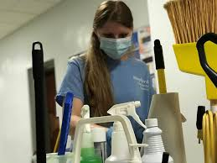
Jack Shaw Vice President for Campus Services
Residence Life Liz Sechler
Wellness Center Jennifer Flora
Student Center Nick Mummert
Rambler Card and Conference Services Traci Morris
Administrative Support Jo Mullikin
Dining Services Keith Crockett (Chartwells)
Bookstore Tina Miller (Follett)
Shepherd University Auxiliary Team

