Slide 1
Make your course Accessible and Usable

Slide 2
Accessibility and Usability
Accessibility
Accessibility addresses discriminatory aspects of the user experience online for people with disabilities. When a website is accessible, it means that people with disabilities can equally perceive, understand, navigate, and interact with the content presented. It also means that users can participate and contribute without barriers.
Some best practices are:
Including closed captions and transcripts for video content on your website.
Not using color alone to convey information.
Using a high contrast ratio between text and background so that people can easily distinguish between the two.
Describing the content and purpose of images through alternative text.
Ensuring that the website is navigable using only the keyboard.
Giving users enough time to read and use the site’s content, and giving users the ability to disable or adjust unnecessary time limits.
In the site’s code, explicitly indicating the language of the text on the page (English or French, for instance), as well indicating the language of any passages that differ from the main language used.
Including no website content that could induce a seizure.
Usability
Usability is about designing products to be effective, efficient, and satisfying. Usability includes user experience design. This may include general aspects that apply to all users and do not disproportionately impact people with disabilities. Usability practice and research does not sufficiently address the needs of people with disabilities alone, but rather in tandem with accessibility standards. While the considerations of people with disabilities are not always included in common practices, they can be easily integrated into user experience design.
https://www.boia.org/blog/accessibility-vs-usability-vs-inclusion

Slide 3
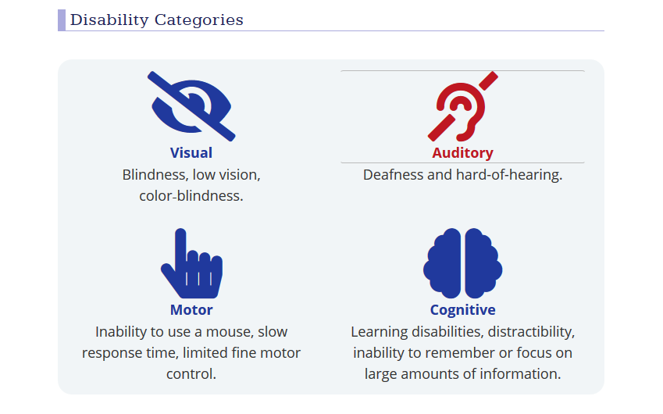
Areas Impacted

Slide 4
Let’s start with simple fixes…
Inconsistent or unclear course design and navigation
This may pose a challenge for all learners, but especially those who use a screen reader for navigation. One common problem is labels inconsistently used throughout a course, such as interchanging words (e.g., "modules" and "units").
Course content without proper headings or styles for navigation
Again, this may present difficulties for learners because the content is poorly organized. However, if bold and italic are used instead of proper headings or styles, a visually impaired learner using a screen reader will not be able to differentiate between main topics and sub-topics.
Unclear or non-descriptive course content
Often, content is written in a manner that is unclear to the learner, which is the reason QM recommends you have someone else review your content. Unclear or non-descriptive content represents a challenge to all learners. Another example of non-descriptive content is the use of acronyms or jargon.
Using Complex Fonts: the US Department of Health & Human Services unofficially recommends the following fonts for PDF files: Times New Roman, Verdana, Arial, Tahoma, Helvetica, and Calibri. At least 12 pt.
What do the above fonts all have in common? For one, they're all basic, simple, and unadorned, with no extra decorations or flourishes. What's more, they usually come automatically installed on computers. When all else is equal, designers should always choose a more popular font over a less popular alternative. This will increase the likelihood that the user's computer can display it.
Although serif fonts are usually preferred for printed items, such as books and newspapers, the opposite holds true for websites. Proportionally, the "ticks" and "tails" of serif fonts take up a larger amount of space on a screen than they do on a printed page. In general, sans serif fonts display better on computers and mobile devices. Above all, avoid decorative or overly stylized fonts, which are often difficult to read even for users without visual impairments or reading disabilities.

Slide 5
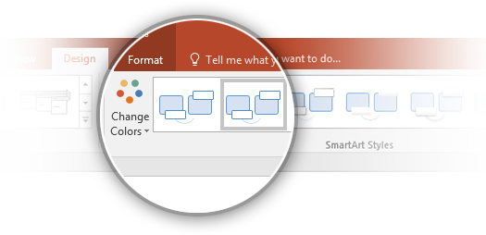
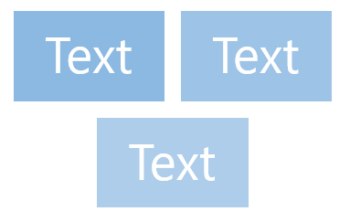
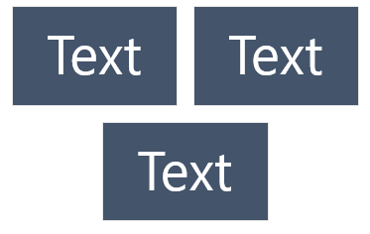

Color Accessibility Rules – Charts and SmartArt
1
Some people can’t see certain colors, so text, tables, and SmartArt need to pass a test that measures these color differences. You can download a color contrast analyzer from the web. To test using this tool, just select the color foreground and background you need and see if it passes!
2
If colors need to be changed to pass the analyzer, change the chart design or color scheme instead of changing the colors directly. To change these, select your chart and go to Chart Tools > Design > Chart Styles or Change Colors.
1
2
Failing color contrast
✓
Passing color contrast
Learn about accessibility best practices

Slide 6
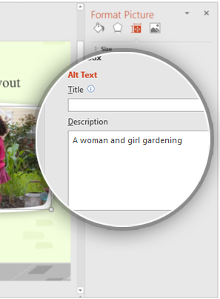
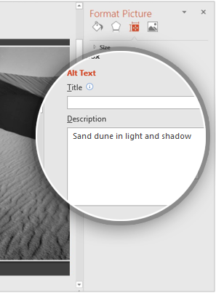
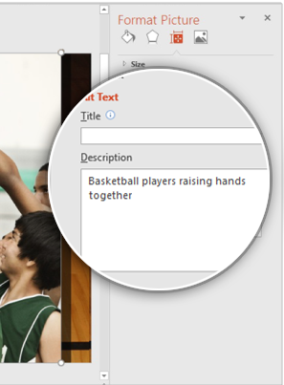
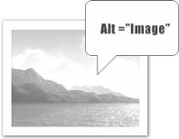
Alt Text Accessibility Rules – Pictures
All your pictures and tables need appropriate descriptive alternative text (known as “alt text”) that doesn’t use the words “photo” or “graphic”.
To add alt text, right click on your picture and select Format Picture, then go to Size & Properties > Alt Text and add alt text only to the Description field.
Alt text examples for pictures on this slide:
1
A women and girl gardening
1
2
Sand dune in light and shadow
3
Basketball players raising hands together
2
3
Learn more about adding alt text to images

Slide 7
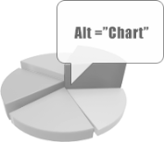
Alt Text Accessibility Rules – Charts
All charts also need to have alt text. To add alt text to a chart, right click on the chart and select Format Chart Area which will open the Format Chart Area pane, then go to Size & Properties > Alt Text and enter your alt text only into the Description field.
Alt text examples for two different chart types on this slide:
1
  Line chart showing values of three series for four categories
2
  Clustered column chart showing values of three series for four categories
1
2
Learn more about adding alt text to charts

Slide 8
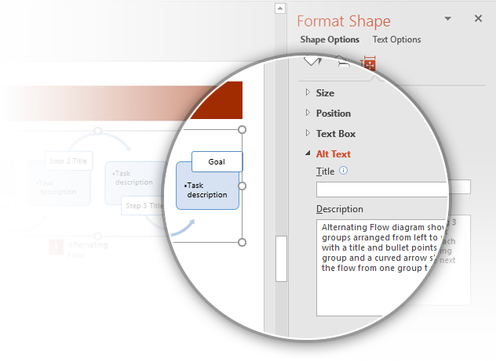
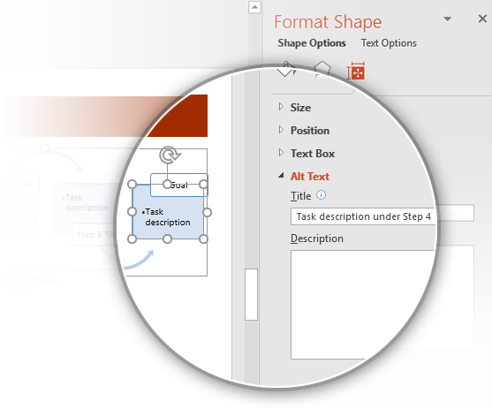
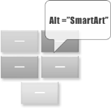
Alt Text Accessibility Rules – SmartArt
Alt text should be added to SmartArt diagrams on both grouped and sub-grouped objects. For grouped objects, only add alt text in the Description field. For sub-grouped objects, only add alt text in the Title field. Here are some alt text examples for SmartArt diagrams:
1
Text example for a grouped SmartArt diagram:
“Alternating Flow diagram showing 3 groups arranged from left to right with a title and bullet points in each group and a curved arrow showing the flow from one group to the next.”
To add alt text to a grouped SmartArt diagram, right click on the diagram and select Format Object > Size & Properties > Alt Text > Description
1
2
Text example for a sub-grouped SmartArt object:
“Task description under Step 4”
To add alt text for grouped objects inside of SmartArt diagrams, right click on the object and select Format Object > Size & Properties > Alt Text > Title
Learn more about adding alt text to SmartArt graphics
2

Slide 9
Unclear or non-descriptive links
An example of an unclear or non-descriptive link is writing, "click here" as the text to describe a link to access content or a course component. Screen readers identify the links on the page. Therefore, when scanning the page, "click here" does not have any meaning or context.
This:
https://support.zoom.us/hc/en-us/articles/207279736-Getting-Started-with-Closed-Captioning
Should be changed to:
How to Caption Zoom Videos

Slide 10
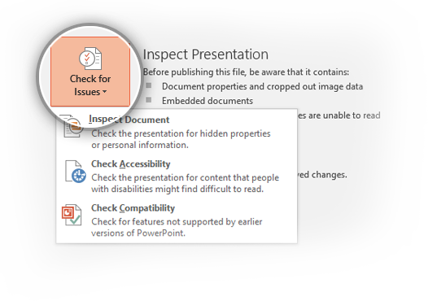
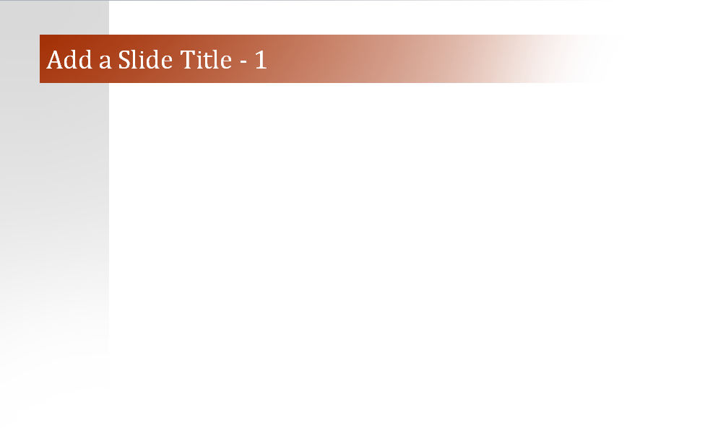

Basic Accessibility Rules
1
The Accessibility Checker should pass without errors on accessible templates. To run the Accessibility Checker, go to File > Check for Issues > Check Accessibility.
2
Every slide needs a unique title. You can use the text "Add a Slide Title - 1“ if you don’t have a specific title, and then you can increase the number for every slide.
1
2
Learn more about using the Accessibility Checker
Learn more about using unique slide titles

Slide 11
Captioning Videos
How to Caption Using Stream:
See CTL homepage: www.shepherd.edu/ctl2

Slide 12
Resources!
Usability
Usability 101: Introduction to Usability by Jakob Nielson (January 4, 2012) is a good article that explains the basics of usability and provides the what, when, how, why, and where for web usability.
Universal Design for Learning
National Center on Universal Design for Learning - Learn about UDL and the three principles that "help educators prepare learners for a lifetime of learning."
CAST is a non-profit research and development organization working to expand learning opportunities for all individuals through Universal Design for Learning.
Readability
Font Readability - WebAIM
Color Contrast Checker – WebAIM
Accessibility
WebAim - Web Accessibility in Mind. Their mission is to "empower organizations to make their web content accessible to people with disabilities." The site contains tutorials to help you learn how to make web content accessible.
Web Accessibility Initiative - The mission of the Web Accessibility Initiative (WAI) is to "lead the Web to its full potential to be accessible, enabling people with disabilities to participate equally on the Web." THE WAI "develops guidelines regarded as the international standard for Web accessibility." You can find support materials and resources at the site to help you implement web accessibility.
Voluntary Product Accessibility Template - (VPAT) files document how technologies comply with Section 508 Standards of the Rehabilitation Act. If you are thinking about adopting a new technology, it will be very important for you to discover how well it complies with Federal guidelines so that learners with motor, visual, hearing, or cognitive impairments can use the technology. VPATs or Accessibility Statements are typically published by hardware and software developers like Microsoft , Apple, Adobe, etc. Web-based products and services like YouTube or Twitter typically publish "accessibility statements" or provide a list of features to help impaired learners use their technologies.

