Slide 1
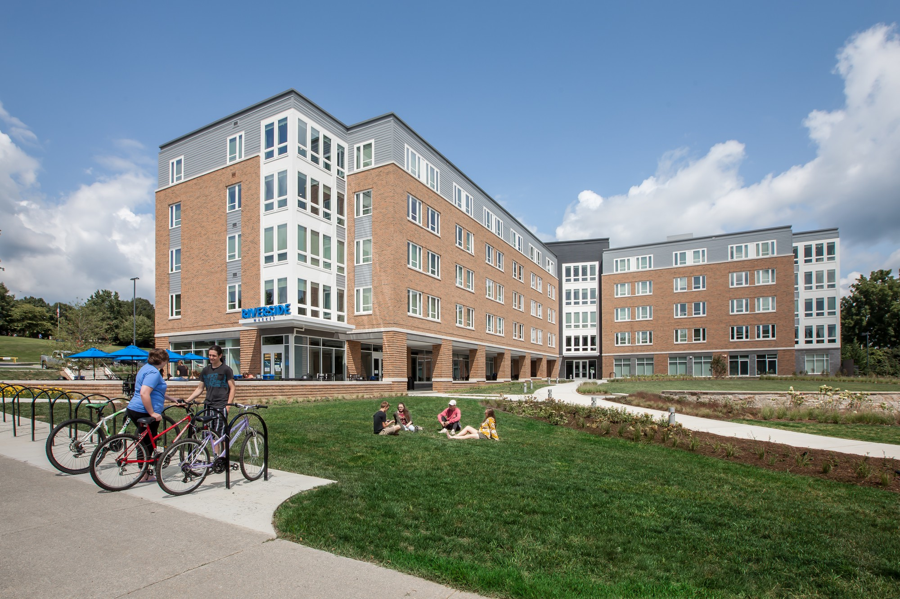
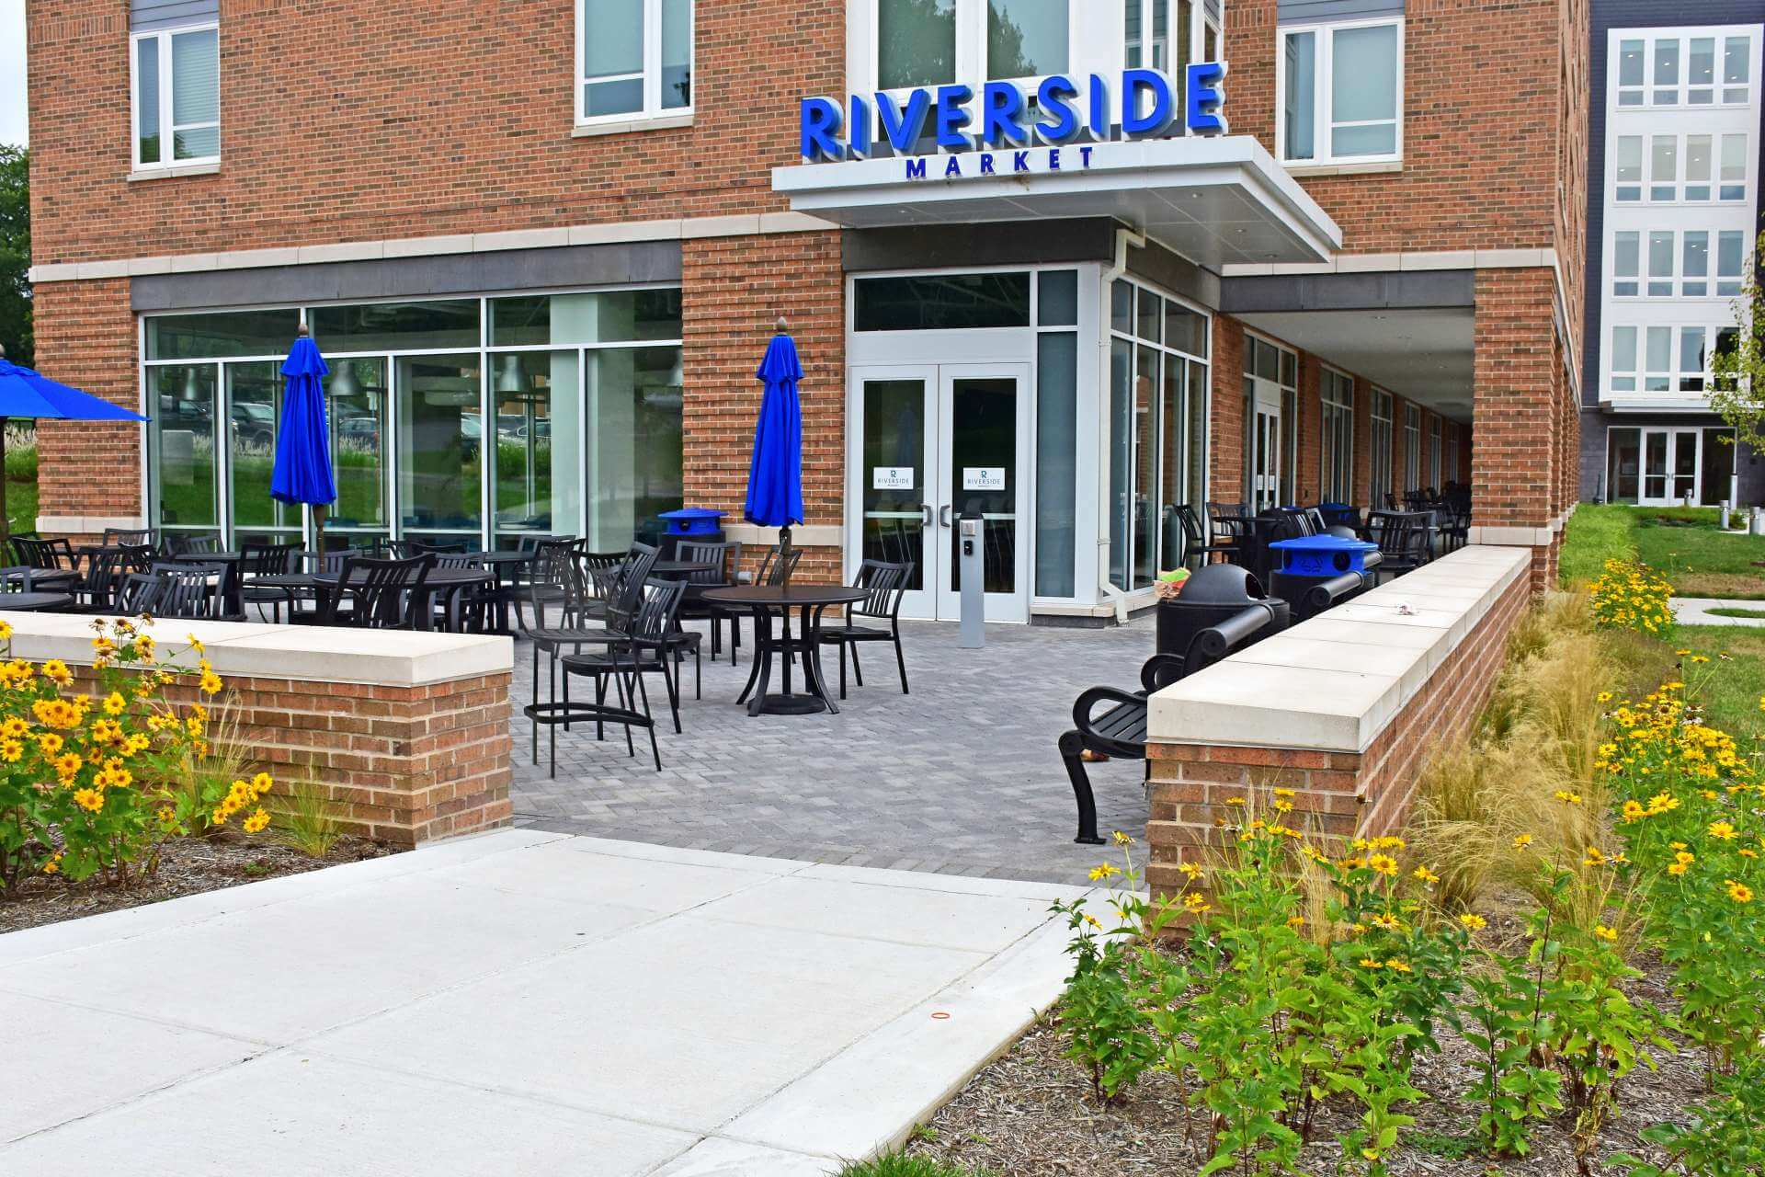
Campus Services
Bookstore/Dining Services/Rambler Card/Residence Life/
Student Center/Wellness Center Annual Report for Fiscal Year 2019

Slide 2
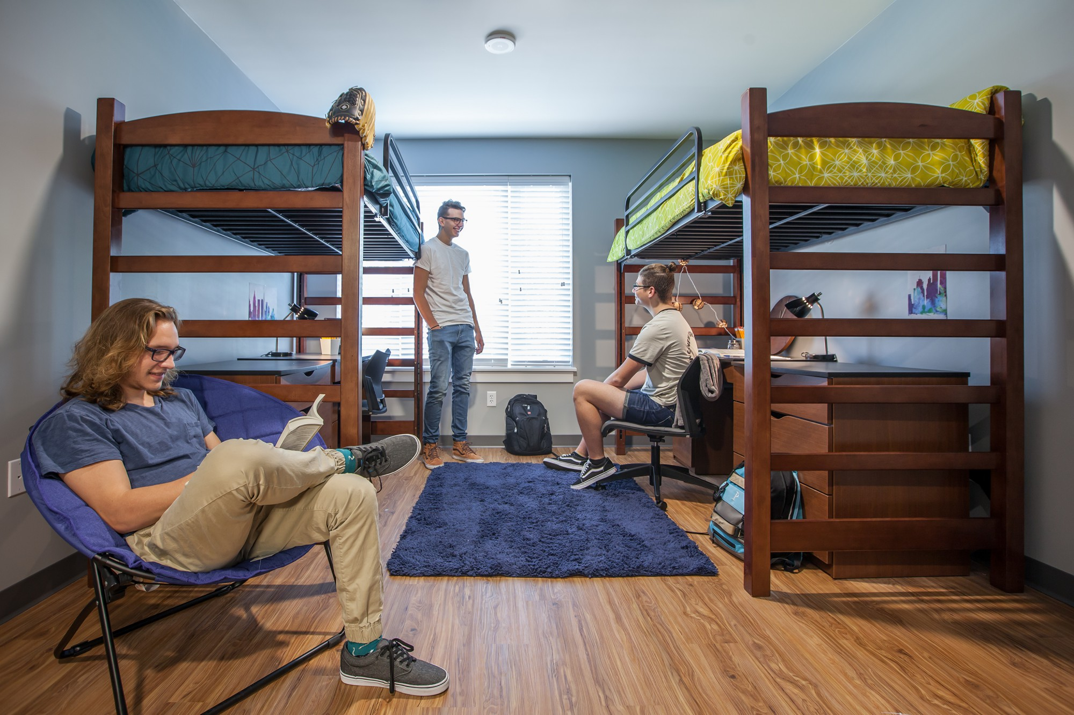
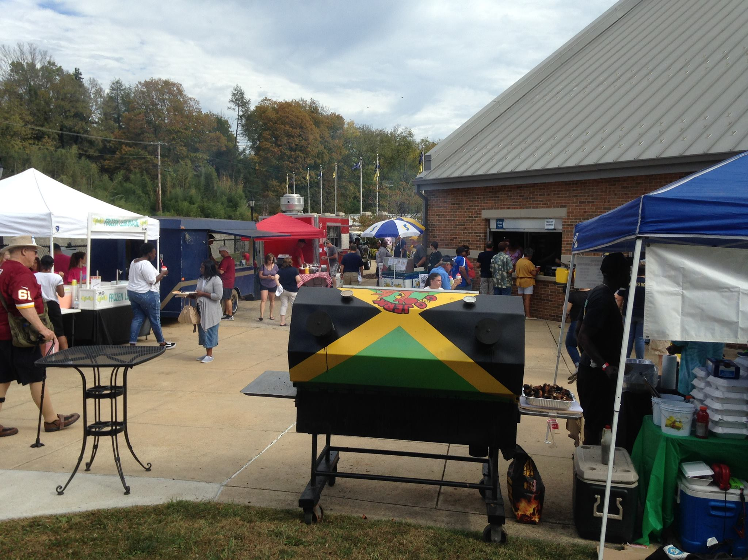
2019 Financial Overview
$10,623,868 Total Revenue
2019 Highlights
Began foodservice contract with Chartwells in July, 2018. Chartwells installed a “We Proudly Brew” Starbucks into the Fireside Bistro over fall, 2018.
Installed new hard surface flooring in Shaw Hall over summer, 2018 and Thacher Hall over summer, 2019.
$ 5,598 Cost of Goods Sold
$ 2,529,544 Personnel Expenses
$ 8,647,488 Operating Expenses
$11,182,630 Total Expenses
$ (558,762) Net Income
$ (724,480) Capital Purchases
$ 532,590 Potomac Place Ground Rent and Reserves
$ (804,891) Cash Flow
$ ( 54,239) Transfers Student Refunds
Hosted over 4,000 guests over summer, 2019.
Completed renovations to Bookstore over summer, 2018. Added new online gift features through the Shepherd athletic web page.
Began planning for new Inclusive Access course delivery model to launch in fall, 2019.

Slide 3
Yearly Recap
Auxiliary revenues, as shown on income statements, are down $1.8 million from year prior, due to transition to contracted services in the Bookstore (Follett) and dining services (Chartwells) and how revenue is accounted for Potomac Place. Adding back Potomac Place rental revenue ($1.9M) places overall Auxiliary revenue slightly above year prior. Potomac Place net revenue is shown as “ground lease” revenue to Auxiliary reserves at the end of the year (after SUFSO audits complete). Labor and COGS were down from the transition to contracted services. Operational expenses were up mostly in non-discretionary areas such as “Waivers” and in contractual payments to Chartwells for board plan services.

Slide 4
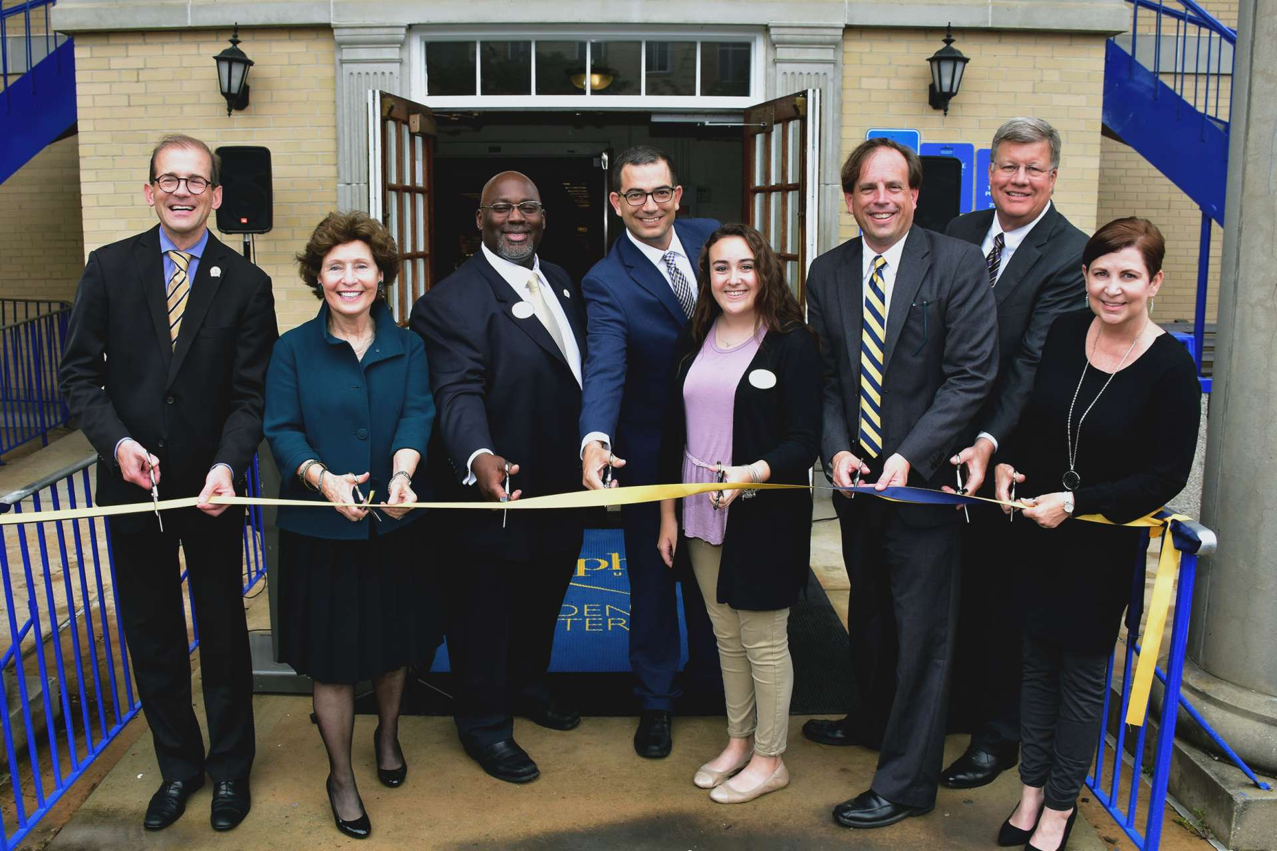
Bookstore
Revenue
2018
2019
$ 87,045
Personnel Expense
Cost of Goods Sold
Operating Expenses
Total Expenses
Net Income
$ 1,165,500
2017
$ 1,489,018
$ 253,682
$ 933,610
$ 122,843
$ 1,310,135
$ (144,635)
$ 250
$ 35,102
$ 51,943
$ 0
$ 307,141
$ 1,026,407
$ 159,059
$ 1,492,607
$ (3,589)
$ 34,852
The bookstore renovation began on July 23, 2018 and was completed on August 8, 2018. Textbooks were received and ready before classes began on August 27, 2018.
The Shepherd Bookstore Grand Opening was on September 25, 2018. The bookstore had giveaways, specials, and a ribbon cutting ceremony in front of the Student Center.
Michelle Bane has taken a position with Procurement Services. Michelle’s last day with the bookstore was May 24, 2019.
Follett began “on demand” on-line sales direct shipped to customers ordering on athletic web page.
Shepherd University Bookstore first full year with Follett financials:
Sales: $1,091,746
Net Profit: ($42,439)
Net Profit Budget: ($83,413)
FHEG Allocation to Shepherd - $85,800

Slide 5
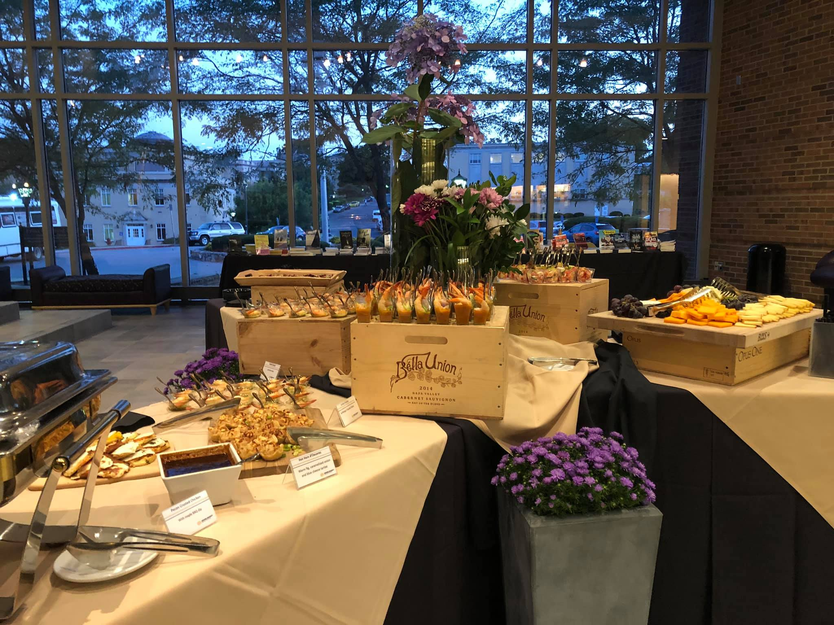
Dining Services
Revenue
2018
2019
$ 3,166,831
Personnel Expense
Cost of Goods Sold
Operating Expenses
Total Expenses
Net Income
$ 3,627,982
2017
$ 3,727,812
$ 1,510,074
$ 1,267,622
$ 772,896
$ 3,550,592
$ 177,220
$ 1,482,310
$ 1,256,538
$ 924,953
$ 3,663,801
$ (35,819)
$ 117,081
$ 1,094
$ 2,990,289
$ 58,367
$ 3,108,464
Chartwells began operations at Shepherd in July, 2018.
Shepherd alum, Mr. Keith Crockett, was selected as the Director of Dining Services.
Ms. Marcey Clemence stayed with the Dining Services as our Catering Director, transitioning to Chartwells payroll.
Six Shepherd staff remained on the university payroll for post retirement benefits purposes.
Meal plan participation for the year was 61.3%, down 10% points from year prior.
Chartwells renovated the Fireside Bistro over fall, 2018 and opened a “We Proudly Brew” Starbucks in late November.
Rotating menus were used in the Riverside Bistro including: Tu Tacos and a BBQ concept

Slide 6
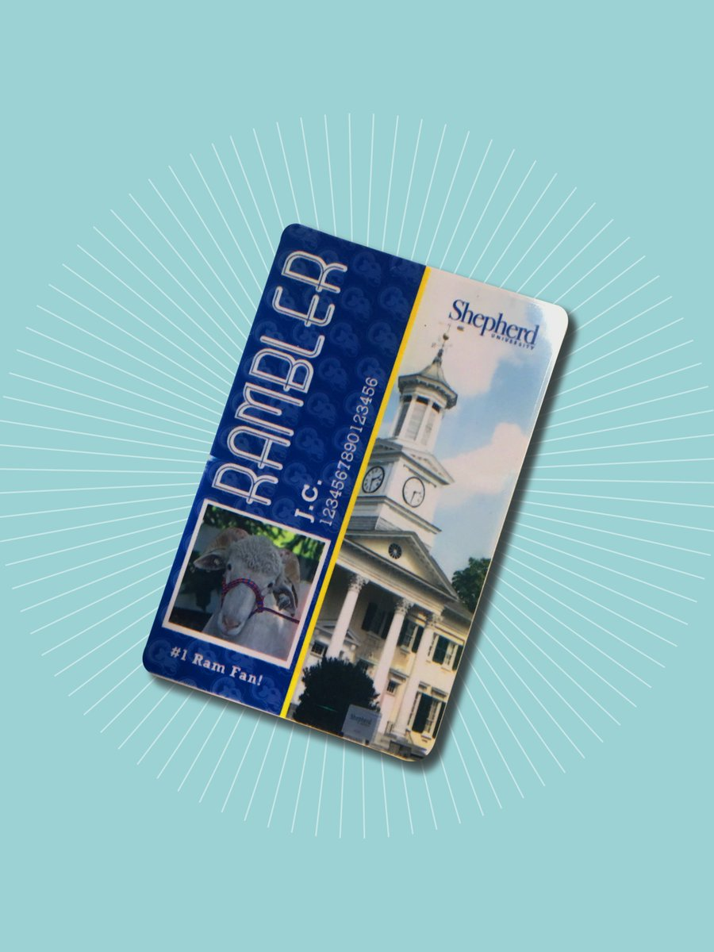
Rambler Card
Revenue
2018
2019
Personnel Expense
Cost of Goods Sold
Operating Expenses
Total Expenses
Net Income
$ 155,692
$ 44,410
$ 91,963
$ 19,319
2017
$ 162,639
$ 40,824
$ -
$ 82,805
$ 123,629
$ 39,010
$ 19,199
$ -
$ (140,666)
$ 159,865
$ 101,518
$ -
$ 136,373
$ 58,347
Increased speed of access to residential living spaces by incorporating student data import actions in the Rambler card replacement process.
Assisted with the integration of Shepherd University’s new dining services partner, Chartwells, by providing technology support and staff training.
Supported High School Dual Enrollment with dedicated card production events.
Modified ID card creation process to support a one-day Orientation Step 1 experience for new students.

Slide 7
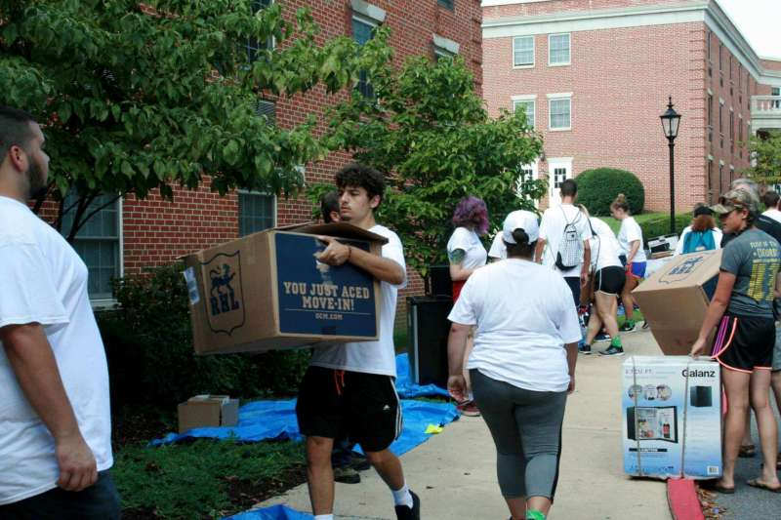
Residence Life
Revenue
2018
2019
Personnel Expense
Cost of Goods Sold
Operating Expenses
Total Expenses
Net Income
$ 3,955,011
$ 1,362,709
2017
$ 5,534,064
$ 1,532,158
$ 64,307
$ 3,800,676
$ 5,397,141
$ 136,923
$ -
$ 3,847,243
$ 5,209,952
$ (1,254,941)
$ 1,028,207
Does not includes conference services data
Includes conference services data
$ 4,068,958
$ 1,457,518
$ -
$ 3,411,930
$ (800,490)
$ 532,590
$ 4,869,448
Potomac Place Ground Rent and Reserves
Does not include conference services data
Transfer of Funds to cover student refunds paid
$ ( 54,239)
Replaced aged carpeting in Shaw Hall rooms (150 residents) with LVP laminate flooring to promote reduced-allergen environment.
Offered 207 residence hall programs, on topics such as alcohol and other drugs, community development, diversity and inclusion, and healthy relationships.
Actively participated in summer Conference Services to yield the highest level of revenue on record.
New and returning students began applying for student housing by November 27, 2018 through the Good Living portal – the earliest this opportunity has been offered.

Slide 8
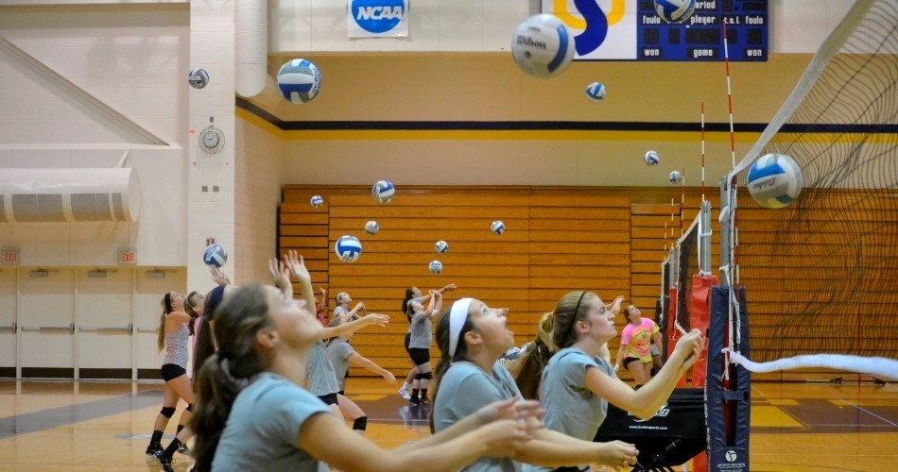
Conference Services
Revenue
2018
2019
$ 106,309
Personnel Expense
Cost of Goods Sold
Operating Expenses
Total Expenses
Net Income
2017
Incorporated into residence life data
$ 191,525
$ 55,343
$ 1,516
$ 0
$ 12,972
$ 14,488
$ 91,821
$ 16,033
$ 29,555
$ 100,931
$ 90,594
Created two new multi-year conference partnerships with Youth and Adult Running Camps hosted by the Eastern Area Health Education Center and the 6-week Upward Bound Academy.
Improved the on-campus experience for conference groups with new informational and directional signage and a 24x7 on-call support number.
Updated Conference Services web page to include imagery and information about our flagship conference venues and self-service information request forms.
Signed year-long space rental agreements with two outside organizations.

Slide 9
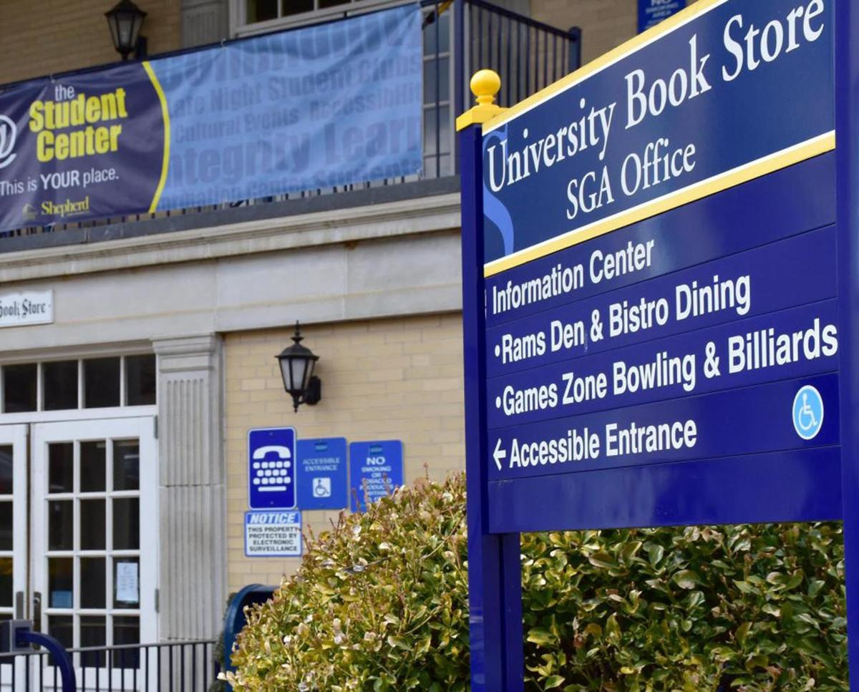
Student Center
Revenue
2018
2019
$ 846,621
Personnel Expense
Cost of Goods Sold
Operating Expenses
Total Expenses
Net Income
$ 204
$ 885,824
$ 237,807
$ 242,922
$ 480,933
$ 404,891
2017
$ 900,328
$ 318,709
$ -
$ 231,820
$ 550,529
$ 349,799
$ 132
$ 257,598
$ 483,377
$ 363,244
$ 225,647
Summer 2018- Asbestos abatement of all 1st and 2nd level ceilings and floors. Storer Ballroom Ceiling abated and replaced over December 2018.
New ceiling tiles, Carpet were installed in all offices, meeting rooms (except Cumberland), lobbies, Games Zone Billiard area, Rams Den, Fireside Bistro, and hallways.
Chartwells renovated the Fireside Bistro complete with new serving line, equipment, finishes, and soft furniture in fall 2018 for a Starbucks “We Proudly Brew” operation.
Two new energy efficient propane boilers were installed in late fall to replace the 1961 and 1973 original oil fired boilers.
Don Rohel, Student Center Director for more than 17 years retired on May 24th, 2019. Nicholas Mummert became the Student Center Operations Manager on May 28th, 2019.

Slide 10
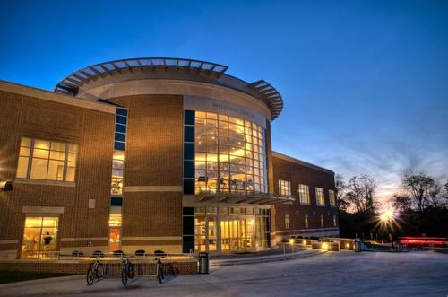
Wellness Center
Revenue
2018
2019
$ 2,328,905
Personnel Expense
Cost of Goods Sold
Operating Expenses
Total Expenses
Net Income
$ 5,577
$ 2,474,839
$ 658,101
$ 1,834,428
$ 2,498,106
$ (23,267)
2017
$ 2,532,707
$ 641,812
$ 9,673
$ 1,906,622
$ 2,558,107
$ (25,400)
$ 634,583
$ 4,372
$ 1,872,931
$ 2,511,886
$ (182,981)
Completed turnover of entire management team (all Coordinators and Director) from July 2018 to August 2019.
Reduced operational expenses by $73K.
Lowered Staffing expenses by $24K even as Wellness Budget absorbed an increase of $29K of expenses of Administrative staff.
Discounted all Shepherd Staff and Faculty membership from $21 per month to $15 per month.
Membership sales began incurring 6% tax (without an increase to fee) reducing net sales.
Mr. Jim Sweeney resigned his position over summer, 2019 to relocate to Tampa, FL. Mrs. Jennifer Flora was hired to fill the vacant Director position and started in late August, 2019.

Slide 11
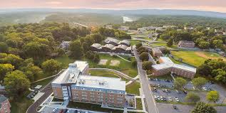
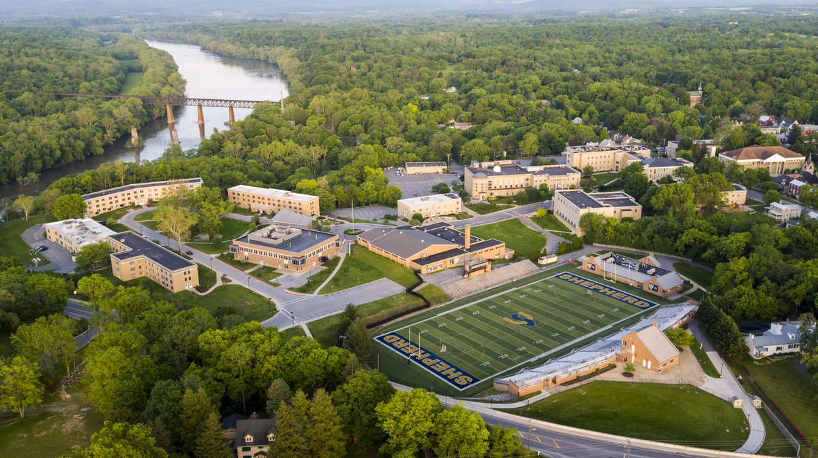
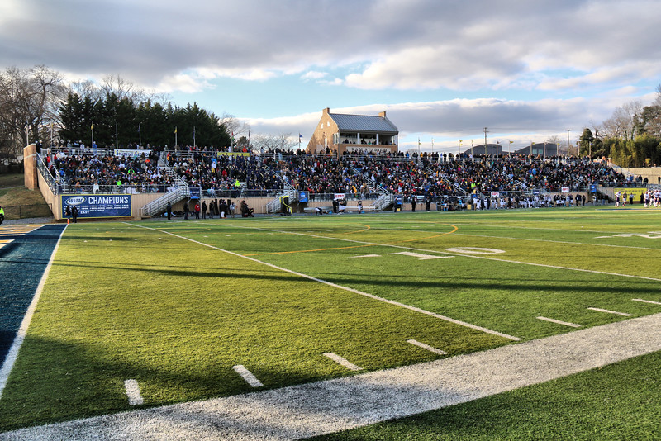
Shepherd University Auxiliary Team
Jack Shaw Vice President for Campus Services
Residence Life Liz Sechler
Wellness Center Jim Sweeney
Student Center Don Rohel
Rambler Card Office and Conference Services Traci Morris
Administrative Support Jo Mullikin Sharika Abdul-Muhaimin
Dining Services Keith Crockett (Chartwells)
Bookstore Tina Miller (Follett)

