Slide 1
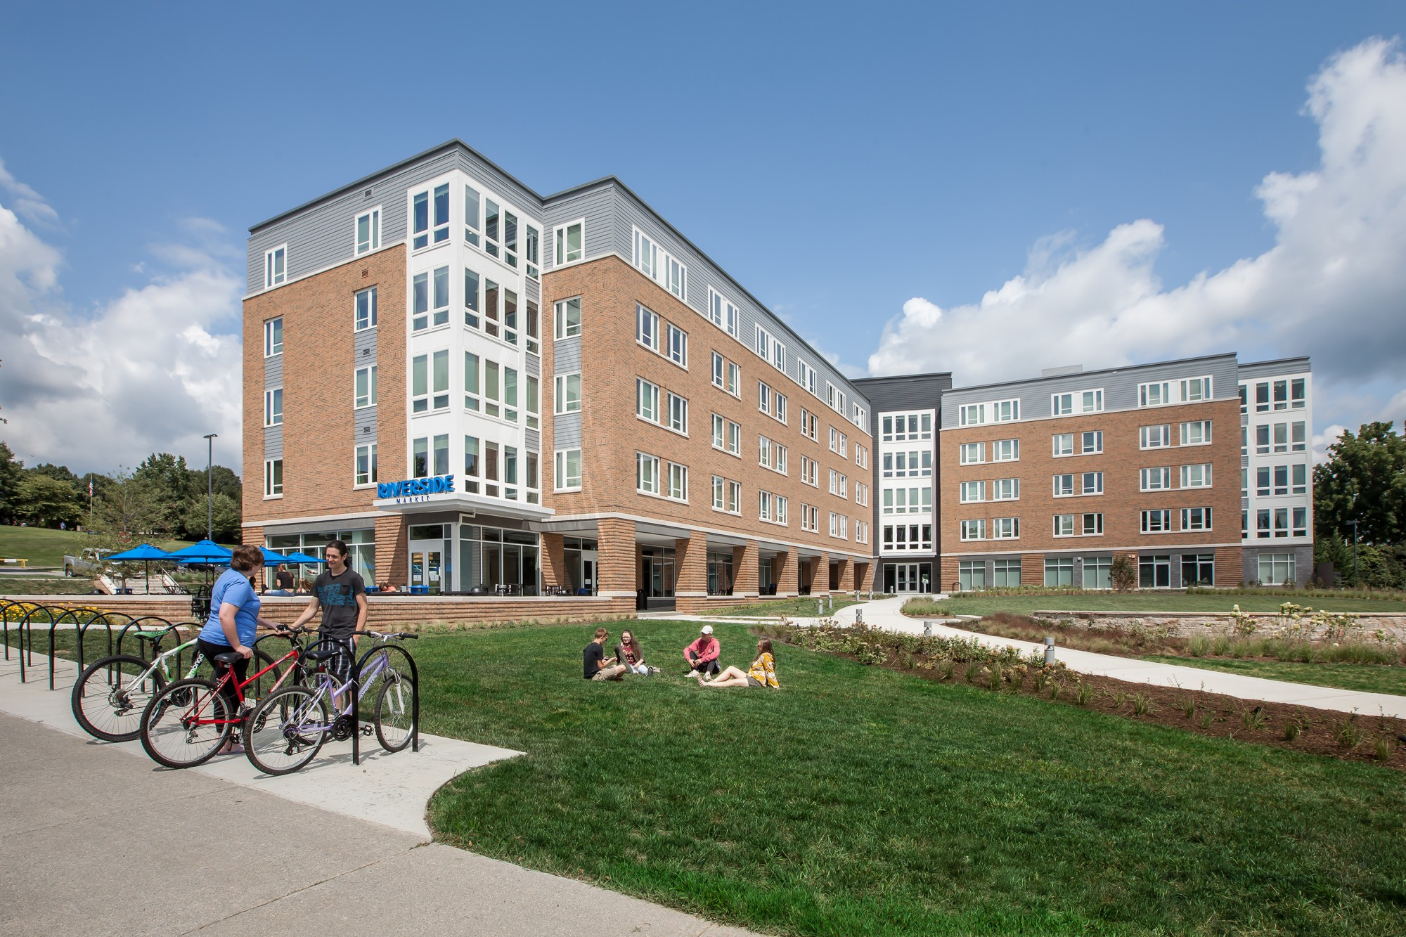
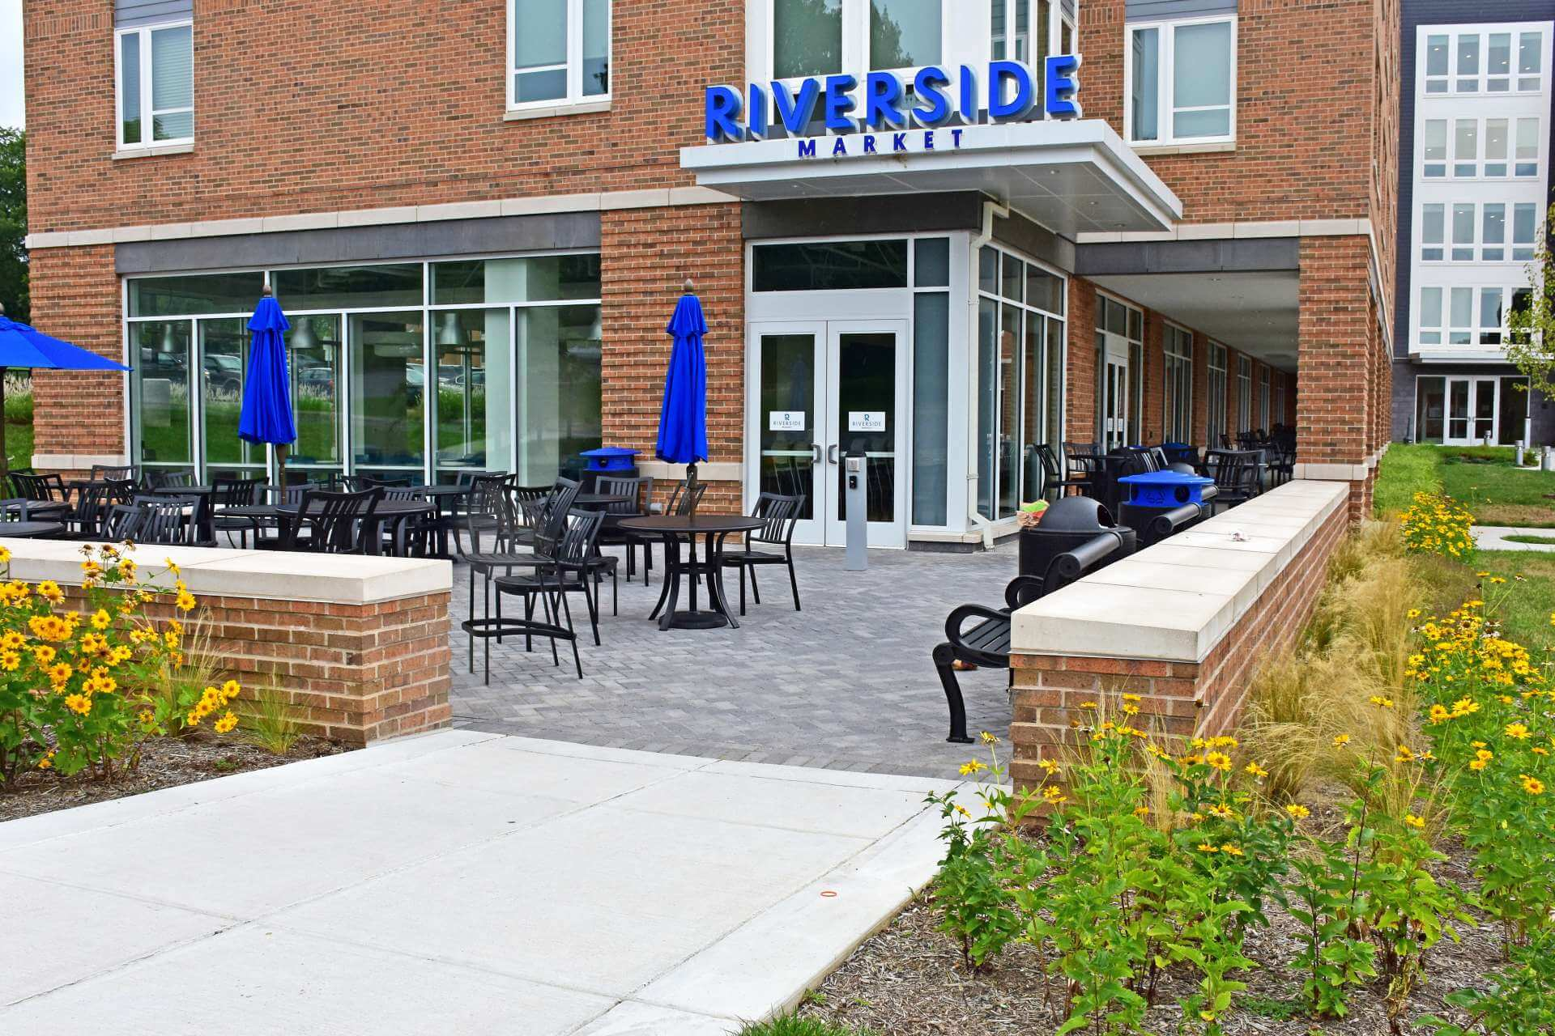
Auxiliary Enterprises
Bookstore/Dining Services/Rambler Card/Residence Life/
Student Center/Wellness Center
Annual Report for Fiscal Year 2018

Slide 2
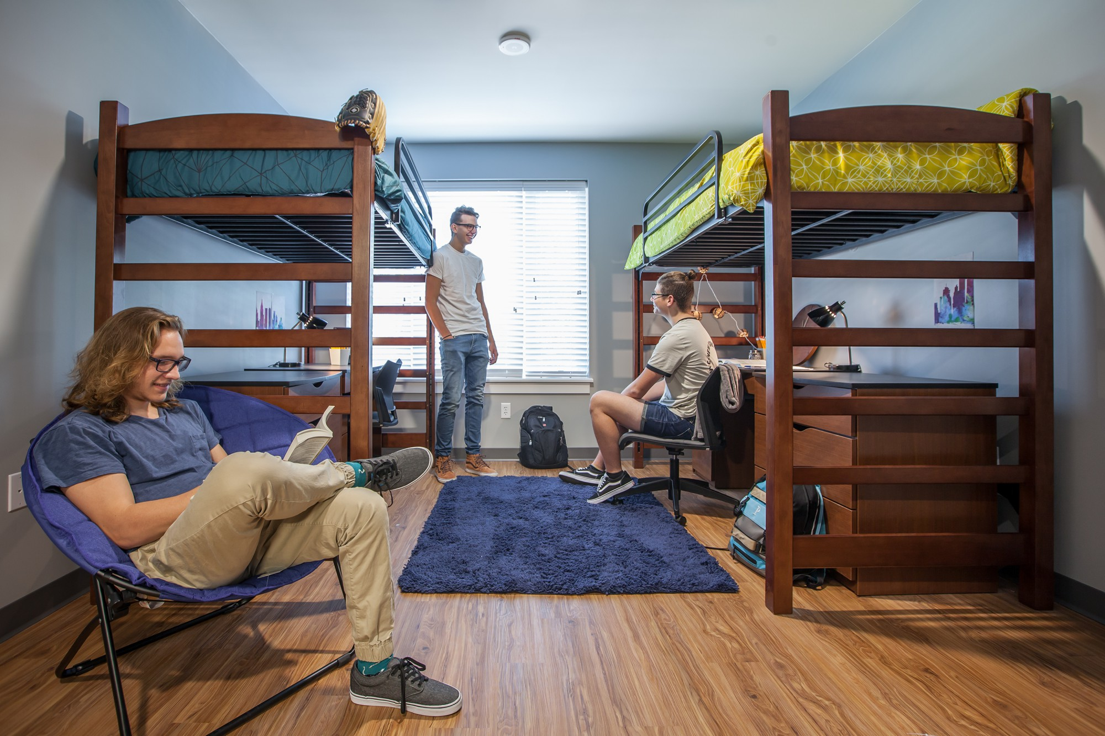
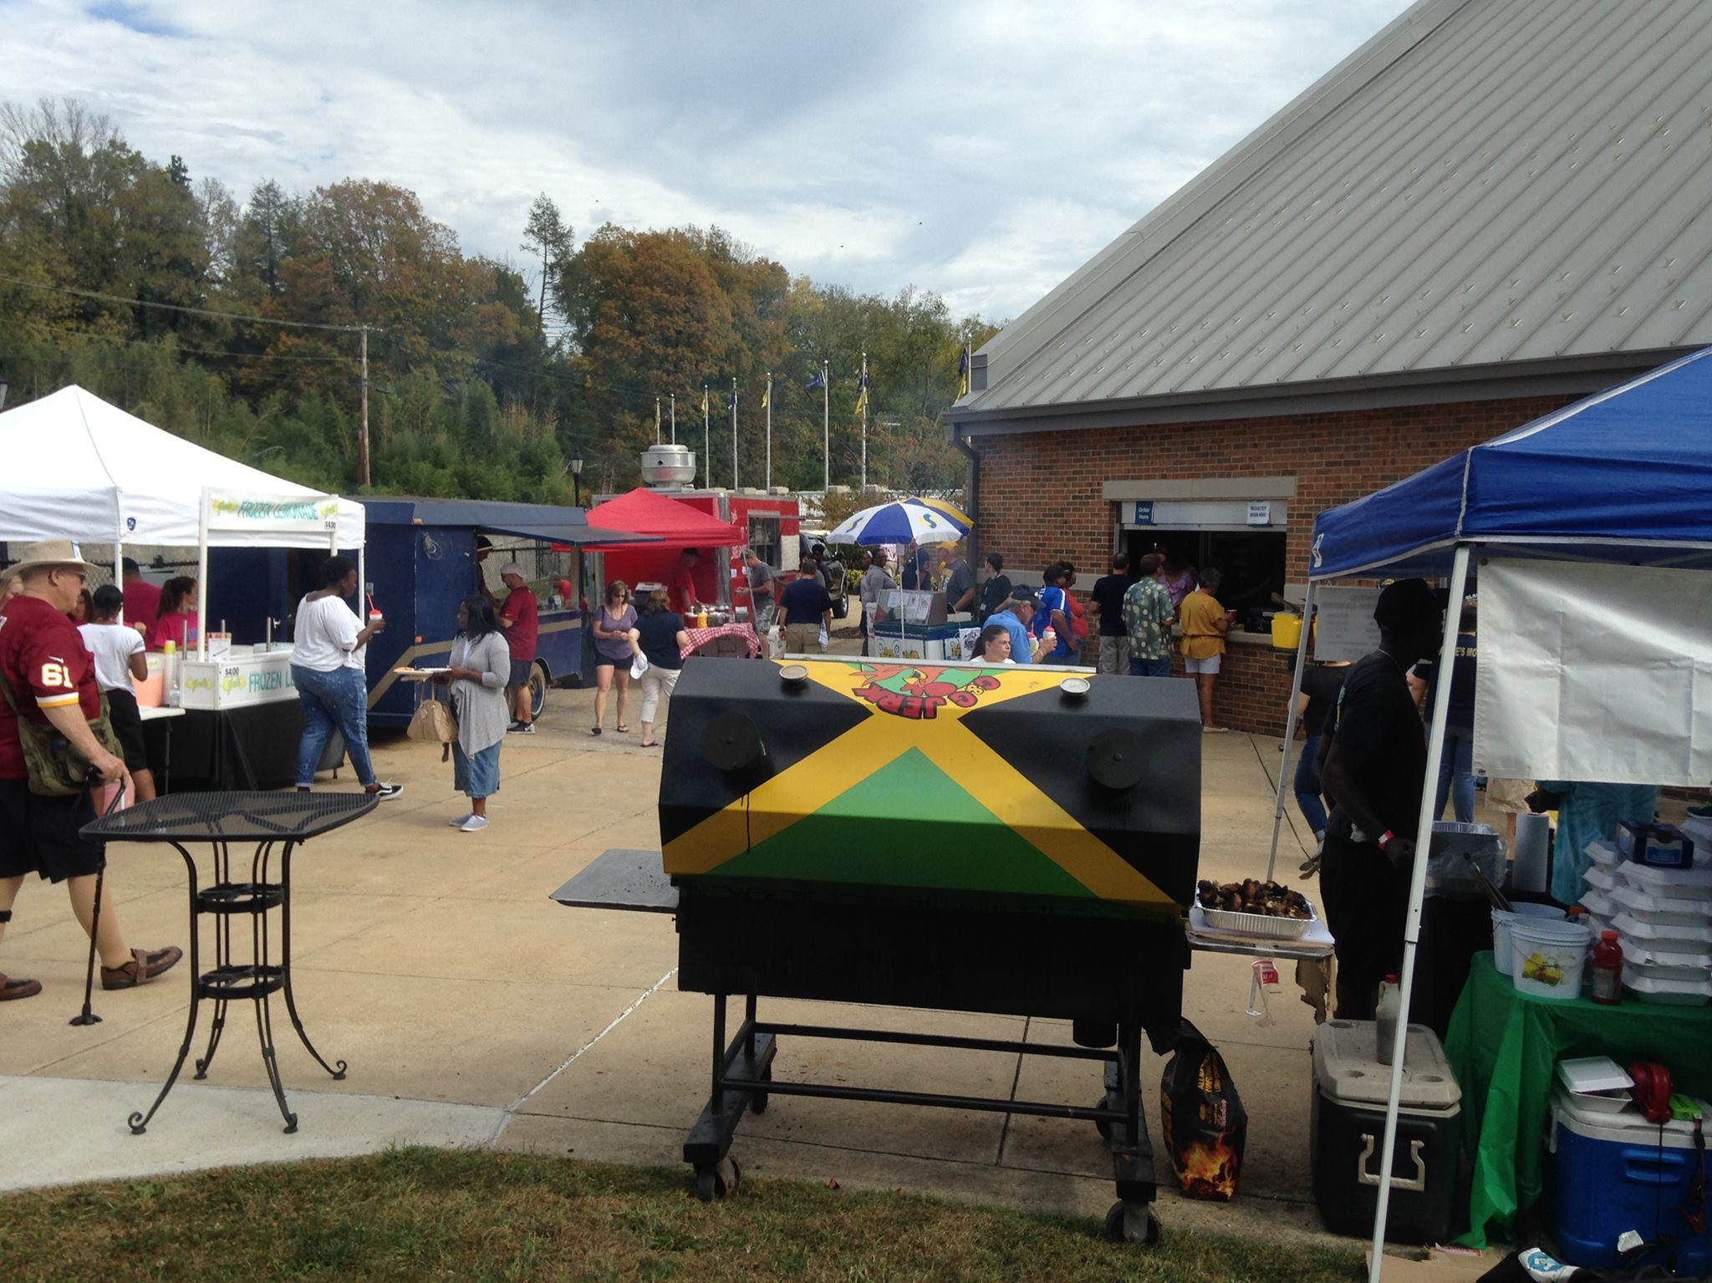
2018 Financial Overview
$12,456,373 Total Revenue
2018 Highlights
Opened Potomac Place and Riverside Market in fall, 2017.
Issued RFP to outsource Bookstore in fall. Chose Follett as partner and transited to leased operations in March, 2018. Follett began renovations to store in summer, 2018.
$ 2,251,272 Cost of Goods Sold
$ 4,055,052 Personnel Expenses
$ 7,093,907 Operating Expenses
$13,400,231 Total Expenses
$ (943,858) Net Income
$ (662,503) Capital Purchases
$ 1,028,207 Potomac Place Ground Rent and Reserves
$ (578,154) Cash Flow
Issued RFP to outsource Dining Services in January, 2018. Selected Chartwells to begin serving campus in FY19. Chartwells to add a “We Proudly Brew” Starbucks to Fireside Bistro in fall, 2018.
Merged Rambler Card operations into Wellness Center to expand card support to patrons.
Traci Morris took over supervision of Conference Services over summer, 2018.
Replaced roof at Shaw Hall.
Completed flooring and ceiling tile replacement at Student Center.

Slide 3
Yearly Recap
Auxiliary revenues are shown (on income statements) as down $1.8 million from year prior. However, adding back Potomac Place rental revenue ($1.9M) places overall Auxiliary revenue slightly above year prior. Potomac Place net revenue is shown as “ground lease” revenue to Auxiliary reserves at the end of the year (after SUFSO audits complete). Labor and COGS were down slightly from year prior. Operational expenses were up mostly in non-discretionary areas such as “Waivers” which led to a reduction in net revenue.

Slide 4
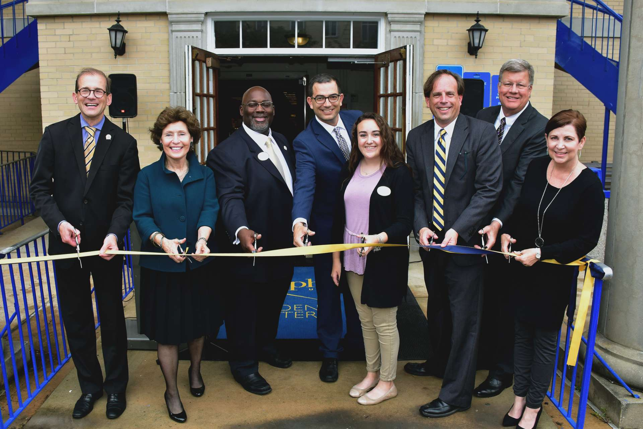
Bookstore
Revenue
2017
2018
$ 1,165,500
Personnel Expense
Cost of Goods Sold
Operating Expenses
Total Expenses
Net Income
$ 1,489,018
2016
$ 1,704,951
$ 310,805
$ 1,199,550
$ 170,476
$ 1,680,831
$ 24,120
$ 307,141
$ 1,026,407
$ 159,059
$ 1,492,607
$ (3,589)
$ 253,682
$ 122,843
$ 1,310,135
$ (144,635)
$ 933,610
Bookstore transitioned to Follett on March 15, 2018. All Shepherd bookstore employees were hired by Follett.
$47,072 of COGS direct result of inventory written off at Follett transition.
Renovation of the bookstore began July 23, 2018 and was completed on August 8, 2018.
Grand opening and ribbon cutting ceremony took place on September 25, 2018. The S.U.B. offered refreshments, giveaways, and discounts during the event.
The S.U.B. participated in the Art Teachers Conference on October 27 and 28, 2018 by having a table present in the art suppliers fair. The S.U.B offered samples of art supplies from Dick Blick, Utrecht, and Art Supply Warehouse that were handed out to the art teachers attending the conference. The S.U.B also donated the name tags and lanyards to the Shepherd University Art Department for all attendees.

Slide 5
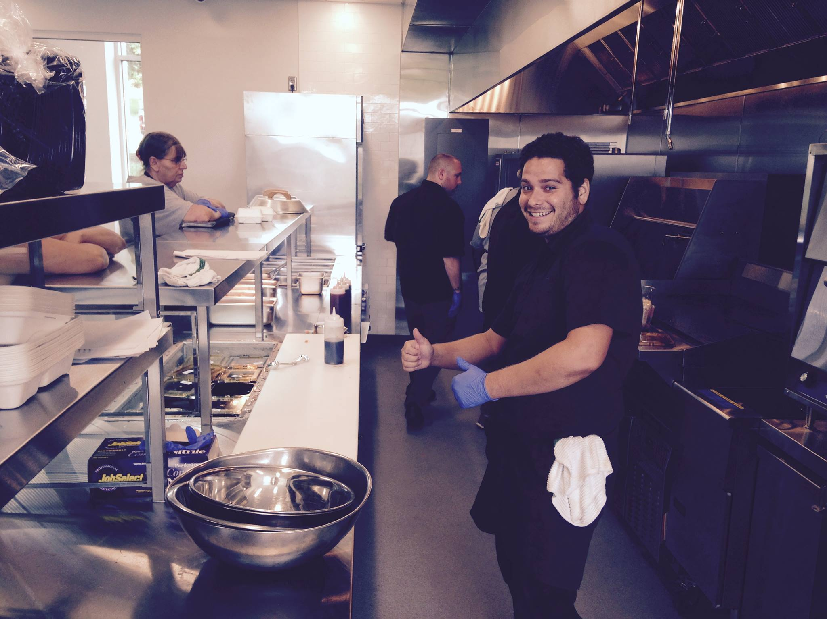
Dining Services
Revenue
2017
2018
$ 3,627,982
Personnel Expense
Cost of Goods Sold
Operating Expenses
Total Expenses
Net Income
$ 3,727,812
2016
$ 4,277,680
$ 1,557,690
$ 1,577,339
$ 809,338
$ 3,944,367
$ 333,313
$ 1,510,074
$ 1,267,622
$ 772,896
$ 3,550,592
$ 177,220
$ 1,482,310
$ 1,256,538
$ 924,953
$ 3,663,801
$ (35,819)
Overall dining participation was 71.74% for the year, down 1.5% points from year prior.
Retail operations served 83% of all board plan meals, up 20% points from year prior. Over the last five years board plan traffic has moved from 60:40 Dining Hall: Retail to the current large majority of traffic in retail operations.
Dining Services opened the Riverside Market (within Potomac Place) in August. The Market served as a convenience store (replacing the Ram Mart) as well as a quick service foodservice destination serving an Asian fusion cuisine that was identified by students as a preferred menu. Riverside Market is open 7 days/week offering a new dining option for students at dinner on the weekends.
The University issued an RFP to outsource dining services in January. Four companies (Alladin, Chartwells, Metz, and Sodexo) responded. Chartwells was selected as the new dining services partner and took over services on July 6, 2018.

Slide 6
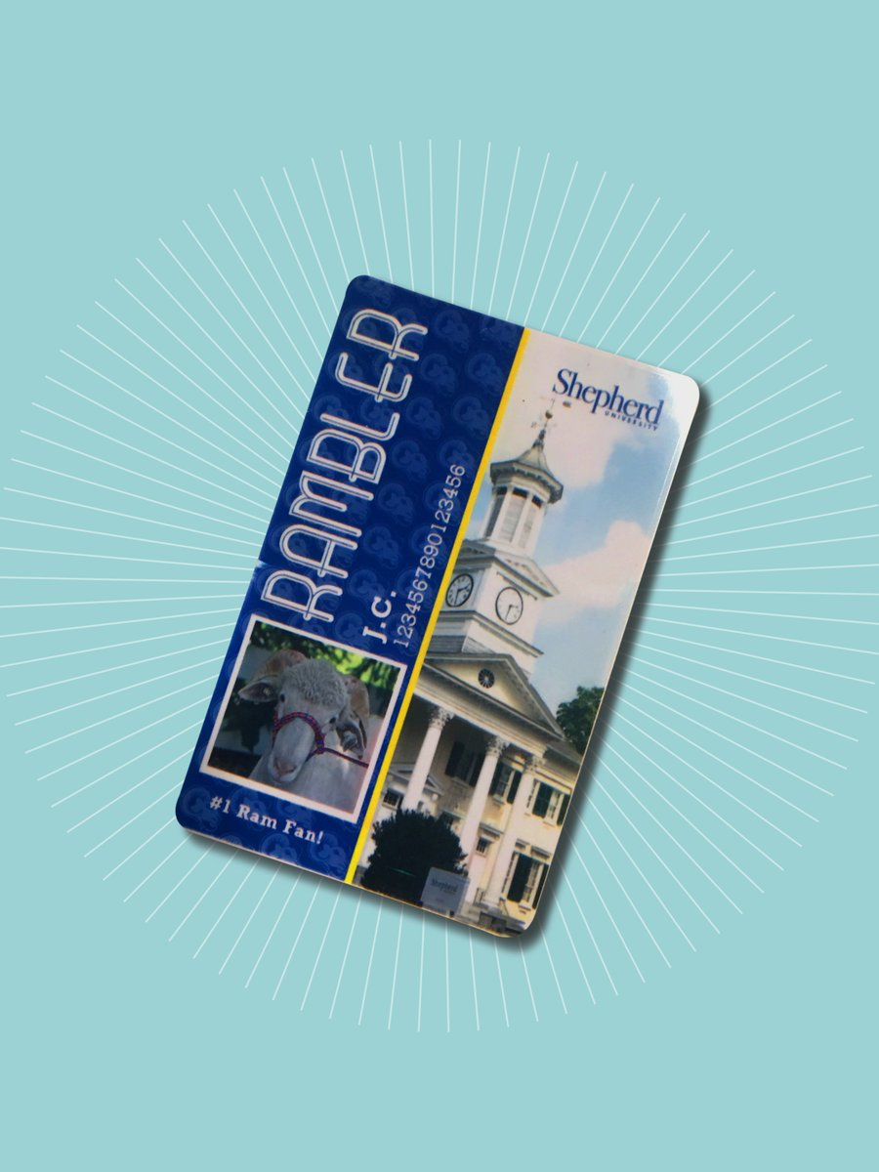
Rambler Card
Revenue
2017
2018
Personnel Expense
Cost of Goods Sold
Operating Expenses
Total Expenses
Net Income
$ -
$ 162,639
$ 40,824
$ 82,805
$ 123,629
$ 39,010
2016
$ 169,303
$ 42,109
$ -
$ 118,891
$ 161,000
$ 8,303
$ 155,692
$ 44,410
$ -
$ 19,319
$ 136,373
$ 91,963
Relocated to the Wellness Center, more than doubling our hours of operation to better serve our students.
Streamlined card replacement procedures for Residential students, providing quicker access to their living spaces.
Created badging solutions for campus retail partners, maintaining campus security while providing convenient access control methods and clear identification of partner staff.
Rolled out card-based meal accounting for summer conference groups, creating transparent accounting and invoicing for both Shepherd and visiting groups.

Slide 7
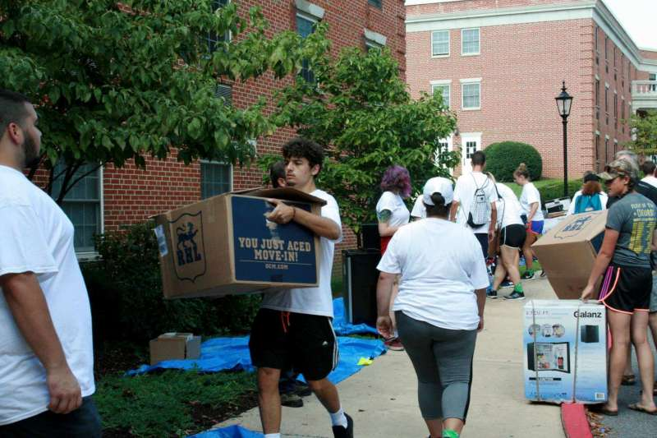
Residence Life
Revenue
2017
2018
Personnel Expense
Cost of Goods Sold
Operating Expenses
Total Expenses
Net Income
$ 5,534,064
$ 1,532,158
2016
$ 6,140,593
$ 1,533,709
$ 83,731
$ 3,748,222
$ 5,365,662
$ 774,931
$ 64,307
$ 3,800,676
$ 5,397,141
$ 136,923
Includes conference services data
Includes conference services data
$ 3,955,011
$ 1,362,709
$ -
$ 3,847,243
$ (1,254,941)
$ 1,028,207
Does not include conference services data
$ 5,209,952
Potomac Place Ground Rent and Reserves
Opened Potomac Place, a 296-bed, suite-style residence hall, on-time and on-budget.
Replaced aged carpeting in Thacher Hall rooms (150 residents) with LVP laminate flooring to promote reduced-allergen environment.
Offered 282 educational programs, on topics such as alcohol and other drugs, diversity and inclusion, and healthy relationships.
Implemented the “Good Living Portal” as a self-service housing software for students.
Increased on campus housing population by +7 over fall, 2016. Increased the percent of students who live on campus by +1.3% points (to 33.9%)

Slide 8
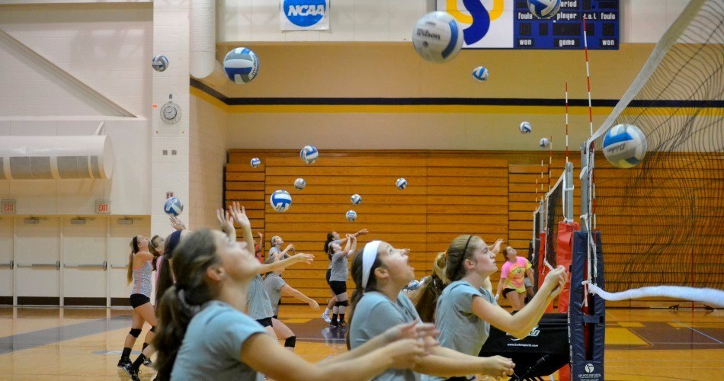
Conference Services
Revenue
2017
2018
$ 191,525
Personnel Expense
Cost of Goods Sold
Operating Expenses
Total Expenses
Net Income
Incorporated into residence life data
2016
Incorporated into residence life data
$ 16,033
$ 55,343
$ 29,555
$ 100,931
$ 90,594
In 2018 Conference Services hosted 32 groups, an increase from 25 groups in FY16 and FY17.

Slide 9
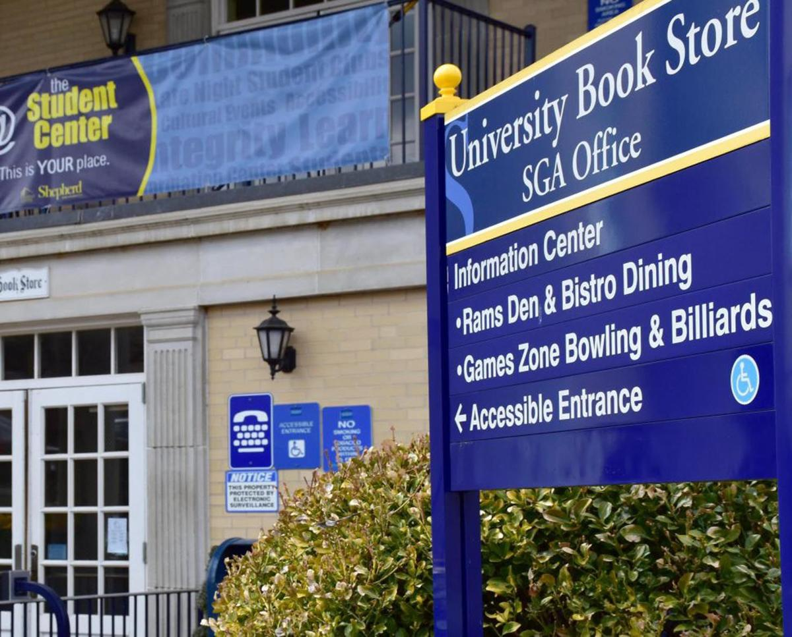
Student Center
Revenue
2017
2018
$ 885,824
Personnel Expense
Cost of Goods Sold
Operating Expenses
Total Expenses
Net Income
$ -
$ 900,328
$ 318,709
$ 231,820
$ 550,529
$ 349,799
2016
$ 935,574
$ 388,848
$ -
$ 234,305
$ 623,153
$ 312,421
$ 237,807
$ 204
$ 242,922
$ 480,933
$ 404,891
Information Center staffing adjusted saving $17,400 in Student Labor.
Games Zone allowed free use of bowling and billiards by all students and adjusted hours of operations to meet their needs resulting in additional savings in student labor.
Budget savings in multiple areas including full-time, part-time and student labor; utilities; janitorial supplies; and programs have helped to offset the budget cuts and revenue declines that have occurred in the past year.
Summer 2018 saw a very large investment in ceiling tile, lighting, and carpet replacement in the Student Center after an abatement of 1961 and 1973 materials occurred on the 1st and 2nd floors.

Slide 10
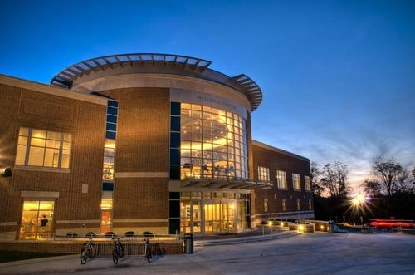
Wellness Center
Revenue
2017
2018
$ 2,474,839
Personnel Expense
Cost of Goods Sold
Operating Expenses
Total Expenses
Net Income
$ 9,673
$ 2,532,707
$ 641,812
$ 1,906,622
$ 2,558,107
$ (25,400)
2016
$ 2,493,315
$ 597,757
$ 6,544
$ 1,904,672
$ 2,508,973
$ (15,658)
$ 658,101
$ 5,577
$ 1,834,428
$ 2,498,106
$ (23,267)
Exceed year end external revenue over FY17.
Management labor cost savings due to reduced administrative staffing (Stover left in January).
New Wellness website launched.
Integrated Rambler operation into Wellness front desk with flex managers learning daily operations, nearly tripling hours of operation to students while decreasing operational costs.

Slide 11
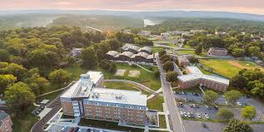
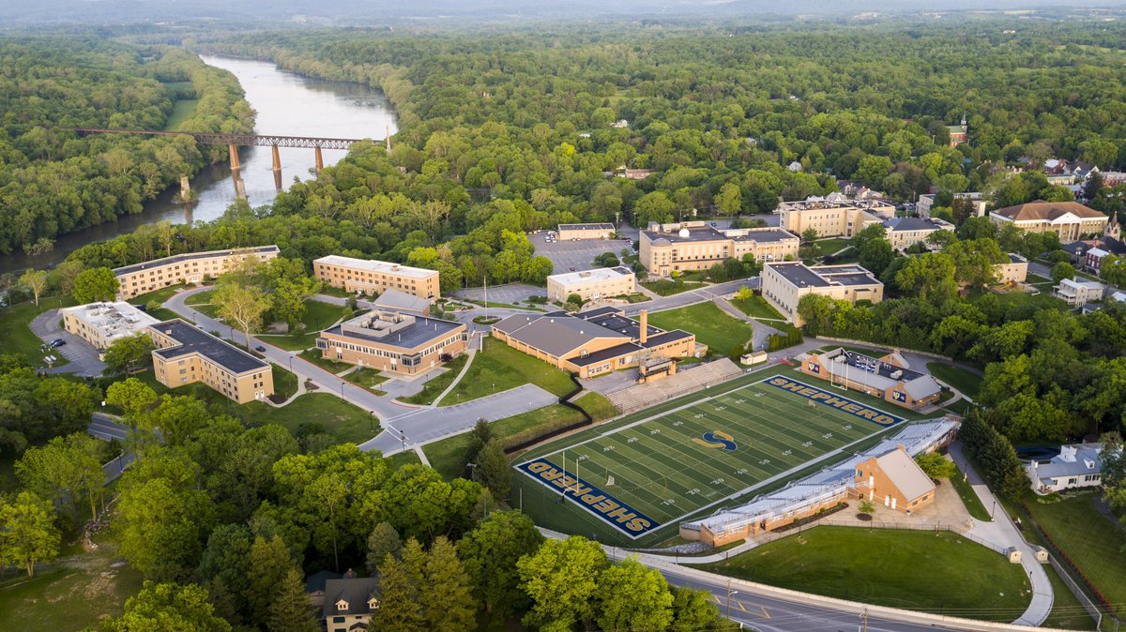
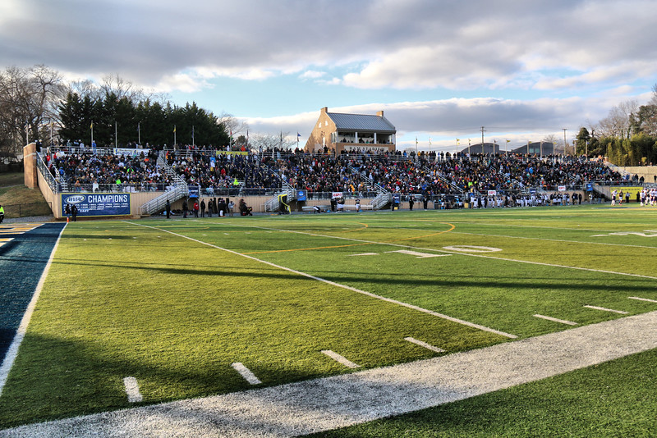
Shepherd University Auxiliary Team
Jack Shaw Interim Vice President for Campus Services
Residence Life Liz Sechler Robin Hosby Ellisa Woodbrey Tim Maggio
Wellness Center Jim Sweeney Jennifer Seeley Nick Mummert Josh Stover Brandi Drummond
Student Center Don Rohel Rachael Meads Michael Golze Christopher Matthias Elizabeth Hess
Rambler Card Office and Conference Services Traci Morris
Administrative Support Jo Mullikin Sharika Abdul-Muhaimin
Dining Services Brian Fletcher Marcey Clemence Lauren Mayer
Bookstore Tina Miller Julie Rohlfs Michelle Bane Vicki Mauzy

