Slide 1
The Gift of Wellness!

Slide 2
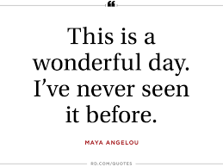
Gratitude

Slide 3
Gratitude Practices
3 Good Things
Write three things that happened over the course of your day that you are grateful for
Big or small occurrences
Optional; write more in-depth about one of these occurrences

Slide 4
Savoring The act of stepping outside an experience to review and appreciate it.
Talking to another person about how good it was/how good you felt
Looking for people to share it with
Thinking about what a lucky person I am!
Thinking about sharing this later with others.
Showing physical expressions of energy; laughing, giggling, jumping up and down with glee
Telling yourself how proud you are to have noticed or done this
Thinking only about the present; being totally absorbed

Slide 5
Thank you!
Write a thank you letter or letter of gratitude to someone who has helped you or has been especially kind to you but has never properly been thanked. Then, deliver that letter in person!

Slide 6
Sleepy Time
Restorative sleep helps to balance the brain and has a strong effect on our mood
Sleep schedule – make one and stick to it!
Relaxing bedtime rituals
Daily exercise
Evaluate your room…Dark? Quiet? Cool?

Slide 7
Living your longest life…
Aging well
Meditation practice
Wide social support
Close emotional and familial relationships
Good sleep with daily activity
Life-long curiosity
Willingness to undertake new challenges

