Slide 1
External Study Credit Granting with SurveyGizmo
Shepherd University
Department of Psychology

Slide 2
Introduction
Following are instructions for using the SurveyGizmo survey website with the Sona system in such a way that Sona users can click a link from your Sona study, take your survey on SurveyGizmo, then automatically return to Sona and receive credit. Note that if the SurveyGizmo interface changes, these instructions may become obsolete.
http://www.surveygizmo.com/

Slide 3
1a
Go ahead and create your survey in SurveyGizmo. While viewing your survey, you can click on the Share tab to get the URL (web link) to your survey. You will use this in Sona, but add “?scode=%SURVEY_CODE%” (without quotes) to the end. So if the SurveyGizmo URL is: http://www.surveygizmo.com/s3/12345/my-survey then change it to http://www.surveygizmo.com/s3/12345/my-survey?scode=%SURVEY_CODE%
When you set up your external survey study in Sona, this is the URL you will paste into the “Study URL” field (under Advanced Settings).
When your participant clicks on this link, Sona will generate a numeric Survey ID that will replace %SURVEY_CODE% in the URL and that SurveyGizmo can use to identify that person. This code gets passed back to Sona when they complete the survey and that is used by Sona to automatically give the person credit for completing the study.

Slide 4
1b
The content of your survey will depend on your study. How to set up the questions is beyond the scope of this document. However, you should make sure that the first page a participant sees is your informed consent form. At the bottom, insert a line that reads something like this:
By clicking the “Next” button below, you are consenting to participate in this research study.
The last page (right before the automatically-generated “Thank you” page) should contain your debriefing script. That should end with something like this:
Please click the “Submit” button below to return to the Sona login page and receive credit for participating in this study.

Slide 5
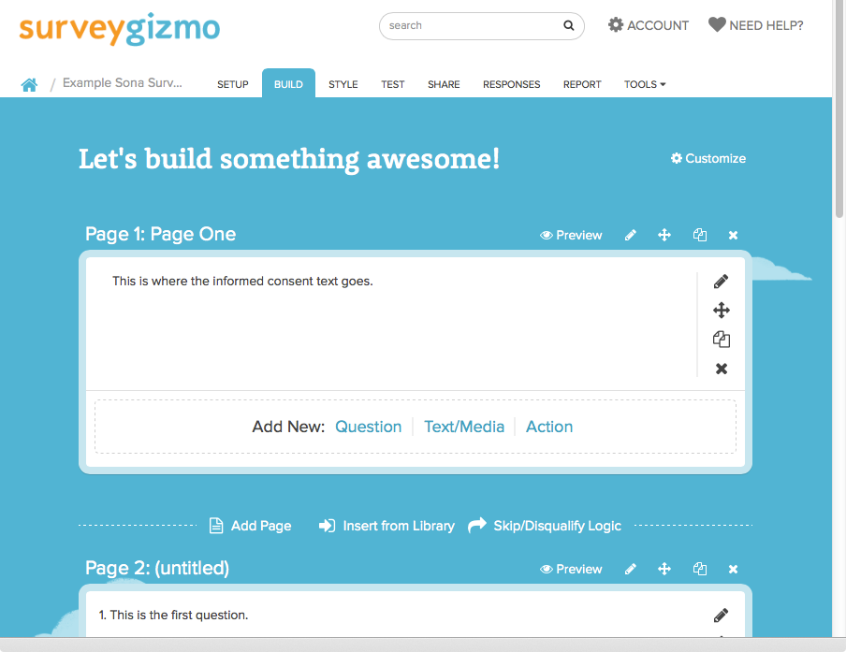
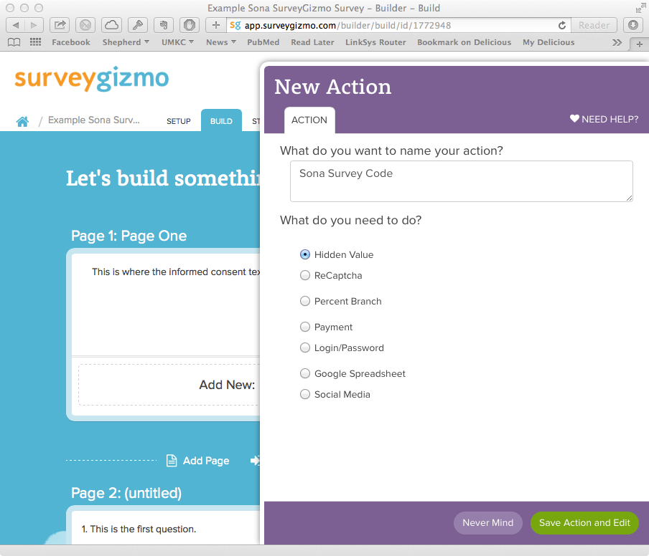
2
You must now set up your SurveyGizmo survey to accept the Survey ID code from Sona, store it in a hidden field while they complete your survey, and then pass it back to Sona at the end. Log into SurveyGizmo, pull up your survey, and click the Build tab (used to edit your survey). You’re going to start by adding an Action to first page, which should contain your informed consent text. On “Page One”, just under where you have your consent text, next to “Add New:”, click “Action” (below, left). In the New Action dialog, type “Sona Survey Code” (no quotes) into the “What do you want to name your action?” box. Leave the “Hidden Value” radio button checked, and click “Save Action and Edit” at the bottom (below, right).

Slide 6
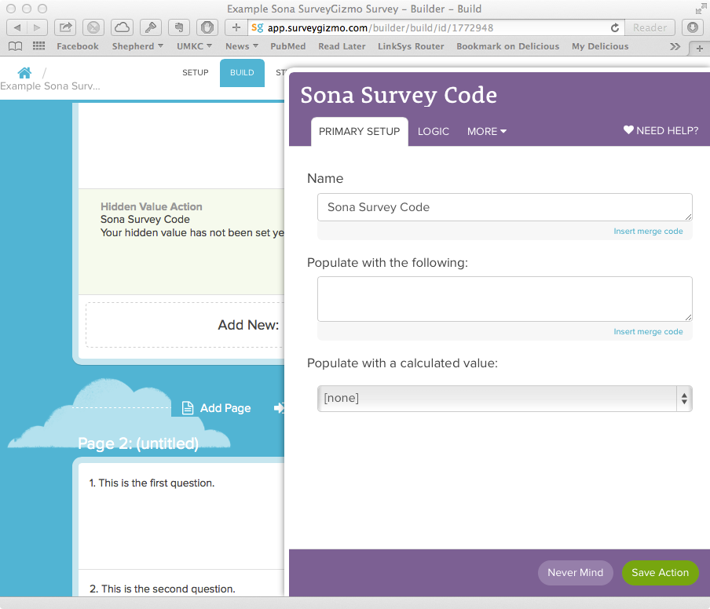
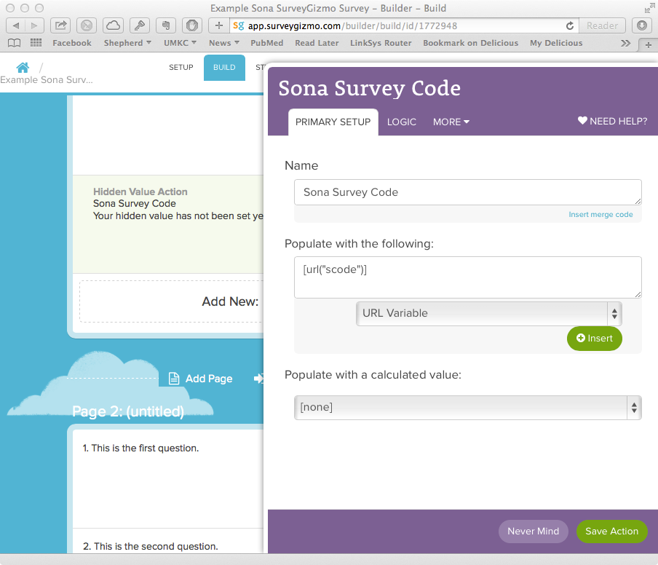
3a
In the “Sona Survey Code” dialog that comes up, just under the “Populate with the following:” box, click the small link that says “Insert merge code” (below, left). From the pull-down menu that appears, select “URL Variable” (under Advanced) and click the “Insert” button (below, right).

Slide 7
3b
After you click the “Insert” button in the last step, some text will appear in the “Populate with the following:” box just above that. Change “xxx” to “scode” so that the box contains [url("scode")]. Click the green Save Action button at the bottom.

Slide 8
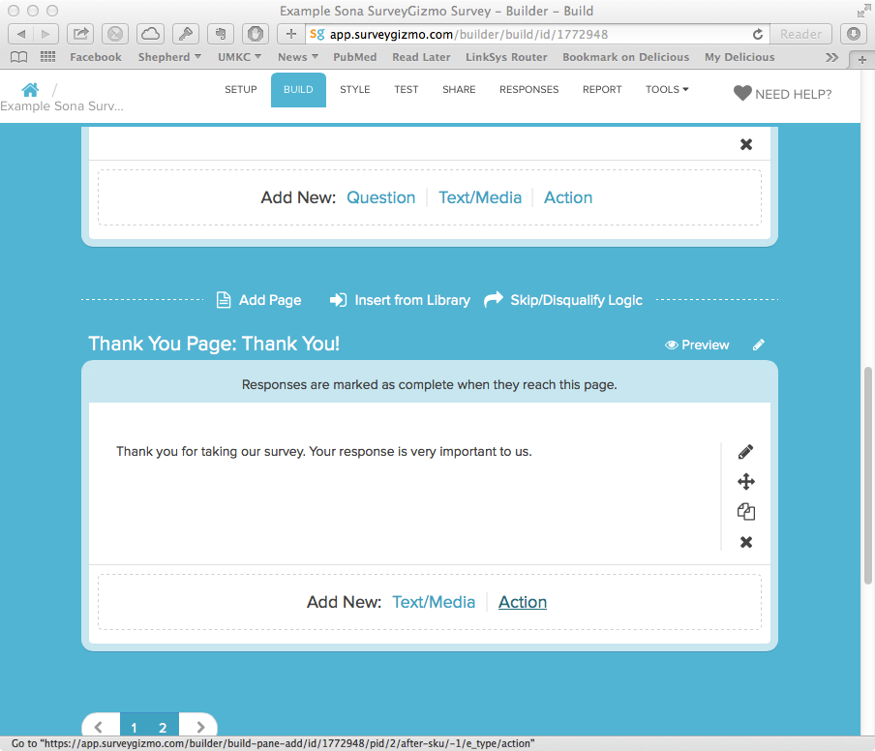
4a
Now, you will need to add something to the end of your survey to take the user back to Sona and tell Sona that they have completed your survey. Scroll down to your Thank You Page and, beside “Add New:”, click “Action”.

Slide 9
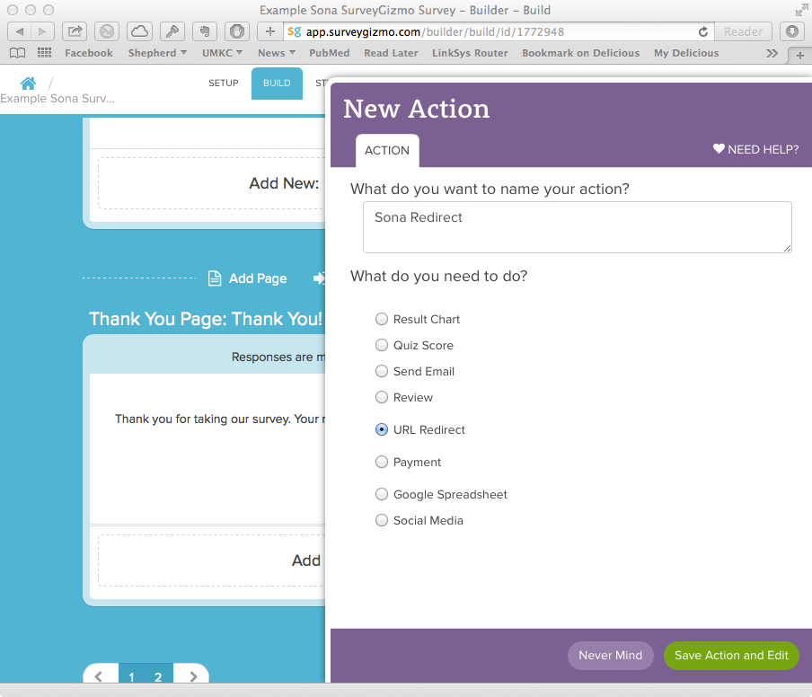
4b
In the New Action dialog, type in a name for this action (“Sona Redirect”) and, under “What do you need to do?”, select the “URL Redirect” radio button. Then click the green Save Action and Edit button at the bottom.

Slide 10
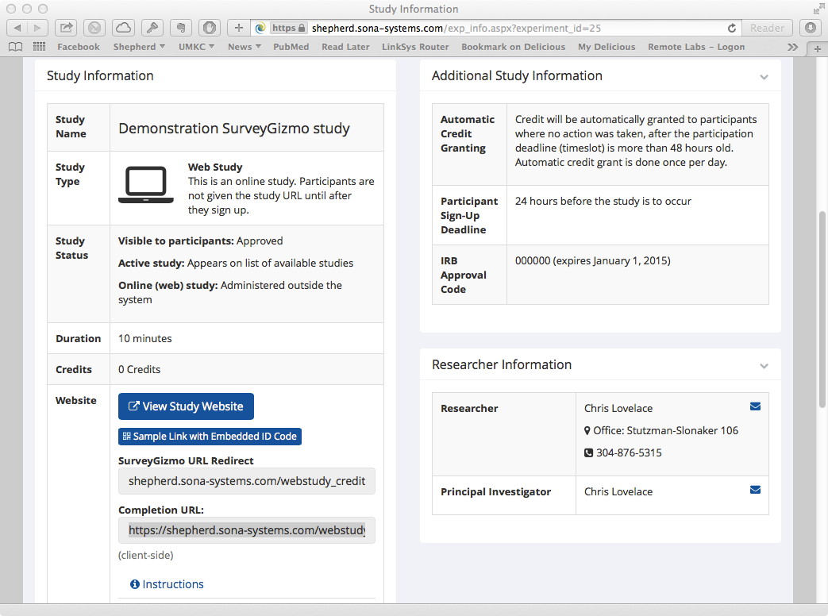
4c
To proceed, you will need the “redirect” link from Sona. Log into Sona and pull up your study. Under Study Information, beside the label “Website”, you’ll see two links labeled “SurveyGizmo URL Redirect” (top) and “Completion URL:” (bottom). Click on the “SurveyGizmo URL Redirect” link text and copy it (see below). Switch back to SurveyGizmo.

Slide 11
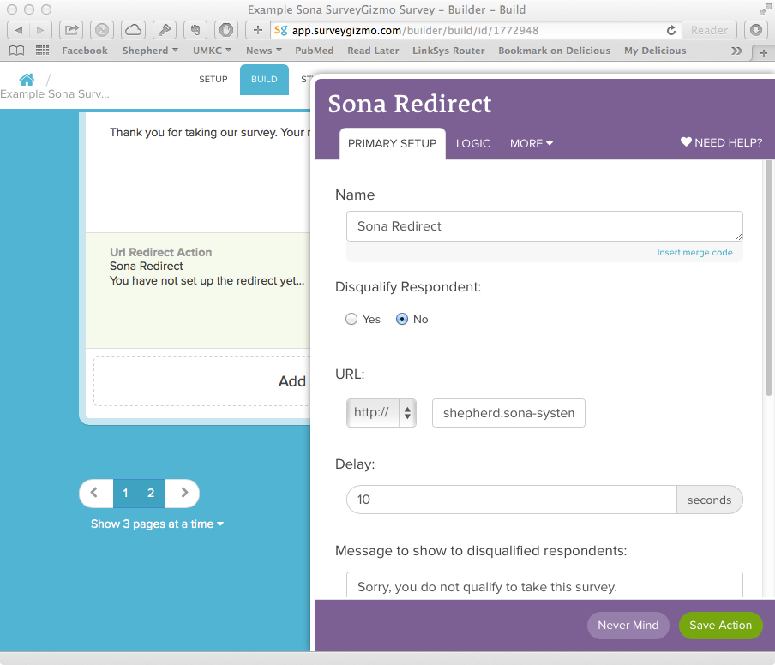
4d
In the SurveyGizmo dialog that came up when you saved this action, paste the Sona web link into the URL field. In the Delay box, make sure the delay is set to 0 (zero) seconds.

Slide 12
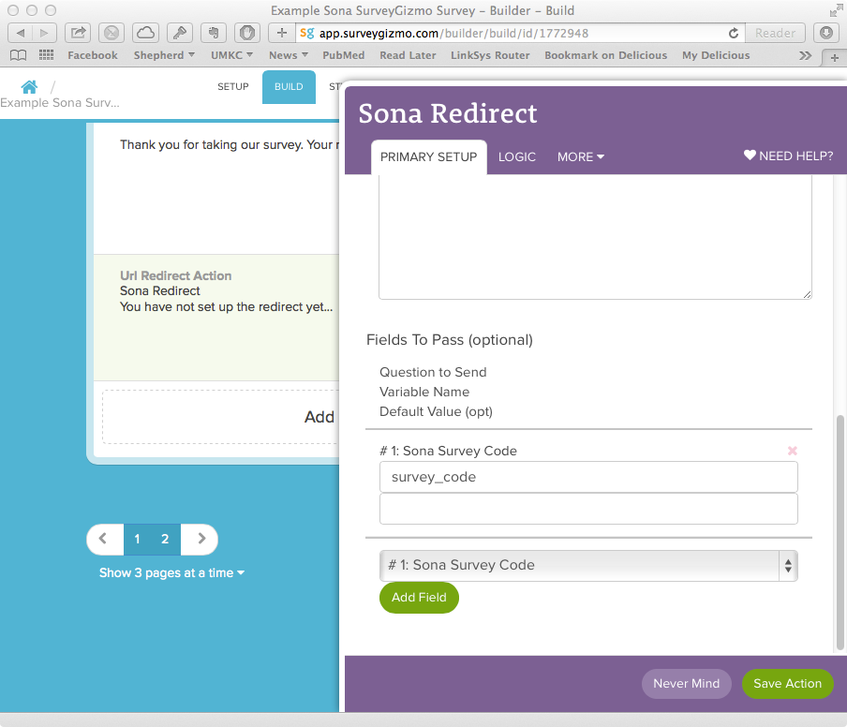
4e
Scroll down to the bottom of that same dialog. In the “Select a question to map” pull-down list, select the one that reads “Sona Survey Code”, then click the green Add Field button. In the field that appears, type “survey_code” (no quotes) and click the green Save Action button at the bottom.

Slide 13
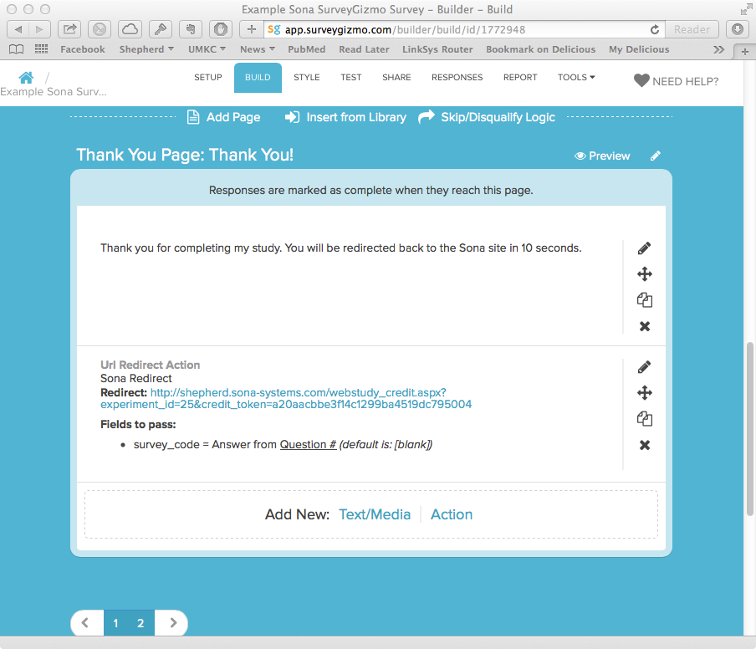
5
Last, delete the thank-you message that appears above your redirect action. The zero-second delay you entered in the last step means that, right after they click “Submit” on the debriefing screen, they’ll be taken right back to Sona.

Slide 14
There is up-to-date help available on the SurveyGizmo website.
http://surveygizmov4.helpgizmo.com/help/article/link/hidden-values
These instructions were developed from some out-of-date instructions supplied by Sona.
http://www.sona-systems.com/help/surveygizmo.asp

