Slide 1
Testing External Survey Automatic Credit Granting
Shepherd University
Department of Psychology

Slide 2
Introduction
Studies set up in Sona as an “External online study” allow a Participant to click a link in Sona, take a survey that’s set up in an external site (e.g., SurveyMonkey, SurveyGizmo, etc.) and then return to Sona and have their participation credit be automatically granted. You, the Researcher, must first set up your external study to accept a code from Sona and return it when the survey is completed. (Instructions are provided elsewhere.) These instructions show you how, once that is set up, to test that the automatic credit granting is working properly.

Slide 3
1
Make sure you have your external survey set up to accept the survey code from Sona (i.e., you’ve added the survey code action to the beginning and the redirect back to Sona at the end) and that you’ve got the correct URL entered into your External Online Survey study in Sona (with “?scode=%SURVEY_CODE%” at the end). This should be in the “Study URL” field (under Advanced Settings).
The instructions that follow will show you how to request a “dummy” Participant account so that you can log in as a Participant, take your survey, and verify that credit is granted at the end. This will be done in such a way as to allow only you, and not any of the “real” Participants, to access your approved, active study (yet).

Slide 4
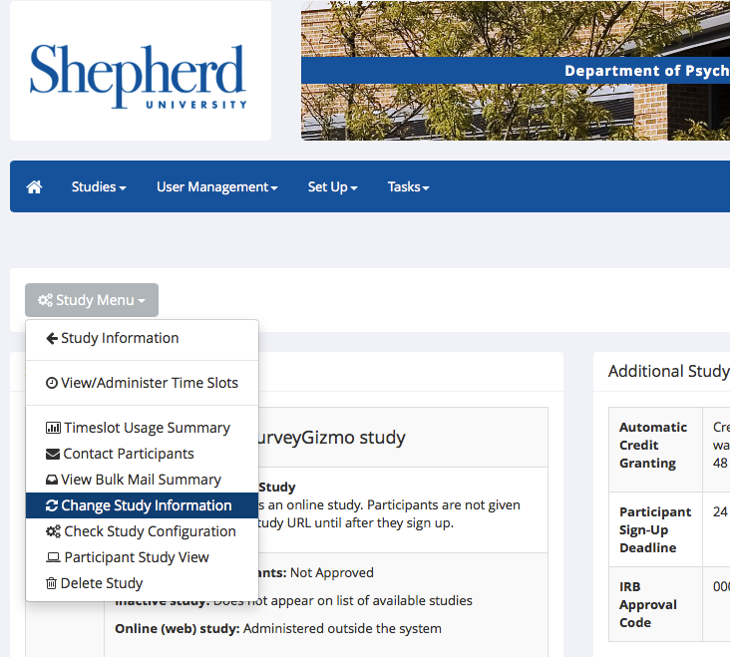
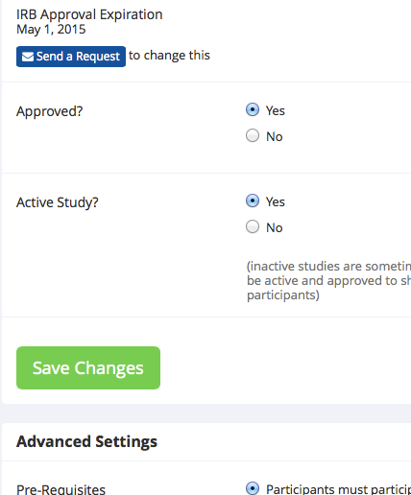
2
The following assumes that you have requested that the Sona Administrator Approve your study, and they have done so.
Start this process by going to your study in Sona, clicking on “Change Study Information”, and, under Basic Study Information, making sure that “Active study?” is set to “Yes”.

Slide 5
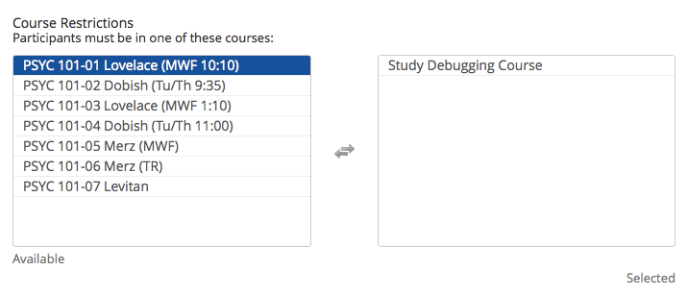
3
While you’re at it, go down to “Advanced Settings” and, under “Course Restrictions”, click on the “dummy” course called “Study Debugging Course” in the left-hand “Available” box to move this into the right-hand “Selected” box. This will, once you make your study Active, cause it to only be available to your dummy Participant account and not any of the real Participants enrolled in PSYC 101. You’ll un-select this once automatic credit granting is verified.

Slide 6
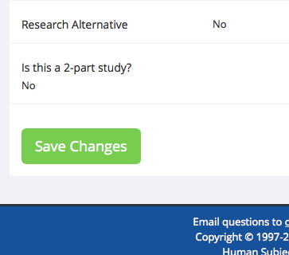
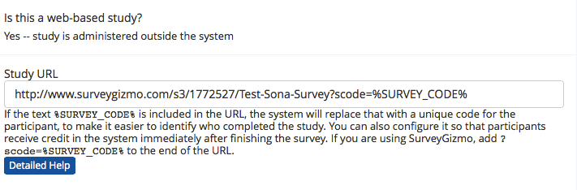
4
This would also be a good time to scroll down a bit more and verify that your study URL is entered correctly. It appears under “Study URL”, just a bit below Course Restrictions (from the last step). Make sure “?scode=%SURVEY_CODE%” appears at the end. If this looks good, then scroll down and click the green “Save Changes” button.

Slide 7
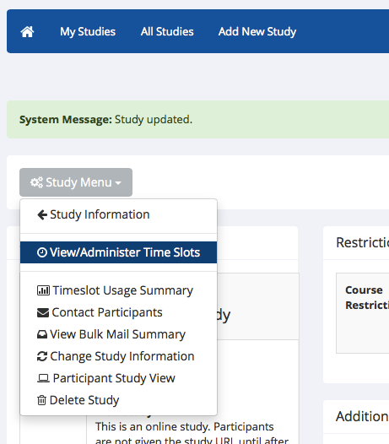
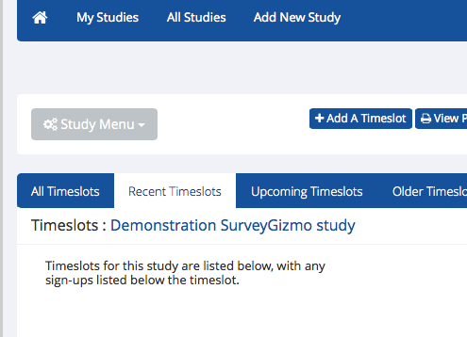
5
From the Study Menu, select “View/Administer Time Slots”. Then, click the blue “+ Add a Timeslot” button. You’ll need to set up a “dummy” timeslot so that you’ll be able to see your study when you log in as a participant.

Slide 8
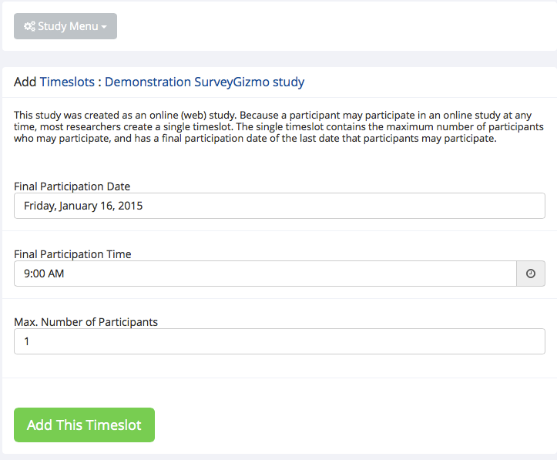
6
Set the “Final Participation Date” to be sometime in the future (say, a week from today). Set “Max. Number of Participants” to one. Then, click the green “Add This Timeslot” button.

Slide 9
7
Now, you’ll need to request a dummy Participant account so that you can log in as if you were a Participant, complete your survey, and verify that you receive credit afterward. First, you’ll need that dummy Participant account. Send the following e-mail to the Sona Administrator (whose address appears at the bottom of every page in the Sona system, beside “Email questions to”)…
Subject: Dummy Participant account request.
Dear Dr. [admin name],
My name is [your name] and I am setting up an online external study in Sona entitled [your study name]. Please establish a dummy Participant account for me so that I can test the automatic credit granting.
Thank you.
[your name]
[your Shepherd e-mail address]

Slide 10
8
The Sona Administrator should get back to you within about 2 business days (if not, feel free to send a polite reminder). You will receive an automated e-mail from the Sona system with a Participant user ID and password. The ID will be something like teststudent08. If you hear back from the Administrator that this has been set up, but you didn’t receive the login credentials, check your “Spam” or “Junk Mail” folder in your e-mail to make sure that message wasn’t incorrectly classified as junk mail. If you don’t see it, let the Administrator know so they can send it again.

Slide 11
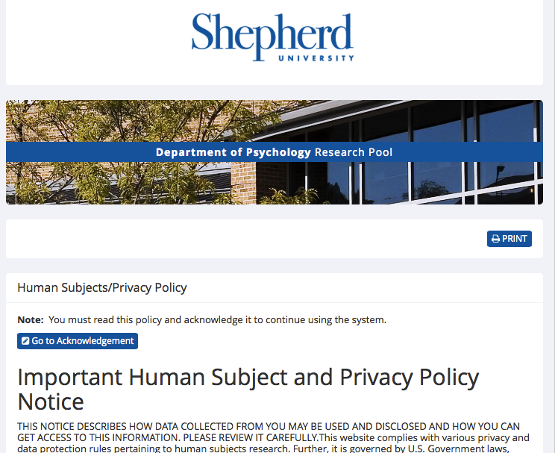
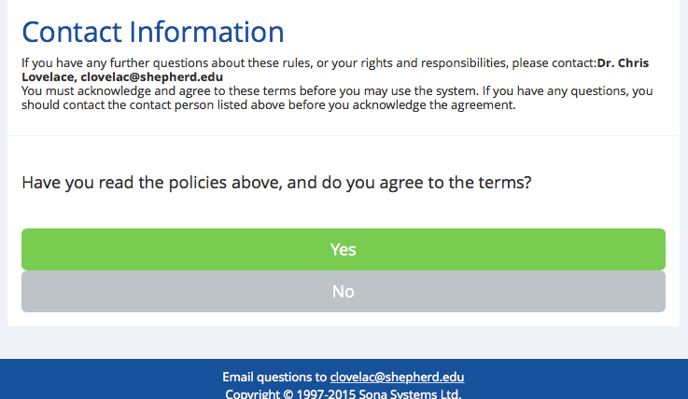
9
Now that you have your dummy Participant login credentials, go to Sona and log in using that ID and password. You should see the Human subjects and privacy notice come up; just scroll to the bottom and click the green “Yes” button.
All of these dummy accounts are assigned to the Study Debugging Course, so only you (and whomever else is doing this same thing for their study) will be able to see your study.

Slide 12
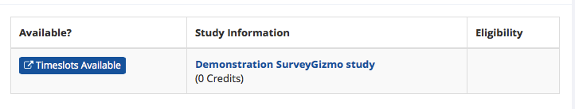
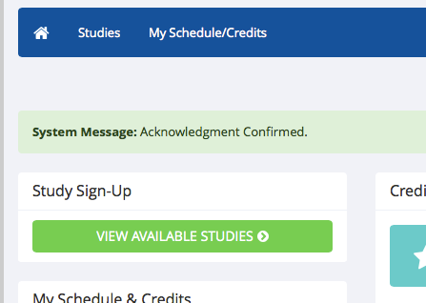
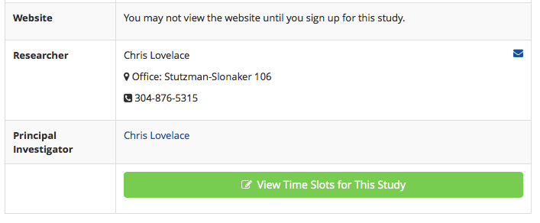
10
From the main menu, click the green “VIEW AVAILABLE STUDIES” button. On the next page, under “Study Information”, you should see your study listed. Click the blue “Timeslots Available” button to the left. Then, scroll down and click the green “View Time Slots for This Study” button.

Slide 13
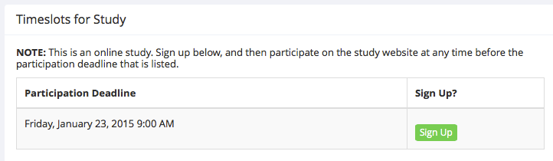
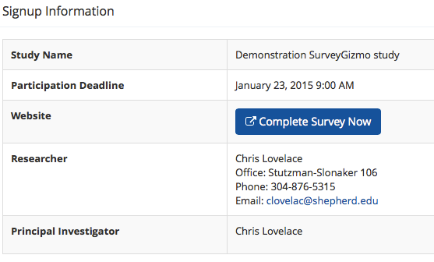
11
Click the green “Sign Up” button¹. On the next screen, click the blue “Complete Survey Now” button. A new window should open and you should see the first page of your survey. Go ahead and complete your survey. I suggest selecting answers that are obviously fake (e.g., answer “1” for every Likert question), so that you will know to delete this set of responses prior to data analysis. On the last page of your survey (usually below the debriefing text), click the Submit button.
¹You will receive an e-mail from the Sona system confirming your sign-up.

Slide 14
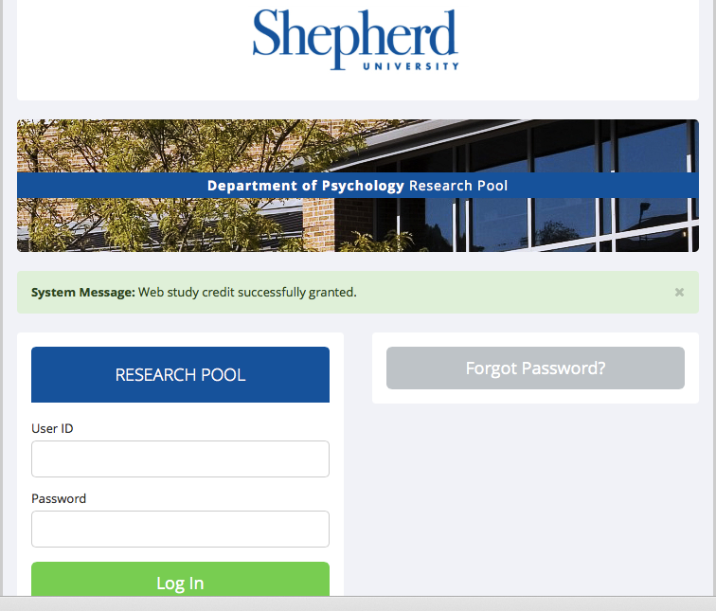
12
Immediately after clicking the Submit button, you should be taken back to the Sona login screen and you should see a message stating that the credit was granted. You should receive an e-mail from the Sona system saying that you were given credit for the study. Log back into your dummy Participant account. On the right-hand side, under Credits Overview, you should see the number of credits you just earned appear over the label “Credits Earned”.

Slide 15
13
If your credits were granted, then you are all set to begin collecting data. Go on to the next page to see what to do.
If you did not get the credit granted message, then something went wrong. Skip the next page and go to the one after that to see what to do.

Slide 16
14
Here’s what to do if the automatic credit granting was successful…
Log back into your Researcher account, select your study and go into “Change Study Information”. Go to “Advanced Settings” and, under “Course Restrictions”, click the “Study Debugging Course” to move it back into the “Available” list. Scroll down and click the green Save Changes button.
Note that, as long as you set that dummy timeslot to only allow one participant (that one participant being you, just a few minutes ago), your study won’t be visible to participants at this point. To make it available, you’ll need to set up your “real” timeslot.
Finally, e-mail the Sona Administrator to let them know that your test was successful.

Slide 17
15
If automatic credit granting was unsuccessful, then you’ll need to go back and troubleshoot your survey. Check your survey settings and consult with the Sona Administrator if you need additional help.
You’ll need to re-test the credit-granting after making adjustments to your study. Continue to the next page to see what to do.

Slide 18
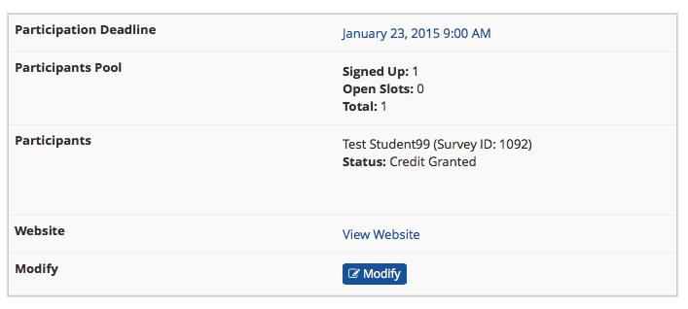
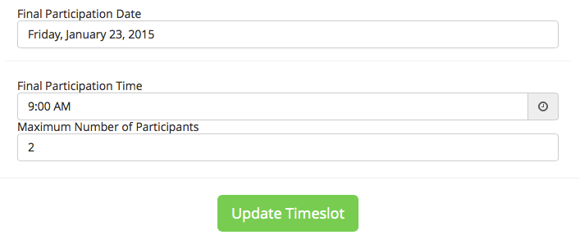
16
Once you’ve made adjustments to your study, you’ll need to re-set some things to test it again.
First, log into your Researcher account, go to your study, and select “View/Administer Time Slots” from the Study Menu. You should see the one timeslot you set up for testing, with zero Open Slots. (You may have to select the “All Timeslots” tab.) Check the Participation Deadline. If it has not yet passed, then go on to the next step. If it has, then click the blue “Modify” button below your timeslot.
Extend the Participation Date, then click the green “Update Timeslot” button.

Slide 19
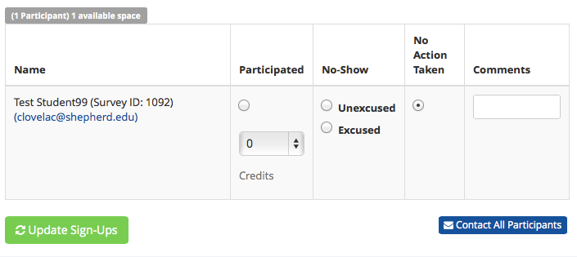
17
If your study is set up to not allow a given Participant to participate twice (as most are), then you’ll have to delete the prior sign-up from your dummy Participant account.
Go back into that timeslot (Study Menu -> “View/Administer Time Slots” -> click the blue Modify button). Scroll down and, under “All Sign-Ups”, you should see your dummy Participant account with the button checked under “Participated”. To delete this sign-up, you’ll first need to change it’s status. Click the button under “No Action Taken”, then click the green “Update Sign-Ups” button. (You will receive an e-mail saying that your credits were revoked.)

Slide 20
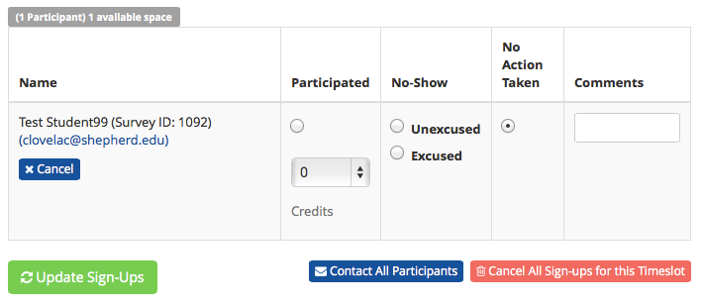
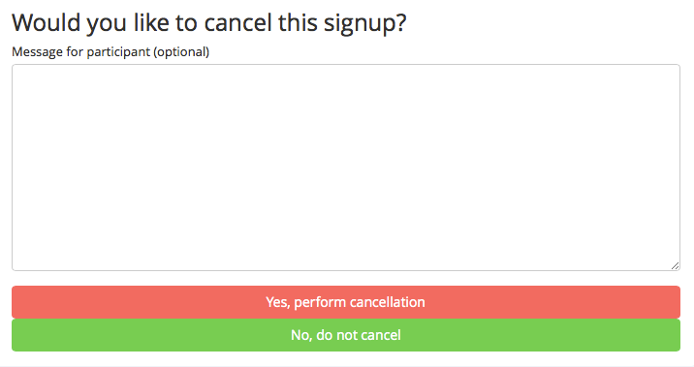
18
On the next screen, you should see the “1 Sign-up updated” message and your timeslot information below that. Click the blue “Modify” button again and scroll down to the dummy Participant. Now, since they’re set to “No Action Taken”, you’ll see a blue “x Cancel” button under the participant’s info. Click that button .
You’ll get a System Message asking you to confirm. Scroll down and click the red “Yes, perform cancellation” button.

Slide 21
19
Now, log back into your dummy Participant account (you won’t have to acknowledge the policy notice again) and participate in the study as before.
If credit still isn’t granted, you’ll need to repeat the previous steps. Continue making changes and testing until credit granting is working.
Contact the Sona Administrator if you need additional help.

