Slide 1
FYEX 101
TIME MANAGEMENT & STUDY SKILLS
Notes:
Hi class. I hope everyone is well. Are there any questions about anything we have discussed so far?

Slide 2
TIME MANAGEMENT
Time Is Your Most Valuable Resource
Maximize Study and Review Time
Organize your Environment
Avoid Pitfalls
Remember…
You control how you use your time so find a system that works for you.
This will help you stay organized and avoid falling behind throughout the semester.
Notes:
Today we will discuss time management, a key factor in achieving academic success. You have control over how you use your time, so it is important to find a system that works for you. This will help you stay organized and avoid falling behind throughout the semester.

Slide 3
R-E-S-P-E-C-T
Your time is valuable. So is your instructors’
Be on time to class.
Know and meet due dates for assignments.
Avoid disrespectful behavior in class.
Don’t dominate the discussion.
Keep appointment times with instructors.
Notes:
It shouldn’t come as a surprise that this slide on respecting others starts with being on time to class. Be sure to prepare in advance. Follow your schedule and get your work in on time.
It is important to manage your behavior and not leave the class in the middle of a lecture. Don’t surf the Web in class, either. Focus on the class lecture or discussion.
Give others time to participate in class and ask questions.

Slide 4
Managing Your Energy
Recognize your daily energy pattern.
When are you most energized? Early morning? At night?
Strategies to re-energize:
Carry healthy snacks
Drink water
Take breaks
Walk it out
Stretch & Breathe
Short Nap (10-15 min)
Don’t overextend yourself!
Notes:
Your best plans will not work if you don’t have the energy to make them happen. Energy is an essential resource. Although it is renewable, we each have a limited amount per day.
Each person has a daily pattern of physical, emotional, and mental activity. Some people are early risers and have a lot of energy in the morning, others accomplish tasks most effectively at the end of the day. You can better manage your energy by recognizing your daily pattern and establishing a routine around it.
Your energy also depends on how you take care of yourself. Give yourself a boost by:
Carrying healthy snacks with you, such as fruit, nuts, or yogurt. This will save your time and money as you avoid trips to vending machines and convenience stores. Eating well will also keep your energy up.
Drink plenty of water.
Take brief naps when possible. Research shows that naps are more effective than caffeine.
Being overextended, or having to much to do given your available resources, is a primary source of stress for college students. Avoid overextension by determining what a realistic workload is for you. Take on only what you can handle, and learn to say “no” to requests that prevent you from meeting your academic goals. You may have to let go of one or more commitments.

Slide 5
Pitfalls: Procrastination and Distractions
Procrastination: putting off necessary tasks
Reasons for procrastination:
Fear of failure or success
Perfectionism
Easily distracted
Find task irrelevant
Distractions:
Find places to study where you can concentrate
Turn off your phone and other distractions
Organize your space
Don’t overcommit!
Notes:
Consider for a moment what might happen if you give in to procrastination. Depending on the class and instructor, there could be many consequences for failing to meet due dates. Be sure you know the late policies for all of your classes. Late policies should be identified in the class syllabus. If you procrastinate a lot, you might jot down in your planner the consequences for failing to meet due dates. That could help motivate you when you see a due date coming up.

Slide 6
Overcoming Procrastination: Ask Yourself the Tough Questions
Make tasks relevant to interests.
Consider consequences.
Create to-do lists.
Break big jobs into manageable tasks
Reward yourself.
Find the right place to study.
Limit distractions.
Notes:
If procrastination is a problem for you, work to overcome it by:
Reminding yourself of the possible consequences if you do not get down to work, and that not enjoying an assignment is not a good reason to put it off – it’s an excuse, not a reason.
Creating a to-do list. Check off items as you finish – this can be gratifying and motivating in and of itself, as you can visually track what you accomplish. Move things that aren’t getting done to the top of the list.
Breaking big jobs into smaller steps. Tackle short, easy-to-accomplish tasks first.
Promising yourself a reward for finishing a task. Use bigger and better rewards for finishing larger tasks.
Finding a place to study that’s comfortable and doesn’t allow for interactions.
Saying “no” to people who want your attention. Schedule time with them later.
Shutting off electronic devices and social media.
Being aware that it may be more difficult to stay on track in online courses, as there are few or no weekly meetings. Connecting with another student in the course can help you both stay focused.
Considering asking those you live with the help keep you on track. Have them remind you to study.
If none of these strategies work, consider re-examining your purpose and priorities in terms of college. If you unwilling or unable to stop procrastinating, may you are not ready to commit to academic priorities.

Slide 7
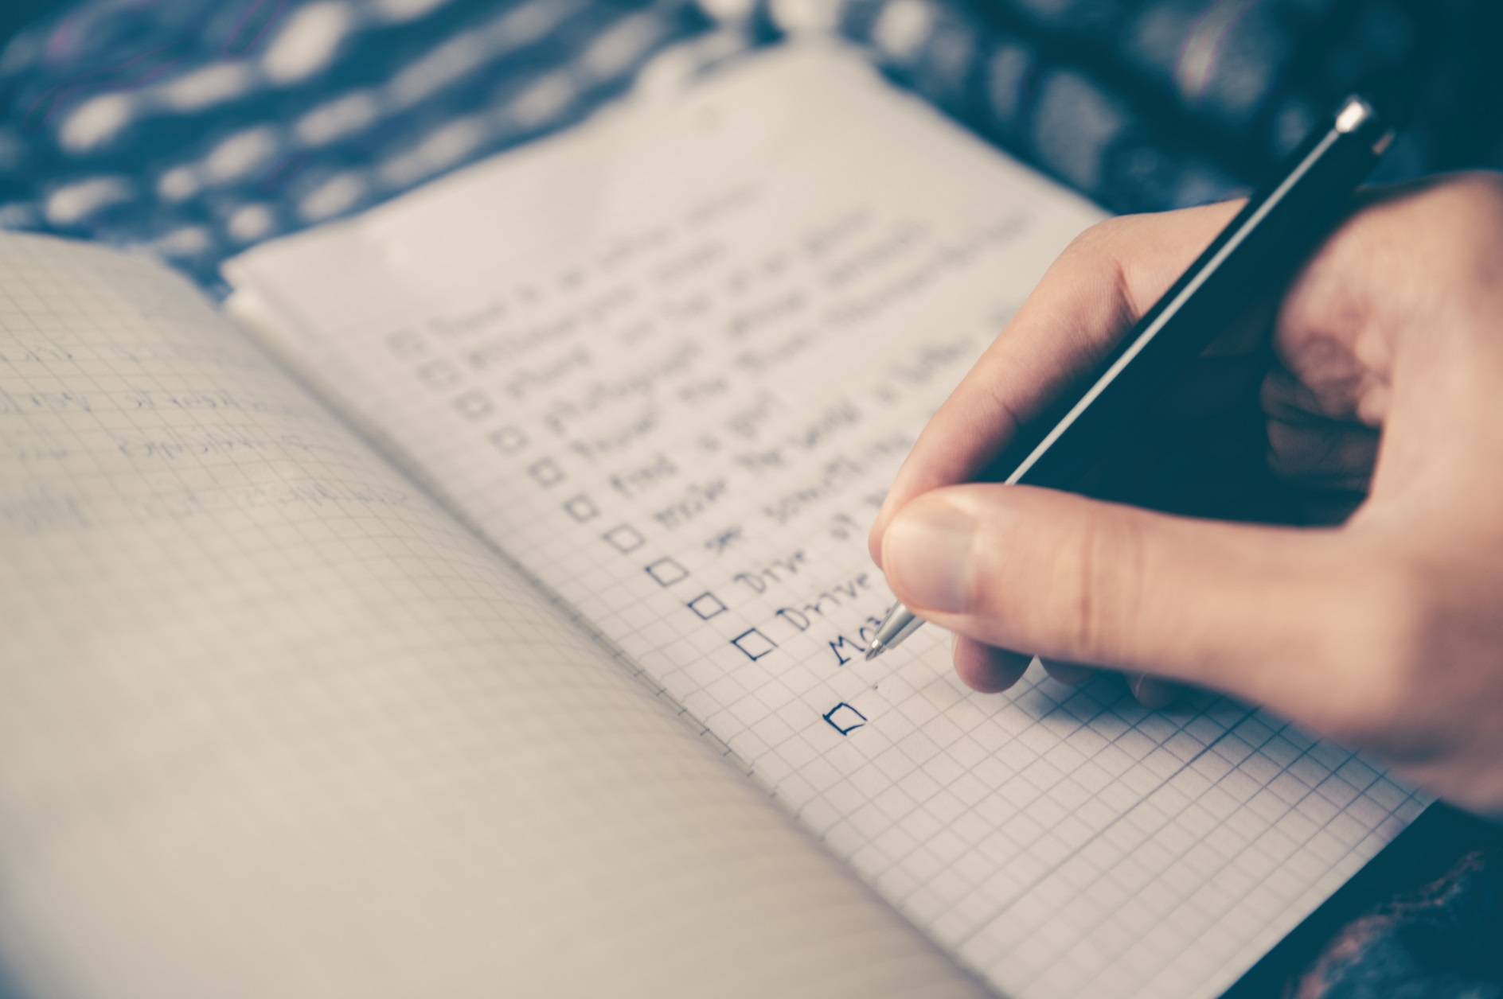
Using a Daily or Weekly Planner
Carry your planner at all times.
Use a planner that is convenient for your lifestyle.
Add contact information.
Back up your planner.
Revise your schedule as needed.
Notes:
Be sure to enter details such as locations, phone numbers, etc. to ensure that your planner is complete.
Many people find a backup planner valuable. You might have heard of people who lost their planner and had no idea of their schedule as a result. Part of time management is developing a backup system. However, there are some challenges to using two planning devices. You can put information on one and forget to do so on another. One trick is to use two electronic planners linked to one another. I suggest you make it a habit to back up one planner daily to the other. That way, any changes you make in your primary planner will be reflected in your backup at least daily.
No matter how thorough you are in your planning, there are many reasons to revise a schedule. You may need to change your plan because some tasks were not completed, and of course, emergencies can happen. Flexibility is important in college, as in life. As you practice skills, you will find that you will need less time for many tasks as you become more proficient in them. You will also get better at estimating the time you need for specific types of tasks.

Slide 8
Scheduling Your Time Week by Week
Enter commitments into a planner.
Review syllabus for each class constantly
Reserve adequate study time.
Follow the 2-for-1 rule.
Consider your body clock.
Estimate time needed for assignments.
Don’t forget to add research & editing/revision time
Schedule exercise & time for workouts.
College often requires more self discipline to ensure due dates are met.
Get help early on
Notes:
After you consider the big picture, you need to focus on daily tasks.
Remember, college often requires more self discipline to ensure due dates are met.
Long-term goals and priorities CAN drive your schedule if you take charge, but remember to be realistic and flexible.
While you are a whole person and have to balance multiple needs and responsibilities, you cannot do everything at the same time. Planning is the key to success.
Practice and flexibility will help you learn to manage your time effectively. And ask for help when needed.
Create one of your own. As you do, keep in mind the suggestions we’ve discussed. Do you want your back-to-back or with breaks in between? How early in the morning are you willing to start classes? Do you prefer—or do work or family commitments require you—to take evening classes? Are there times of day when you are more alert? Less alert?

Slide 9
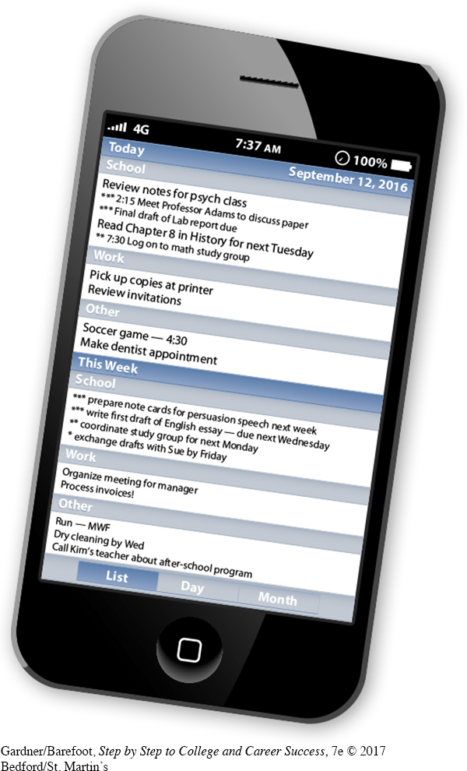
Maintain a To-Do List
Prioritize your list
Use in conjunction with your planner
Add Reminders or Alerts
Note when things are done for a sense of accomplishment
Notes:
Almost all successful people maintain a daily to-do list. The list may be in paper or electronic form. Get in the habit of creating and maintaining your own daily list of appointments, obligations, and activities.
Let’s take a poll. Do you use a to-do list? Yes, sometimes, or no? I encourage you to use a to-do list if you do not do so already. It will help you focus on the immediate tasks, and checking off items on a to-do list is incredibly satisfying.
If you find some tasks overwhelming, break them up and put the items individually on your to-do list and schedule. That way you will see progress toward the whole project as you complete individual items.
Sometimes having a to-do list with everything on it can become overwhelming and discouraging. You might create two separate lists, a long-term list and a daily (or weekly) list to help you identify immediate priorities and increase a sense of accomplishment when short-term goals are completed.

Slide 10
Maximizing Study and Review Time
Find your space.
Stick to a routine.
Break down large tasks.
Set realistic goals.
Review when the material is fresh.
Study difficult or boring subjects first.
Divide study time into 50-minute blocks.
Avoid multitasking.
Overcome distractions.
Let others help.
Be flexible.
Reward yourself.
Use travel time wisely.
Notes:
Studying effectively means that you need to consider the time of day or night when you study best, where you can study with the least distractions, and how to actually learn while you study. Strategies to get the most benefit from studying include:
Find your space. Use the same study area regularly.
Stick to a study routine.
Break down large tasks.
Set realistic goals. Assess how long it takes you to a task, and schedule your time accordingly.
Review when the material is fresh.
Know your best times to study, and routinely assess your attention level.
Study difficult or boring subjects first. The exception to this is if you are having trouble getting started, in which case it might be easier to start with you favorite subject.
Divide study time into fifty-minute blocks, and take breaks in between.
Script your study sessions. Create a plan for your study time, and follow it.
Avoid multitasking. Research has shown that you study more effectively if you focus on one thing at a time.
Limit distractions.
Let others help. Find an accountability partner to keep you on track.
Be flexible. Build in extra time for unexpected interruptions.
Reward yourself. Use larger rewards when you finish larger tasks.

Slide 11
Get the Most out of Class
Pay attention to the syllabus.
Do assigned reading.
Use additional materials provided by instructor.
Be organized.
Listen for main concepts & new ideas
Know your Learning Style
Notes:
It is important to keep the syllabus for your classes in a safe place. Once the professor distributes a syllabus, it becomes your responsibility to follow the course requirements with few or no reminders. Each week, do your assigned reading and review notes and summaries.

Slide 12
Be an Active Participant
Sit close to front.
Keep eyes on teacher.
Focus on the lecture.
Raise your hand when you don’t understand.
Speak up in class.
Never feel your questions are “stupid.”
When called on to speak, don’t bluff.
Listen carefully to other students.
Bring in relevant outside materials.
Notes:
Have you noticed that some people are reluctant to sit in the front of the room? Sitting in front can help you hear better, minimize distractions, and see better as well. It is more important to sit where you can get the most out of class for your learning style than to sit with friends.
Always ask questions; it is very likely that if you do not understand something others will also be confused. They will be glad you had the courage to speak up.
When called on to answer a question, answer as best you can. Be honest if you do not know Do not try to show off and monopolize class time with extra material, neither your classmates nor instructor will appreciate it.

Slide 13
Take Notes in Class
Identify main ideas.
Don’t try to write down everything.
Prepare to use your notes as a study tool.
Make adjustments for different classes.
Summarize in your own words
Highlight, use color coding, or visual breaks
Notes:
You may have some instructors whose lectures are not well organized. It will be important for you to develop a system to organize the information later into notes that will help you recall what was said. Reviewing and revising your notes as quickly as possible after a lecture will help you study.
Use your own words to summarize information. Summarizing will facilitate active listening and help illustrate what you do not understand so you can ask questions.

Slide 14
Use Specific Strategies
Create separate binders for each course.
Download materials before class.
Use only the front of each page.
Listen carefully to questions and answers.
Use asterisks and other symbols.
Consider using pencil.
Write down diagrams, equations, graphs, etc.
Write down worked problems step by step.
Refer to the textbook after class.
Notes:
Math and science classes can be particularly challenging for many students. The bullets on this slide are important for your success.
We have not yet discussed organizing your notes and keeping them after the course has ended. If you take many science or math courses keeping previous notes can be critical but keeping notes from social science classes may also be helpful for understanding the relationship between complex concepts.
Your syllabus should have all of the information about the instructor’s website. Be sure to check it out and actively check the Web site information.
Being organized is critically important in math and science classes.

Slide 15
Prepare For The Lecture
Read all textbook material relevant to the topic being covered prior to class.
Attend Class
Take Notes
You are familiar with the subject & you know what to ask.
You don’t waste time by writing down stuff that is already in your study materials.
You know what to write, concepts are clearer, you’re one step ahead of the game.
By the time the lecture is over, you are in a much clearer state of mind.
This way, taking notes becomes more meaningful and helpful.
Ask professors who lecture too fast if you can tape their lecture.
Notes:
Taking notes in math and science differs in many important ways from non-quantitative courses. Summarizing information will not be helpful in math and science. Math and science terminology is unique to the context and can be confusing because terms have a generic meaning as well as a specialized meaning for a course. For example, vector has many meanings in different contexts. In math, vector is quantity that has both direction and magnitude, such as force or velocity, and is usually represented by an arrow. In computer language a vector has any length but only one dimension. Finally, in biology a vector could be a disease-transmitting organism like a mosquito. It is important to listen carefully to the meaning of terms in specific classes and consider the context.
Also be sure to write down and explain symbols and abbreviations. Check your notes after class to ensure you correctly recorded the information.

Slide 16
Reviewing Your Notes
Forgetting curve: most forgetting happens in 1st twenty-four hours
Write down the main ideas a second or third time.
Recite ideas out loud.
Preview your notes again before the next class.
Compare notes.
Notes:
Review and revise your notes as quickly as possible after each class and do not wait until later to review and highlight notes. You will remember information better if you review the material immediately, and waiting until later will likely result in your forgetting information.
Reflect on how the class meshes with the information you already know.
Revise your notes as needed.
If you are an aural learner, reciting your ideas out loud might be helpful.
Remember that reflection is important for learning. Reflection and identification helps you better understand and remember information.
Consider how classes mesh with each other when setting up your schedule. Perhaps it will help to have an hour or so between classes so you have time to revise your notes from the previous class and review your preparation for the upcoming class.
One challenge of college is that in a single day you may have classes with distinctly different content. What strategies could you use for example between an English literature class and a biology lecture?
Exercising between classes could help you clear your head.
Finally, being organized is incredibly important when you need to review notes before the next class or for a test so using binders can be really helpful.

