Slide 1
Building
GRIT & RESILIENCE
First-Year Experience 101
Tips for Success

Slide 2
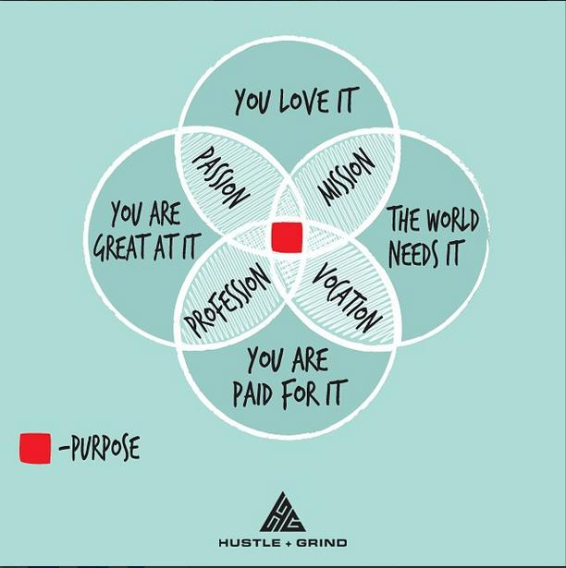

Slide 3
THRIVING =
ENGAGED LEARNING
+
ACADEMIC DETERMINATION
(how a student PERCEIVES their ABILITY to learn)
Grit & resilience are factors
(Thriving in Transitions. Schreiner, Louis, Nelson. 2012)

Slide 4
Transitioning to Success
Look at successful seniors who were considered high-risk
What behaviors, resources, & strategies did they employ to help them succeed?
4 Themes Emerged:
SUCCESS MINDSET
2. ACADEMIC STRATEGIES
3. SUPPORTIVE RELATIONSHIPS
4. MEANINGFUL INVOLVEMENT
Thriving in Transitions, 2012
Notes:
Do it for self, family, something to prove. Positive attitude; potential; worth; internal locus of control
establish graduation goal; use academic resources; adapt learning techniques; ability to work hard; self awareness
parents, peers, staff, spirituality
cocurriculuar; leadership skills, social capital

Slide 5
What can you do?
Understand that setbacks are normal & are part of a rigorous education.
Use Goal Setting with Obstacle Planning.
Failure is an important part of the learning process.
Reflect on what you did wrong/right? How would you do it differently/same next time?
Take Risks. Be Brave.
You belong.
Don’t look at failure as something that should be avoided at all costs; see it as something essential to a meaningful education.

Slide 6
Personal Resiliency Builders
Relationships
Service
Humor
Inner Direction
Perceptiveness
Independence
Optimism for the future
Flexibility
Love of Learning
Self Motivation
Competence
Self Worth
Spirituality
Perseverance
Creativity
Focus on Strengths, not Weaknesses
Patience

Slide 8
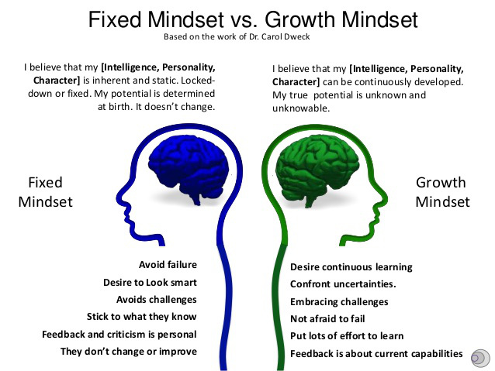

Slide 9
What is Grit?
Passion coupled with the tenacity to overcome obstacles

Slide 10
MINDSETS to INFLUENCE GRIT (Dept. of Ed., 2013)
I can succeed at this
2. My ability and competence grow with effort
3. Challenge is inevitable for success
4. This work is in line with my interests, values, or goals
5. I belong in this academic community

Slide 11
FAMOUS FAILURES
Things don’t always work out the way we want.
What matters is what you do when you FAIL.

Slide 12
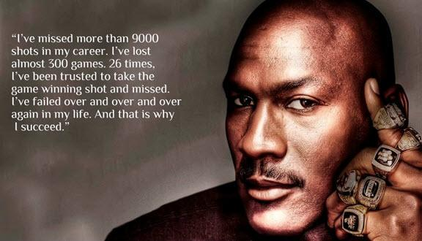
GUESS WHO?
After being cut from his high school basketball team, this famous failure went home, locked himself in his room and cried.
Michael Jordan

Slide 13
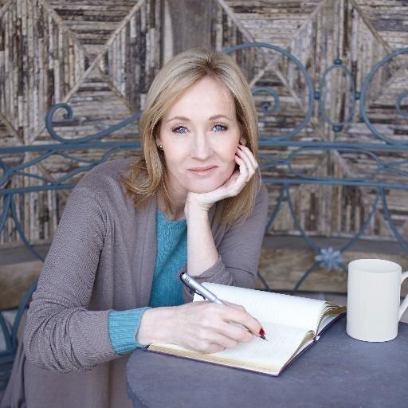
GUESS WHO?
Before she wrote this book series, she was nearly penniless, divorced, severely depressed, and trying to raise a child on her own while attending school and writing a novel. The first nine publishers rejected her book before a small business man accepted it.
JK Rowling

Slide 14
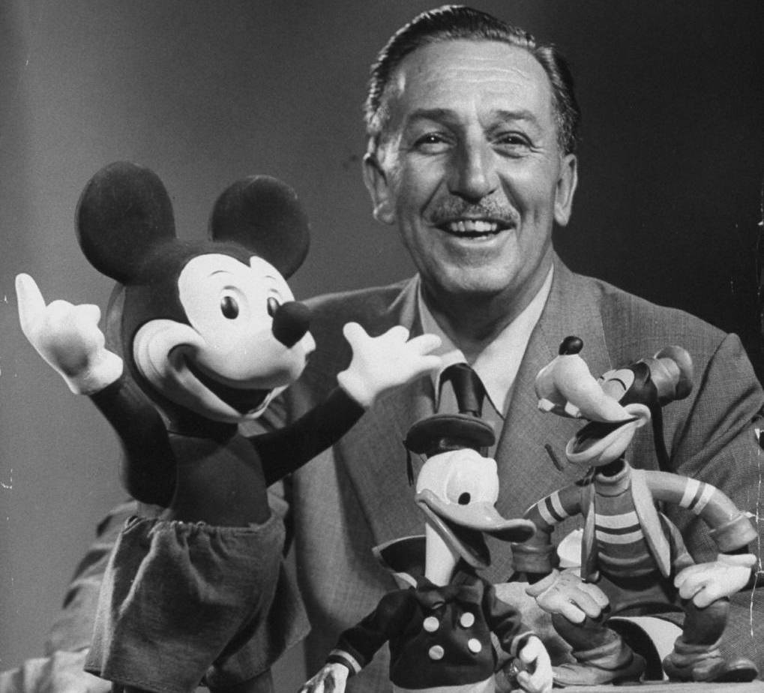
GUESS WHO?
Walt Disney
Was once fired from a newspaper for “lacking imagination” and having “no original ideas”

Slide 15
GUESS WHO?
She was demoted from her job as a news anchor because she “wasn’t fit for television”.

Slide 16
Example Exercise
Think of something that you are good at doing
How did you first learn to do it?
What made you keep doing it even though it was hard?
What helped you get better at it?
Once you started to get good at it, what made you want to get even better?
(Cushman, 2008)

Slide 17
Exercise, continued
In pairs, share with one another the thing that you are good at.
What was similar about your experiences?
What was different?

Slide 19
Additional Resources
2013 US Dept. of Ed Report Promoting GRIT, Tenacity, and Perseverance: http://pgbovine.net/OET-Draft-Grit-Report-2-17-13.pdf
The Duckworth Lab at Univ. of Pennsylvania: https://sites.sas.upenn.edu/?q=duckworth/pages/character-lab-0
The Resilience Project @ Stanford: https://undergrad.stanford.edu/resilience
Jia Jiang’s 100 Days of Rejection: http://fearbuster.com/
The Science of Resiliency: https://www.youtube.com/watch?v=403i7IWrv78
Resiliency quiz: http://www.resiliency.com/free-articles-resources/the-resiliency-quiz/
TedTalks: Scott Gellar, Carrie Green, and Eduardo Briceno

